Slide 1
Introduction To Technical Analysis
BI Online Chapter
January 17, 2024
Saul Seinberg

Slide 2
Disclaimer
The information in this presentation is for educational purposes only and is not intended to be a recommendation to purchase or sell any of the stocks, mutual funds, or other securities that may be referenced. The securities of companies referenced or featured in the seminar materials are for illustrative purposes only and are not to be considered endorsed or recommended for purchase or sale by BetterInvesting® / National Association of Investors™. The views expressed are those of the instructors, commentators, guests and participants, as the case may be, and do not necessarily represent those of BetterInvesting. Investors should conduct their own review and analysis of any company of interest before making an investment decision.
Securities discussed may be held by the instructors in their own personal portfolios or in those of their clients.
BetterInvesting presenters and volunteers are held to a strict code of conduct that precludes benefitting financially from educational presentations or public activities via any BetterInvesting programs, events and/or educational sessions in which they participate. Any violation is strictly prohibited and should be reported to the CEO of BetterInvesting or the Director of Chapter Relations.
This presentation may contain images of websites and products or services not endorsed by BetterInvesting. The presenter does is not endorsing or promoting the use of these websites, products or services.
This session is being recorded for future use.

Slide 3
Topics to be Covered
In this presentation, I will review:
  Basic explanations of fundamental and technical analysis
  TA websites
  Charting and charts
  Types of charts and indicators
  Relative Strength
  Performance Charts

Slide 4
Fundamental Analysis
Fundamental analysis is the term applied to the method of evaluating a company and its potential for long term growth by assessing company related performance of fundamental factors such as revenue, profits, profit margins, earnings, debt, ROE, P/E, cash flow, expenses, tax rates, and dividends

Slide 5
Fundamental Analysis
Fundamental analysts also attempt to weigh the effects of non-company economic factors such as interest rates, employment rates, industry conditions and the overall economy on the future growth of the company to determine their effect on its future performance
The ultimate goal of financial analysis is to determine if a company being analyzed is currently a buy, hold or sell based on its past and projected fundamental performance

Slide 6
Technical Analysis
Technical analysis is the term applied to methods of evaluating the potential of a company’s stock price to increase in the short or intermediate term primarily based on past and current prices and volume
Technical analysis rests on three principles:
  Everything that is known about a company is reflected in its market price
  Prices move in accordance with immutable law of supply and demand, often in trends
  Market action and price patterns are often repetitive and therefore predictive

Slide 7
Technical Analysis
Technical analysis can be effectively applied to virtually any investment candidate and time horizon
Investors usually apply TA in a manner that compliments their own investment philosophy
The ultimate goal of FA and TA is to determine if a company being analyzed is a current buy, hold or sell
TA can be used to evaluate the overall market, any of its sectors, funds; almost any tradeable item
FA and TA are not mutually exclusive!

Slide 8
Data, an Important Difference Maker Between FA and TA
Data for FA purposes is always stale, from 45 to 90 or more days old; creates a data age gap
Price data for TA purposes is always fresh, compensates for the age data gap
Intervening ‘significant’ events covered by form 8K
TA, therefore, helps measure what investors perceive has or will happen to a stock in the interim between end point of current quarterly/annual FA data and the release of new quarterly/annual FA data

Slide 9
Earnings Estimates – Can They Be Trusted?
Investors use historical data to estimate future earnings for a company to determine its growth potential
The accuracy of earnings estimates made by analysts has been debated for many years
A 2008 article by The Motley Fool reveals that a 20 year study of EPS estimates by pros were found to be over-estimated by around 40%; other studies agree
Conventional wisdom has always warned us to discount EPS projections
Thus, investors need supplementary methods to compensate for questionable EPS projections

Slide 10
Why Use Technical Analysis In Stock Studies?
TA helps compensate for stale data
TA helps avoid errors in EPS projections
TA provides a picture of the broader market and key sectors not available from fundamentals
TA can be used to resolve concerns raised in a fundamental based stock study
TA allows valuation of stocks, sectors or funds, by themselves or relative to one another, FA does not

Slide 11
Technical Analysis Already in Stock Studies
It may surprise you to know, as an SSG user, that you’re using TA
The SSG uses and places critical reliance on TA in using share price to compute P/E and then using P/E to help determine suitability of an investment
Price, however, is not a fundamental metric because price does not reflect a company’s fundamental performance as do sales, earnings, cash flow or profit margins metrics

Slide 12
Technical Analysis in Stock Studies
Price is merely a reflection of what the worth of a share of a company’s stock is to investors (buyers and sellers) at a specific point in time
Price is what investors think price should be at the time of a trade
Price changes are based on perception as derived from both fundamental and non-fundamental factors
Thus, share price is not a direct measure of what a company achieved on a fundamental basis although it eventually could be

Slide 13
Technical Analysis in Stock Studies
Price, as an element of P/E, is a critical driver of analysis in the SSG and permeates all results within that form although price is not itself an item of fundamental data
The use of P/E in an SG doesn’t bother me at all, but all users should appreciate that any SSG is based, at least in part, on technical analysis
In fact, without the use of price and P/E, past and projected, the SSG falls apart and can’t be properly completed

Slide 14
Performing Technical Analysis in Support of Stock Studies
We all know how to perform a stock study based on fundamental analysis
Import or enter fundamental data into an SSG form along with P/E data to complete a stock study
How then do we supplement a stock study with technical analysis?
Answer: start by finding a viable, intuitive website with plenty of help that provides the TA tools, data, computational capability and explanations you need

Slide 15
Technical Analysis Websites
Here are a few websites that provide access to TA charts, indicators and other tools:
  StockCharts (free and subscription user levels)
  Big Charts (free)
  Yahoo (free, but limited)
TA sites provide data and computational capability, allows greater focus on analysis
Each site has positive and negative aspects, but my preferred service is StockCharts

Slide 16
Indicators
Indicators are the most common tools used by TA investors
Technical indicators are mathematical tools, based on historical data, which investors use to forecast future price trends and make trading decisions
There are several popular types of indicators in use
  Momentum indicators
  Trend indicators
  Volume indicators
  Volatility indicators
  Breadth indicators
Indicators and chart patterns will be covered in a future presentation

Slide 17
Charts
We are familiar with charts partly because of Section 1 of the SSG
Patterns in charts, for TA purposes, are used to derive future price action
As it turns out, there are four basic TA types of charts, but not all websites have them:
  Bar chart (traditional)
  Candlestick chart (currently most popular)
  Line chart (SSG uses these)
  Point and Figure chart (only in StockCharts)

Slide 18
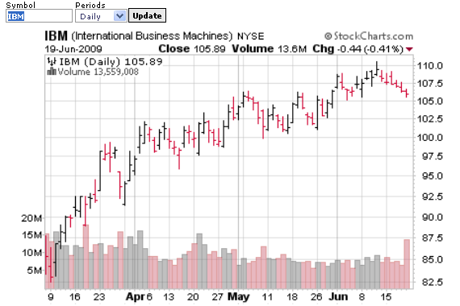
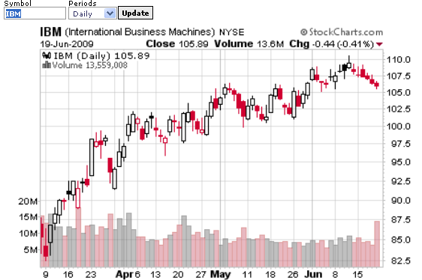
Chart Types
OHLC Bar Chart
Candlestick Chart

Slide 19
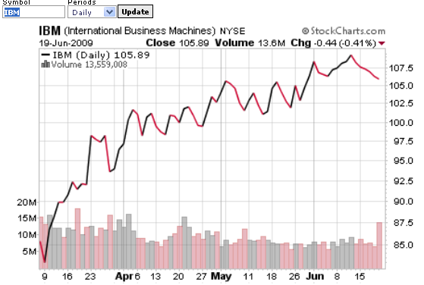
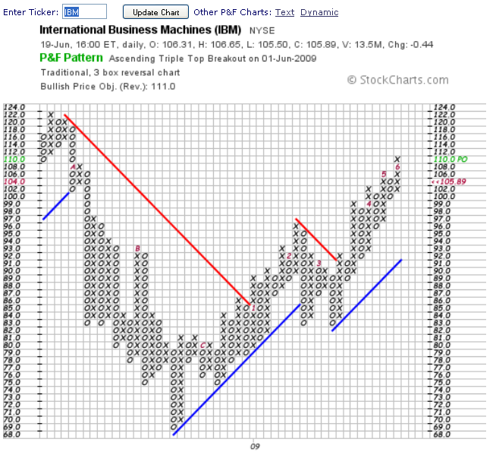
Chart Types
Line Chart
PnF Chart

Slide 20
What is Relative Strength?
Relative Strength (RS) measures how well a stock, fund or index of choice is performing compared or relative to another market index, sector, industry, stock or fund
Relative Strength is used as a basis for momentum investing
Relative Strength should not be confused with the Relative Strength Index (RSI), a popular TA indicator, which measures how well a stock, fund or index is performing with respect to its own past performance

Slide 21
What is Relative Strength?
Relative Strength is often used by a typical fundamental analysis based investor as a supplementary tool
Relative Strength provides a basis for to determine Relative Performance, which seeks to identify the best performer in a group of sectors, indexes, stocks or funds over a given time period

Slide 22
Why Care About Relative Strength?
Aren’t you trying to pick a stock or fund that is outperforming or will outperform the market?
Wouldn’t you want to pick a stock, industry or sector that is outperforming the market as well as other stocks, industries or sectors?
If so, you should be very interested in learning about the use of relative strength and relative performance despite their reliance on price based performance
Note that inclusion criteria can rely on FA

Slide 23
Why Care About Relative Strength and Performance?
Several academic studies have indicated that stocks with higher relative performance outperform their peers going forward
Other studies have shown that from 65% to 95% of a stock’s performance is fairly well correlated to its sector’s performance
In other words, relative strength and relative performance add helpful tools to your arsenal of investment analysis devices

Slide 24
What is Relative Strength and Relative Performance?
Relative Strength is an excellent tool that can be used to supplement stock studies and comparisons and you only need a modest amount of TA experience to call on
Relative performance can steer you to a better choice of a stock or fund in a sector or industry
The best place to look for and use technical analysis (IMHO) is StockCharts, which has a free level of relatively ‘easy to use’ basic services

Slide 25
StockCharts.com
The URL is www.stockcharts.com
This service has both free and fee based user user levels (subscriptions)
It has a comprehensive set of tools including standard line, candlestick and point and figure charting and describes many technical indicators in its Chart School
StockCharts also covers many domestic and foreign based indexes and sectors

Slide 26
Using Relative Strength?
As an example of using Relative Strength, I will compare Aflac Inc. (AFL)
  to $SPX (S&P 500)
  to XLV (Health Care Spider)
  to CVH (Competitor)

Slide 27
Saving StockCharts
The free basic service for StockCharts doesn’t permit a user to save chart preferences
Work-around: after your chart is set-up as desired, scroll to “Permalink” at bottom of chart, click on that link and save it as a bookmark
To return to your specific StockChart set up in the future, click on this new link, then change the stock name to reuse the set-up you created for a new stock

Slide 28
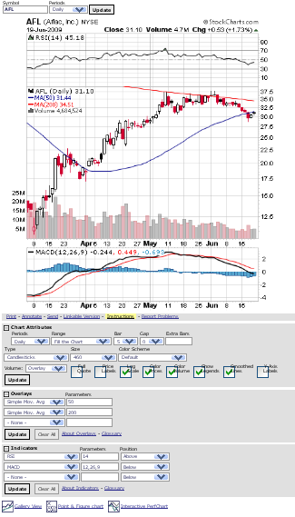
AFL SharpChart

Slide 29
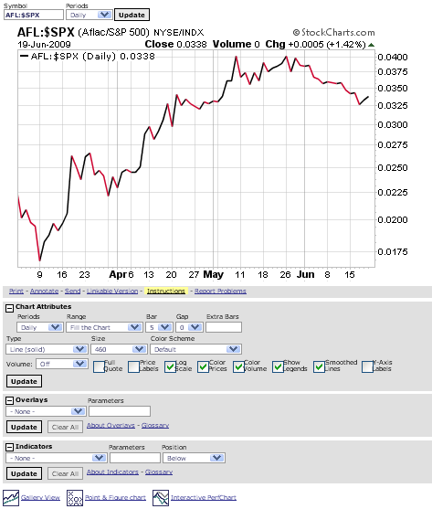
Relative Strength
AFL v. $SPX

Slide 30
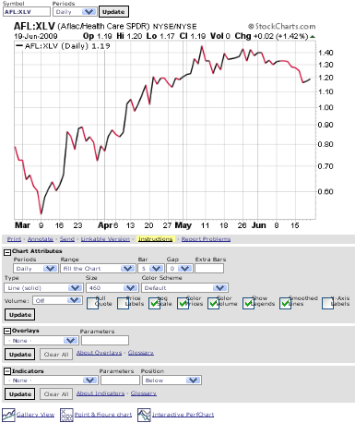
Relative Strength
AFL v. XLV

Slide 31
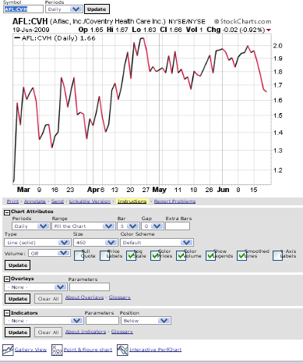
Relative Strength
AFL v. CVH

Slide 32
What is Relative Performance?
Relative performance charts or PerfCharts are provided at StockCharts
PerfCharts indicate the difference in price performance from a common starting point for groups of stocks, funds, or indexes; can be mixed
There are a number of default relative performance chart sets at StockCharts
A user may also create mixed relative performance charts sets of stocks, funds and sectors

Slide 33
Relative Performance
When starting StockCharts, pick “Charts and Tools” in the top horizontal menu at the home page
Then scroll down to “PerfCharts”
Enter symbols of choice in the box “Use Commas to Separate Symbols” then click “Go” to run an evaluation of your own symbols or portfolio
Or choose from one of the pre-defined collections by clicking on “Predefined Groups” at the bottom
A comprehensive set of inter-industry PerfCharts is then available for your review

Slide 34
Relative Performance
For this example, I picked Sector SPDR PERF charts as a predefined set of interesting items to focus on
The screen that follows shows a line chart default set of the S&P Sector ETFs plus the S&P 500
By default, the S&P 500 serves as a reference for the other sectors, but this can be changed
The default line chart can be a little daunting to read so click on the Histogram Chart icon which is just below the default line chart

Slide 35
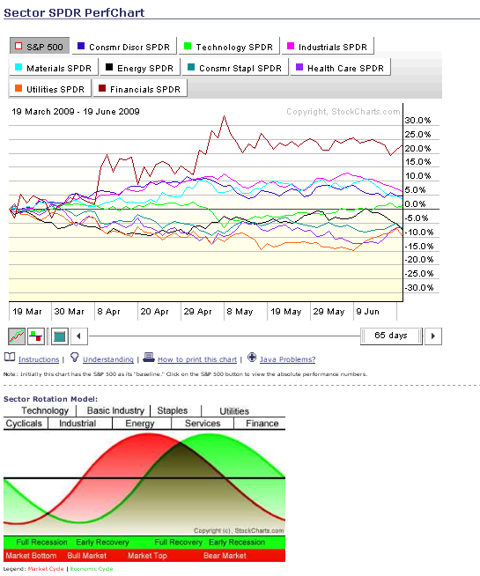
Default Line PERF Chart
Switch to histogram

Slide 36
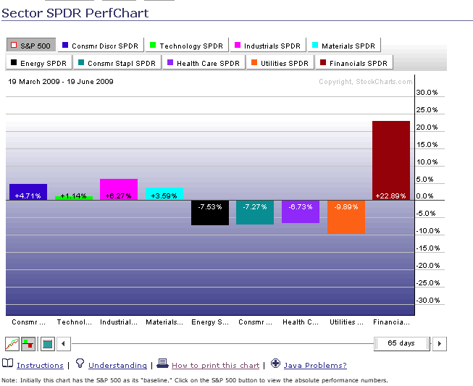
Default Histogram PERF Chart

Slide 37
Customized PERF Charts Example: Club Holdings
You can create your own custom PerfChart of up to 10 stocks, mutual funds, or indices.
The first step in creating a PerfChart is to know the ticker symbols of the securities you are interested in
With the ticker symbols in mind, there are a few different methods of quickly creating your PerfChart
From the StockCharts.com homepage, simply click the PerfCharts button, enter up to 10 ticker symbols, then click “Go” to see your results
A switch to a histogram (bars) view is very helpful

Slide 38
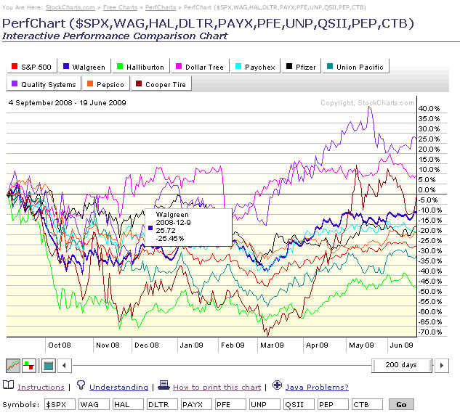
PERF Line Chart - Club

Slide 39
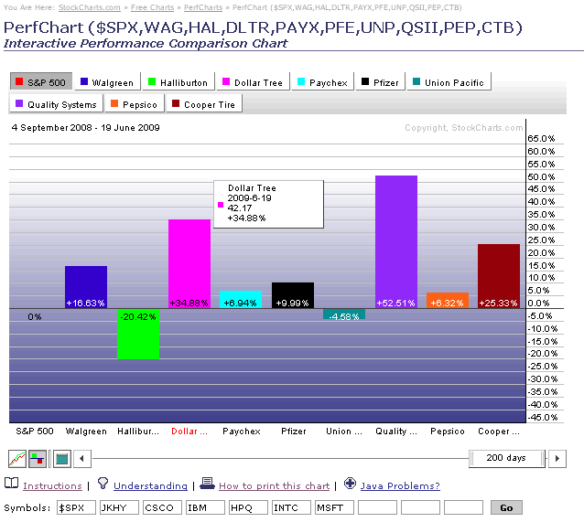
PERF Histogram Chart - Club

Slide 40
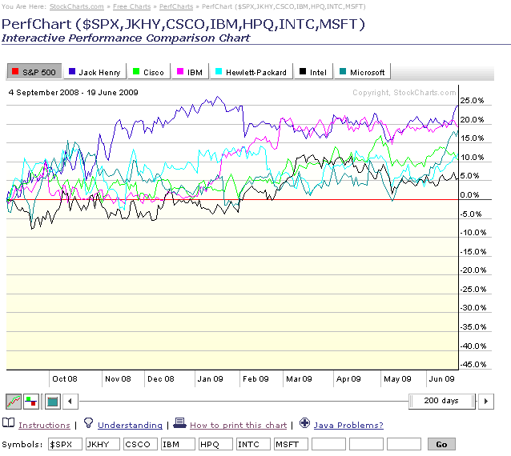
PERF Line Chart - Tech

Slide 41
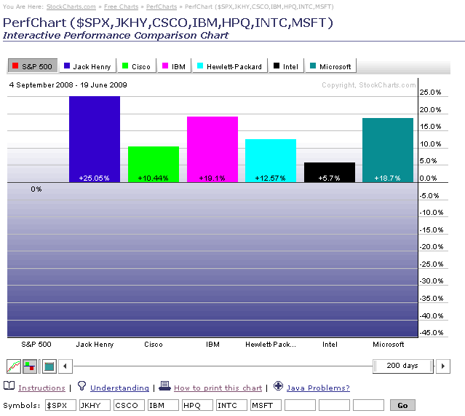
PERF Histogram Chart - Tech

Slide 42
References
Technical Analysis, Plain and Simple, 3rd Edition, by Michael Kahn (2010)
Technical Analysis From A to Z, 2nd Edition, by Steven Achelis (1995)
The Technical Analysis Course, 3rd Edition, by Thomas Meyers (1994)
Getting Started In Candlestick Charting, by Tina Logan (2008)

Slide 43
Summary
A basic understanding of relative strength and performance is helpful in supplementing stock studies or performing “at a glance” reviews of portofolio holdings or watch lists
Histogram or bar charts are very effective for club meetings and club portfolio reviews
Don’t make an investment decision based solely on technical analysis; first update your SSG or create a new one, then apply TA

Slide 44
Questions
Presentation: Introduction to Technical
Analysis
Presenter: Saul Seinberg
Contact Info: saul.seinberg@gmail.com

