Slide 1
The Tax Man Has Nothing On Us:
A Deep Dive Retirement Series
BI Consortium
May 29, 2025

Slide 2
Diving Into Roth Conversions plus 2024 Q&A Review
Christi Powell, CFP®, RICP®
Oklahoma Chapter Director
May 29, 2025

Slide 3
Disclaimer
The information in this presentation is for educational purposes only and is not intended to be a recommendation to purchase or sell any of the stocks, mutual funds, or other securities that may be referenced. The securities of companies referenced or featured in the seminar materials are for illustrative purposes only and are not to be considered endorsed or recommended for purchase or sale by BetterInvesting™ / National Association of Investors™. The views expressed are those of the instructors, commentators, guests and participants, as the case may be, and do not necessarily represent those of BetterInvesting. Investors should conduct their own review and analysis of any company of interest before making an investment decision.
Securities discussed may be held by the instructors in their own personal portfolios or in those of their clients. BetterInvesting presenters and volunteers are held to a strict code of conduct that precludes benefitting financially from educational presentations or public activities via any BetterInvesting programs, events and/or educational sessions in which they participate. Any violation is strictly prohibited and should be reported to the CEO of BetterInvesting or the Director of Chapter Relations.
This presentation may contain images of websites and products or services not endorsed by BetterInvesting. The presenter is not endorsing or promoting the use of these websites, products or services.
National Association of Investors™, BetterInvesting™ and the BetterInvesting™ Icon are trademarks/registered trademarks. All rights reserved. © 2021 BetterInvesting™.
We may be recording this session for our future use.

Slide 4
Objectives
Answer questions from 2024 presentation.
Learn what a Roth conversion is and why you might consider doing one.
Learn what the tax ramifications are when you do a conversion.
Work through a Roth Conversion flow-chart.

Slide 5
2024 Questions
What do you mean by ‘taxable’, ‘tax-deferred’, and ‘tax-free’?
How does muni tax-exempt income affect IRMAA brackets?
What about muni bond income in retirement years?
How are transactions taxed in your retirement account?
How are inherited capital gains taxed? How about a trust account?
Should I/we prepay funeral expenses?

Slide 6
Define ‘Taxable’, ‘Tax-deferred’, ‘Tax-free’
A taxable account is any account that is not a retirement account or an health savings account (HSA).
Regular brokerage account, trust account, TOD/POD/DesigBen account
A tax-deferred account is any retirement account where the contributions are pre-tax. Both contributions and growth/income are taxed as income when withdrawn.
Traditional IRA, 401[k], 403[b], 457, TSP, SIMPLE, SEP-IRA
A tax-free account is any retirement account where the contributions are post-tax and both contributions and growth are not taxed when withdrawn.
Roth, Roth 401[k], TSP Roth, HSA

Slide 7
Medicare IRMAA & Muni Bond Income
Muni bond income is added back into your taxable income to establish your Medicare premiums. This new amount is your “Modified Adjusted Gross Income” or MAGI.

Slide 8
Muni Bond Income for Retirees
Most helpful in higher tax brackets.
Will affect your IRMAA bracket for Medicare.
Other tax-advantaged investments include investments such as:
Business Development Companies (BDCs)
Master-Limited Partnerships (MLPs)
Real Estate Investment Trusts (REITs)

Slide 9
Retirement Account Taxation
Roth accounts are tax-free, both for owner and beneficiaries.
Any withdrawals from ALL other retirement accounts are taxed as ordinary income. Uncle Sam owns part of your tax-deferred retirement account(s).
Exceptions:
Qualified Charitable Distributions (QCDs)
Qualified Emergency Withdrawals (see Secure Act 2)
LTC premiums up to a limit (currently $2,500)

Slide 10
Taxes on Inherited Assets
Retirement Accounts (except Roths) are taxed as ordinary income with no step-up in basis.
Taxable brokerage accounts, including Revocable Living Trust accounts, receive a step-up in basis with long-term capital gains treatment from day of death.
Other assets in a Revocable Living Trust receive step-up in basis.
Irrevocable Trusts DO NOT receive step-up in basis.
Notes:
Just to hammer this home again, everything that comes out of a tax-deferred retirement account is taxed as ordinary income.

Slide 11
Pre-Pay Funeral/Burial Expenses
It depends.
Access to funds to pay final expenses?
Ease of pre-planning and pre-paying takes the pressure off heirs.
Are you going to move or be moved by caregivers?
Cremation can cause emotional distress if no one knows what to do with the remains or follows through.

Slide 12
Roth Conversion Flowchart
What are your goals for your investments? Why?
What is your current tax bracket and estimated future brackets? Think long-term.
Do you have cash outside your IRA to pay the taxes on the conversion?
What are the Medicare IRMAA and NIIT brackets this year and how close are you to them? Think long-term.
What are your other sources of income? Can you defer some?
What are your other sources of expenses? Can you bunch them?

Slide 13
Notes:
My apologies for the business information on this slide. It comes with the flowchart. Please ignore it. I am not offering my services or making specific Roth recommendations. Your tax brackets, your goals, and your personal cash flows will affect your decisions.

Slide 14
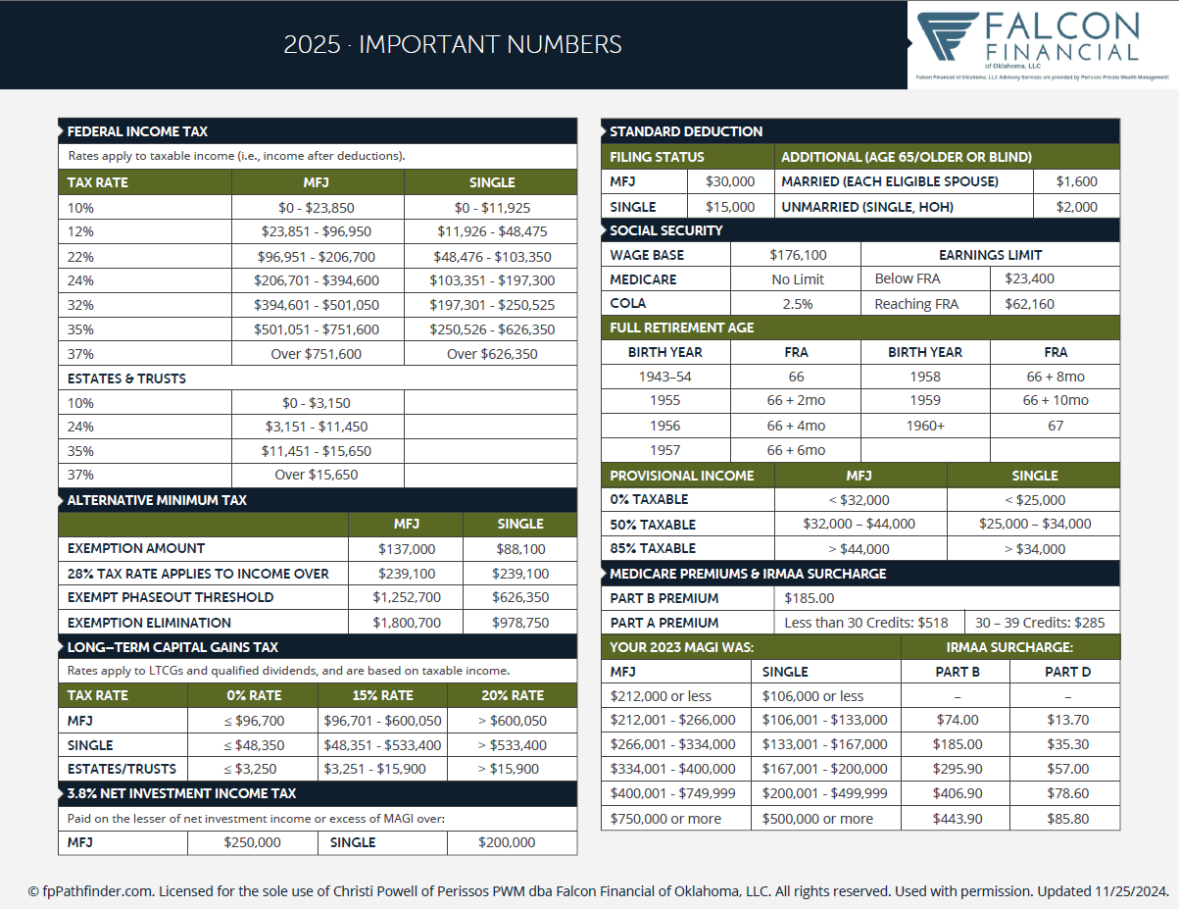
2025 Tax
Info

Slide 16
John & Sally Smith
John is 67. Newly retired.
He took a $50,000 IRA distribution for living expenses.
Sally is 65. Newly retired.
Both applied for their Social Security and have traditional
Medicare and taxes deducted from their benefits.
Notes:
Let’s look at an example of how this might work. Since we are discussing Roth conversions, I have not included Social Security strategies in our analysis. When you begin your Social Security benefits is an important decision with lifelong ramifications. But that is another class.
We’re going to a site called Holistiplan that about 25% of all financial planners are currently using for strategic tax planning. It allows us to discuss possible strategies to lower your lifetime tax burden and then confer with your CPA for implementation.

Slide 17
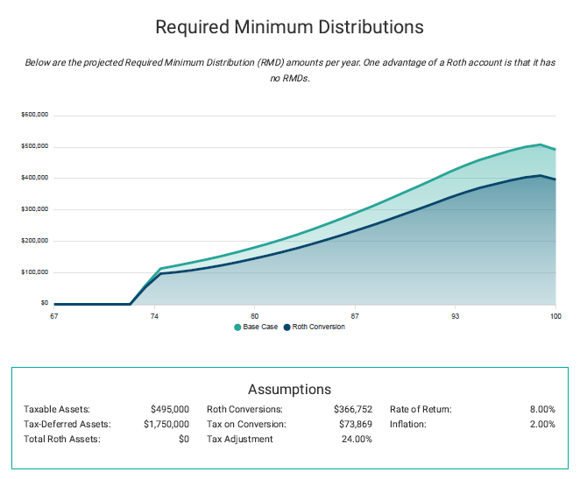

Slide 18
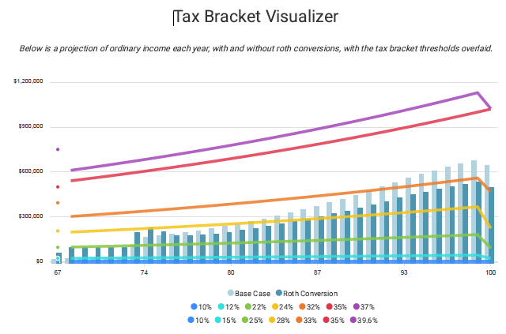

Slide 19
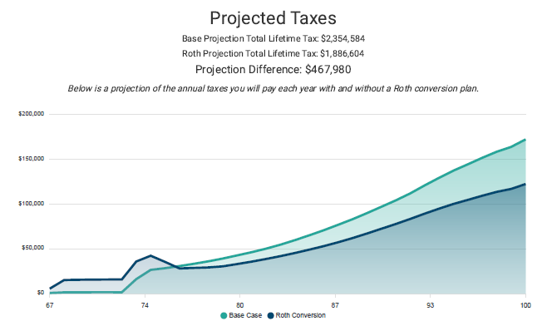

Slide 20
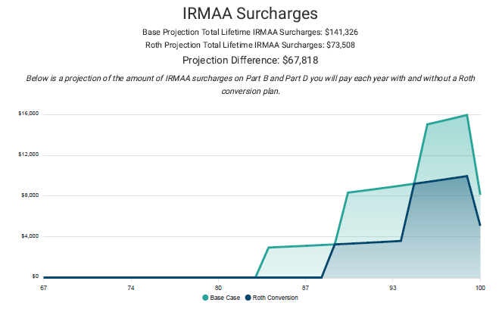

Slide 21
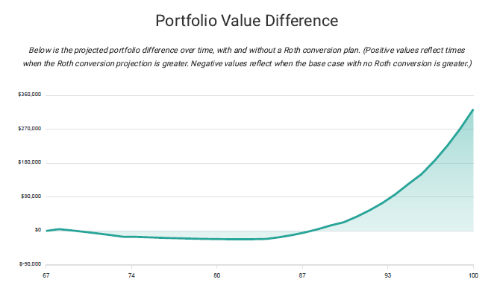

Slide 22
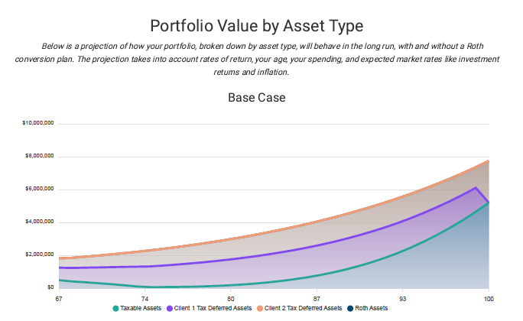

Slide 23
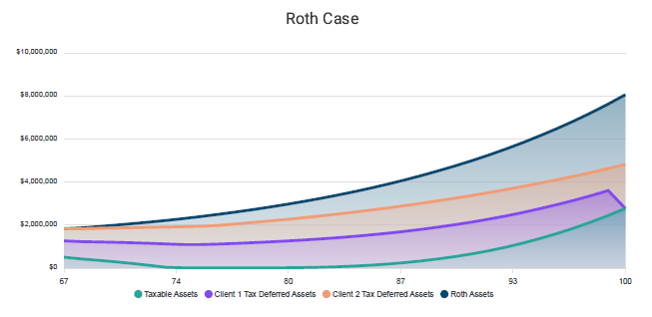

Slide 24
Strategies To Consider
24
Bunch deductible expenses: taxes, medical, contributions. Coordinate them all.
Pay your property taxes using bunching in alternating years.
Roth conversions in a year you have low income or large medical expense.
Bunch your charitable donations using the same schedule you use for property taxes.
Front load a Donor Advised Fund (DAF) with your local Community Foundation.

Slide 25
Summary
We’ve cleared up some questions from last year.
We’ve defined Roth conversion and answered questions about our unique situation.
We’ve discussed the flowchart to help guide our decisions.
We’ve talked with our CPA and CFP about this.
We’re ready to combine this with other tax strategies if appropriate.

Slide 26
Questions

Slide 28
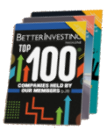
Make a Difference in Someone’s Life
If you have benefited from BetterInvesting
Please share some BetterInvesting materials and introduce others to this dynamic investment education opportunity!
TM
Pay it forward!

Slide 29
Save the Date
Upcoming Events

Slide 30
Email Questions or Comments to a Presenter…
Email Subject Line: Roth Conversion Consortium class
Presenter: Christi Powell
Email Addr.: cpowell@falconfinancialok.com

Slide 32
Alternate/Additional
Question Slides

Slide 33
Questions

Slide 34
Questions

Slide 35
Questions

