Slide 1
Trim or Sell? Which Is Better for Your Portfolio?
2025 SF Bay Area Chapter
Investor Education Day
Craig Braemer CFP® CFA®
Director, San Francisco Chapter
Craigbraemer1@gmail.com

Slide 3
Content
What is trimming?
If it is time to sell –what to do?
Some reasons why selling is tough.
Why trim versus sell?
Economic moats – What are they?
Guidelines to trim a holding.
Holding a stock forever?
Summary

Slide 4
The Concept of Trimming
Definition – Trimming is where you sell a portion of your holding and let the rest of the holding run.
Many investors spend a lot of time trying to figure out their losers and less time on their winners.
You can automate this process for winners.
Investors find it easier to buy versus selling stocks.
Assume we are looking to trim high quality stocks as identified on the SSG.
Notes:
Go into Moats and castles and that moats are competitive advantages that helps protect them from competition. Every company is a castle and how big is their moat? A company is like a castle with a moat.

Slide 5
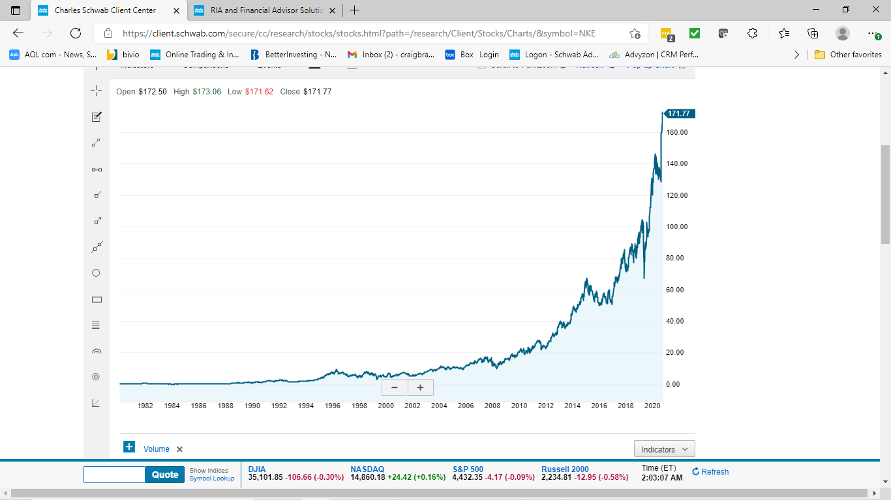
How Do You Manage A Winning Stock Like This?
If our goal is to try and find these kinds of stock charts. In this case Nike.
If you trim each time, you lost money vs selling at today’s higher prices. This is a risk that I have been willing to make.
With trimming, the majority of your holding is still growing. It should continue to have a solid SSG.
Thus, trimming is a way to control large winning stocks.
Securities are for educational purposes only
Source: Charles Schwab, 8-9-2021.
Notes:
These are good things to have happen.

Slide 6
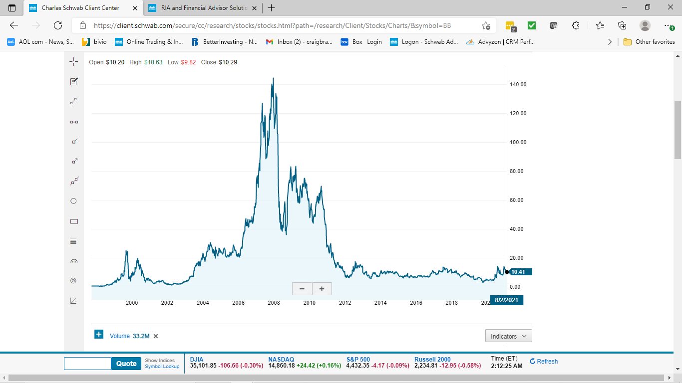
However - We Might Have This Stock - BB
Trimming could help with a stock like this, but if you sold it all at certain times, you did great.
If you did nothing, you made no money over many years.
Obviously, we would like to avoid this kind of stock, but there end up being a lot of them over time. It is hard to know the future.
Source: Charles Schwab, 8-9-2021.
Securities are for educational purposes only

Slide 7
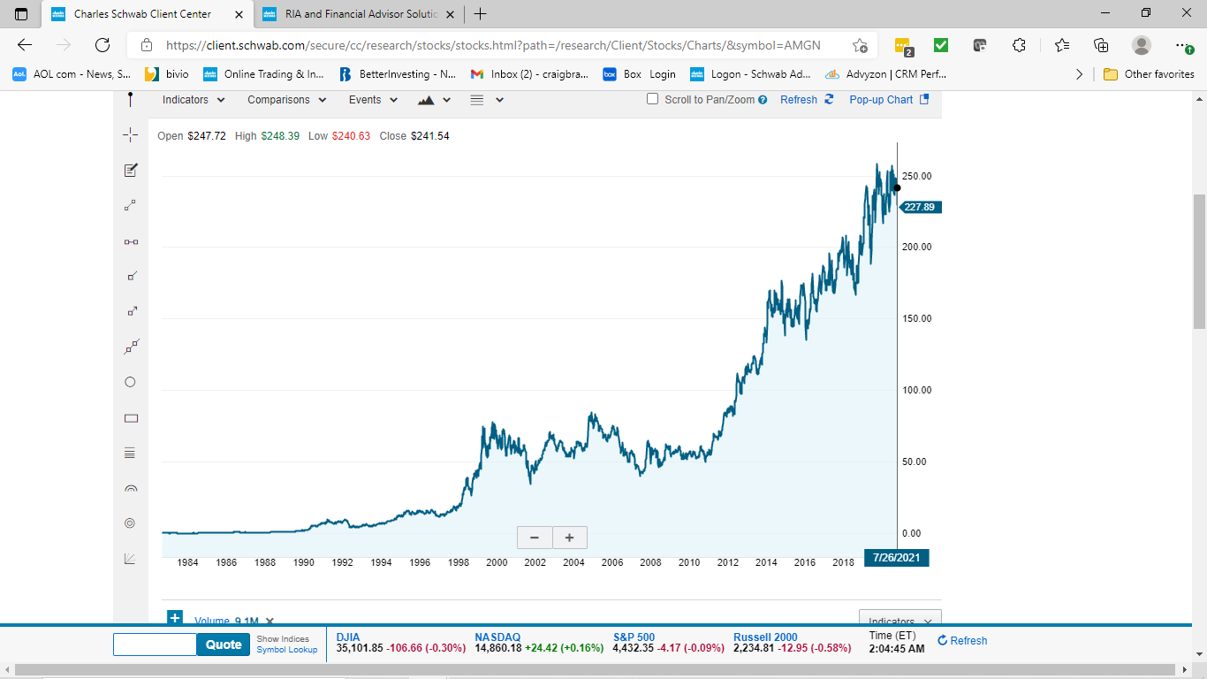
What About This Kind of A Stock - AMGN
This is a challenge – over 10 years of no stock appreciation.
Do you have the patience?
Trimming might help you wait for the stock to start going up again.
Source: Charles Schwab, 8-9-2021.
Securities are for educational purposes only
Notes:
I owned this stock and trimmed it twice (green arrows) before it went into its 10 year slump.
Unfortunately, I did not have the patience to wait and missed the 5x fold

Slide 8
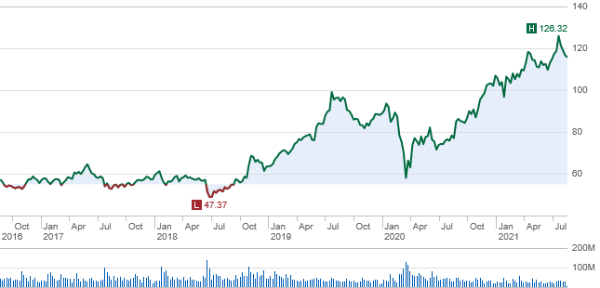
Every Day an Investor Has Four Options
SBUX
Sell your shares
Buy more shares
Nothing
Trim
Source: Charles Schwab, 8-9-2021.
Securities are for educational purposes only
Notes:
We are not going to address two of the options:
Buy more shares
Nothing

Slide 9
What Do We Do Now?
Check out your SSG!
Source: Charles Schwab, 8-9-2021.
Securities are for educational purposes only
Notes:
Make the assumption that this is a high quality company with a strong SSG.
Consult your SSG for analysis.

Slide 10
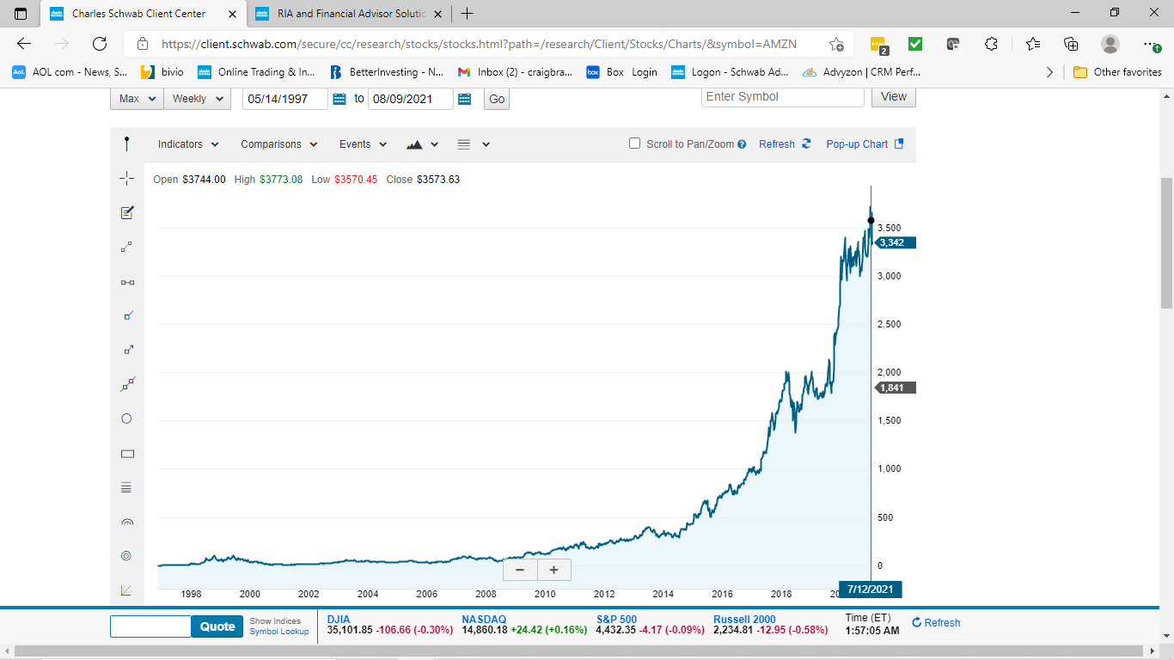
What Do We Do Now?
Check out your SSG!
Source: Charles Schwab, 8-9-2021.
Securities are for educational purposes only

Slide 11

Summary of These Charts
It is easier to see a good stock looking backwards.
It is easier when given the name of the stock.
We are assuming we are looking at high quality stocks.
It is a lot harder to say, “What do you do now?
Consider your SSG for guidance at each decision point.
The Amgen chart is a great example….
Notes:
However you can’t just buy wide moats.

Slide 12
Selling Your Whole Holding Is Tough
As you just saw with the charts, it isn’t always easy to figure out the future. Selling issues include:
People don’t like to admit they made a mistake.
Fear of Loss AND Fear of Regret.
Want to get out and get “even” if they are at a loss.
There is no precise mathematical formula.
If you sell now, you miss out on the future.
You lost money.
Many psychological issues with selling.
Notes:
Go into Moats and castles and that moats are competitive advantages that helps protect them from competition. and every company is a castle and how big is their moat? A company is like a castle with a moat.

Slide 13
It Is Time To Reduce A Holding – Three Options
Trimming a position – Winning Stocks
Selling out of a position – Winners and Losers.
Tax loss harvesting – Losing Stocks
We will address these first two in this class.
The third item – tax loss harvesting has a goal to generate some tax benefits from a position where you are at a loss. You could retain a position over time.
Tax losses can be seen as a good thing in portfolio management.
Notes:
Go into Moats and castles and that moats are competitive advantages that helps protect them from competition. Every company is a castle and how big is their moat? A company is like a castle with a moat.

Slide 14
Core Decision Tree On If You Should Sell or Trim
The long term outlook for the company is unfavorable
Deteriorating corporate financial condition
Time and original thesis didn’t work
Temporary declining profit margins
Bloated current asset balance sheet - Inventories
Adverse management change
Increasing competition impacting profits
Dependence on a single product
High valuation of a quality stock
Position size has become too large – this is a risk too
Probably sell
Trim or sell
Trim

Slide 15
You Found This Stock - AMZN
If you sold everything at any of these points, you missed a lot of future gains – yet you made good money. This is risk of selling it all!
The big risk, in my opinion, to an investor is missing out on this kind of a great long term stock.
Source: Charles Schwab, 8-9-2021.
Securities are for educational purposes only

Slide 16
You Have A Risk With A Big Winner
Having a stock winner with a large position size can help your investment performance.
However, big position sizes are a risk too.
Large single stock positions can impact your returns if that stock falls significantly or goes to zero.
Examples – Worldcom, JC Penney, Lehman, Silicon Valley Bank and First Republic Bank.
Trimming helps control the size of big winning positions and raise some cash for diversification.
If you sell it all, you have to try and find another successful replacement.
Notes:
It becomes a very large size in your portfolio – this is a real risk. Congrats on the winner – you want this problem.

Slide 17
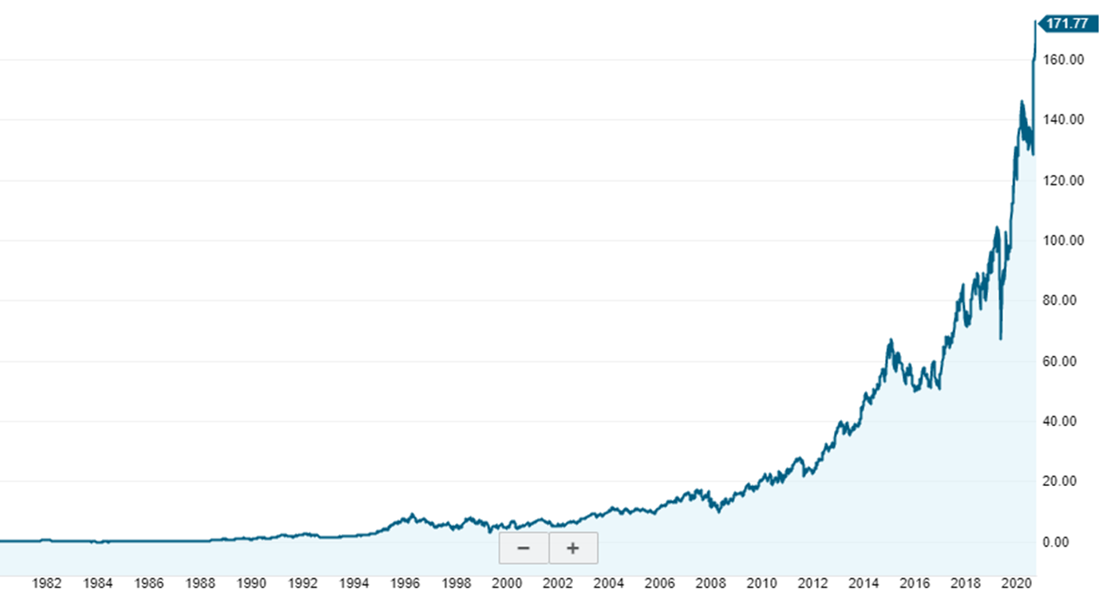
My History with Trimming vs Selling
Here is a list of stocks from my personal clubs that have grown very well over time. These companies are: NKE, BDX, MCD, COST, GOOG, AAPL, ISRG, SBUX, DOCU.
Many of these have been trimmed several times, despite having strong economic moats.
I want to own these kind of a chart.
Securities are for educational purposes only
Notes:
Many of these stocks have wide moats.

Slide 18

So Why Trim Versus Sell?
It is my desire to own my stocks forever – as long as they are executing. Thus, I lean toward trimming vs selling.
It seems, winners continue to win if they have a good economic moat.
Thus, my biggest factor is whether the stock has a wide economic moat - No moat, I look to sell.
Why? Not many long term winners vs the market. Not many wide moat stocks.
The goal is to control the position size. Risk reduction.
Notes:
Go into Moats and castles and that moats are competitive advantages that helps protect them from competition. and every company is a castle and how big is their moat? A company is like a castle with a moat.
Roughly 200 wide moat stocks out of 1,500.

Slide 19

In the Long Term
As an investor, I’m doing research to find information that confirms or denies my beliefs about a company’s moat or business model.
If it continues to execute, keep owning it!
There are not many successful companies that last over several decades. Thus, you might have to sell.
Economic Moats = Business Models = Strong SSG

Slide 20



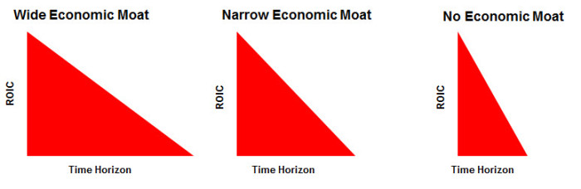
Economic Moat Thought Process
Source: Pat Dorsey, Morningstar.
Notes:
Think of every company as a castle. Some might be wide and others narrow or No economic moat.
“No moat” stocks can do well, you might have to trade it more frequently.
Buffett likes companies with strong economic moats.
3 categories
A wide moat will show on Section 2 as representative of a good business model.
By doing this work it can help:
Hold stocks longer of good, quality companies.
You to understand the SSG numbers.
Generate better returns over long time periods.
Only 200/1500 companies considered wide.
ROE is similar to ROIC – Return on Invested Capital.

Slide 21
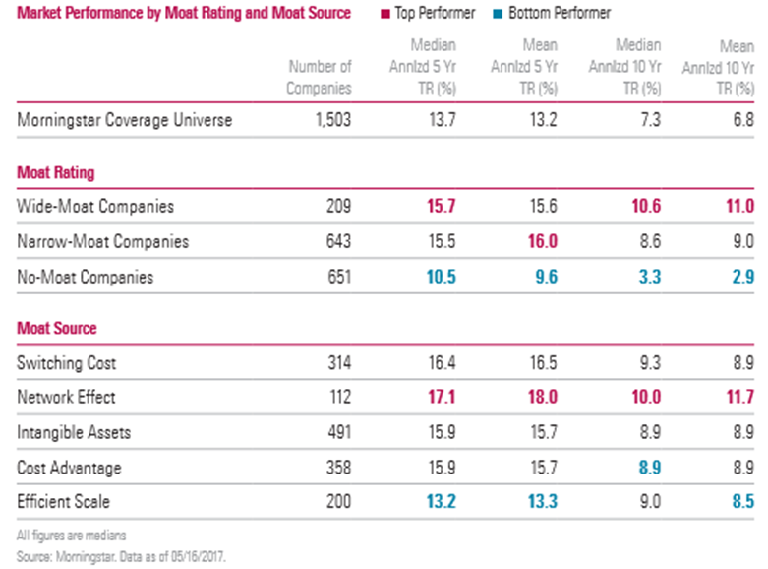
Moat Performance – Wide Moats Win
Source: Morningstar Magazine, August / September 2017.
Securities are for educational purposes only
Notes:
10 year time period – Universe return is 6.8%
Wide Moat is almost 2x the universe, Narrow moat has strong performance too.
No Moat is 25% of the market average

Slide 22
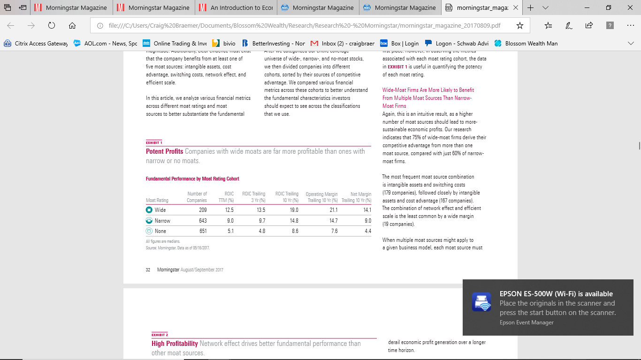

Moat Analysis
The potential of wide moat stocks are intriguing.
Wide moat stocks should have higher margins over a longer timeframe.
Why? Sustainable competitive advantage.
Source: Morningstar Magazine, August / September 2017.
Securities are for educational purposes only
Notes:
3 categories – only 209 Wide moat stocks

Slide 23
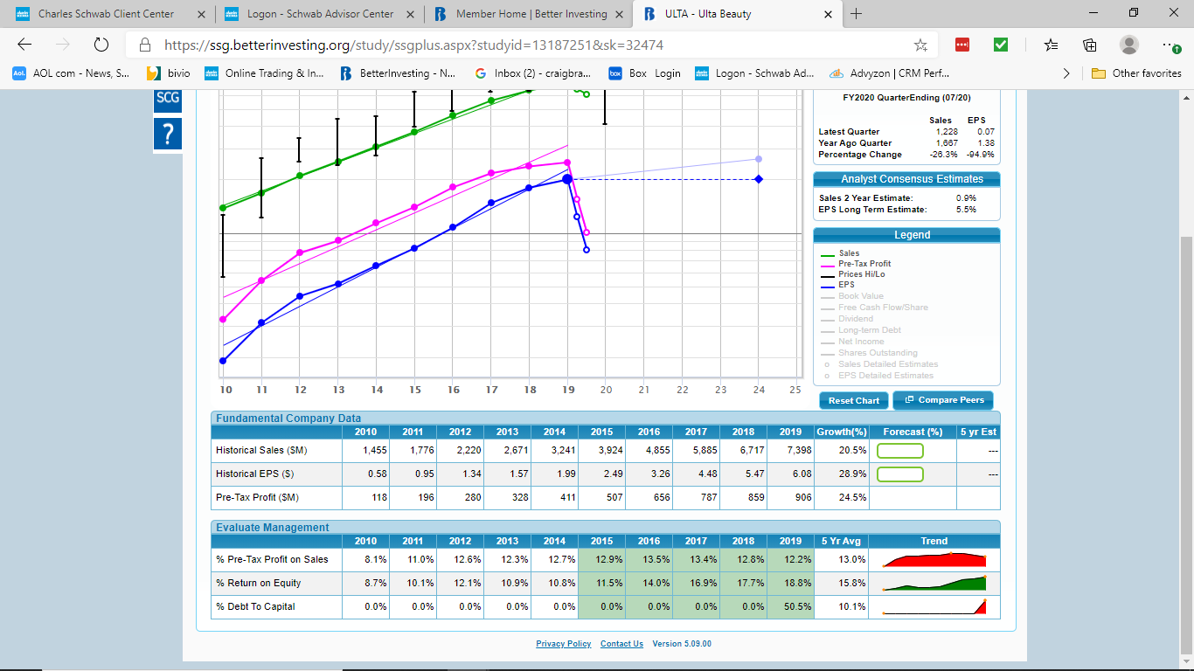
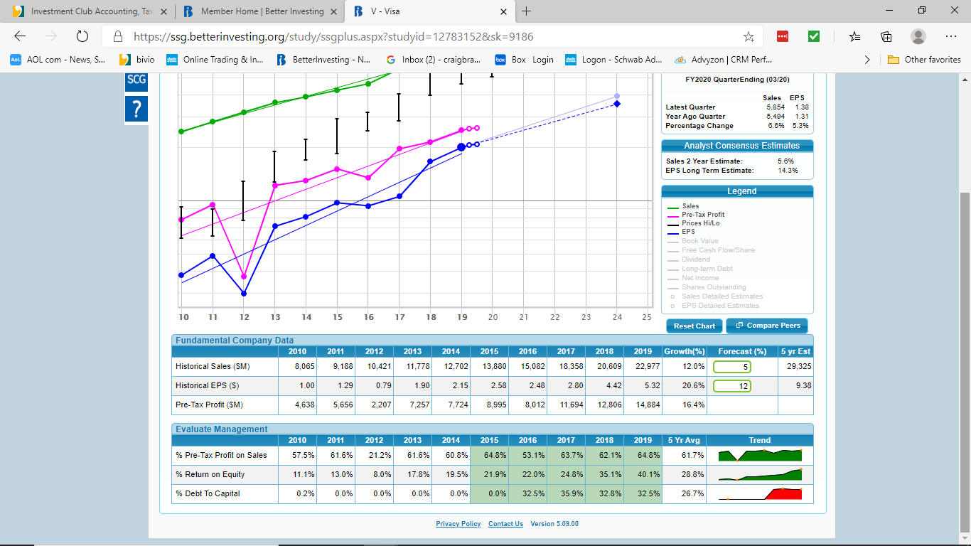
Evaluating Management SSG Style –
Narrow vs Wide Economic Moat
Narrow Moat
Wide Moat
Securities are for educational purposes only
Notes:
ULTA, V – Put new SSG section2 in here.
By doing industry studies versus just a single stock you might find industry consistency

Slide 24
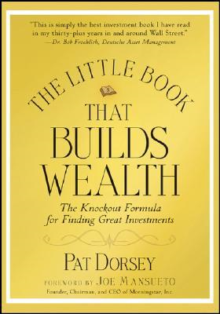
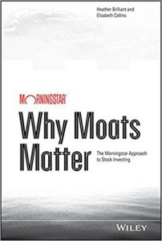
If You Want to Learn More on Economic Moats?
To obtain economic moat information – online libraries that subscribe to Morningstar or available from Schwab.
Securities are for educational purposes only

Slide 25

Question Time

Slide 26

The Trimming Evolution
I’ve been using a trimming policy since 1990.
Theory - stocks don’t move in a straight line.
Learned this with my first club.
Managing risk is the goal. Concern about position size.
Buy more when cheap?
Is this a wide moat stock?
Again, trimming is for handling winners.
SBUX
Securities are for educational purposes only
Notes:
Go into Moats and castles and that moats are competitive advantages that helps protect them from competition. and every company is a castle and how big is their moat? A company is like a castle with a moat.

Slide 27
Mechanical or Manual Process
Manual, you select your levers each time.
Since my goal is managing risk, I focus on portfolio weight and capital gain.
The bigger the weight, the more often I want to trim.
How much to trim is your choice – it could be:
5%, 10%, 15%, 20%, 25% or more?
I have typically used 10% or 20%.
I prefer mechanical, then discuss in club.
Notes:
I prefer mechanical, meaning we see that the Selling System has been triggered and we discuss is there any reason to not due the sale and what percentage do we want to do.

Slide 28
Mechanical Trim Example
I am willing to trim when a position size is greater than 2x the average portfolio weight. Assuming I don’t want to just sell it all out.
A 15-stock portfolio = 6.67% average weight
(100% portfolio weight/15 stocks)
2x Average Weight = 13.3%.
Potentially TRIM if the largest weight is above 13%.
Remember, position weights in the portfolio are relative to the performance of all of the stocks in the portfolio. Long term – this is key.

Slide 29
Combined Lever
First lever is the stock’s portfolio weight greater than 2x average portfolio weight.
AND
Second lever says the stock has a gain of at least 60%, or you would not trim.
You could use any percent gain and easy to do in excel. I selected 60%
Focus on wide moat stocks and hope to own forever.

Slide 30
The Excel Formula
Source: Craig Braemer’s Bullpen Club Portfolio, 6/30/2021.
Securities are for educational purposes only
Notes:
Target price is not related to the SSG, but you could, it just wouldn’t make it automatic

Slide 31
The Formula Driven by Relative Weight and Performance
=IF(current price>Target Price, IF(% in Portfolio> 2X Avg. portfolio weight, ”Yes”, ”Maybe”),”No”)
My definition of the target price = cost plus 60%. You could use a different number like 100% gain.
Issue with small positions - must grow to big weights prior to trimming. Small positions don’t impact performance as much as large positions. Thus the formula isn’t going to sell these.
Notes:
Go into Moats and castles and that moats are competitive advantages that helps protect them from competition. and every company is a castle and how big is their moat? A company is like a castle with a moat.

Slide 32
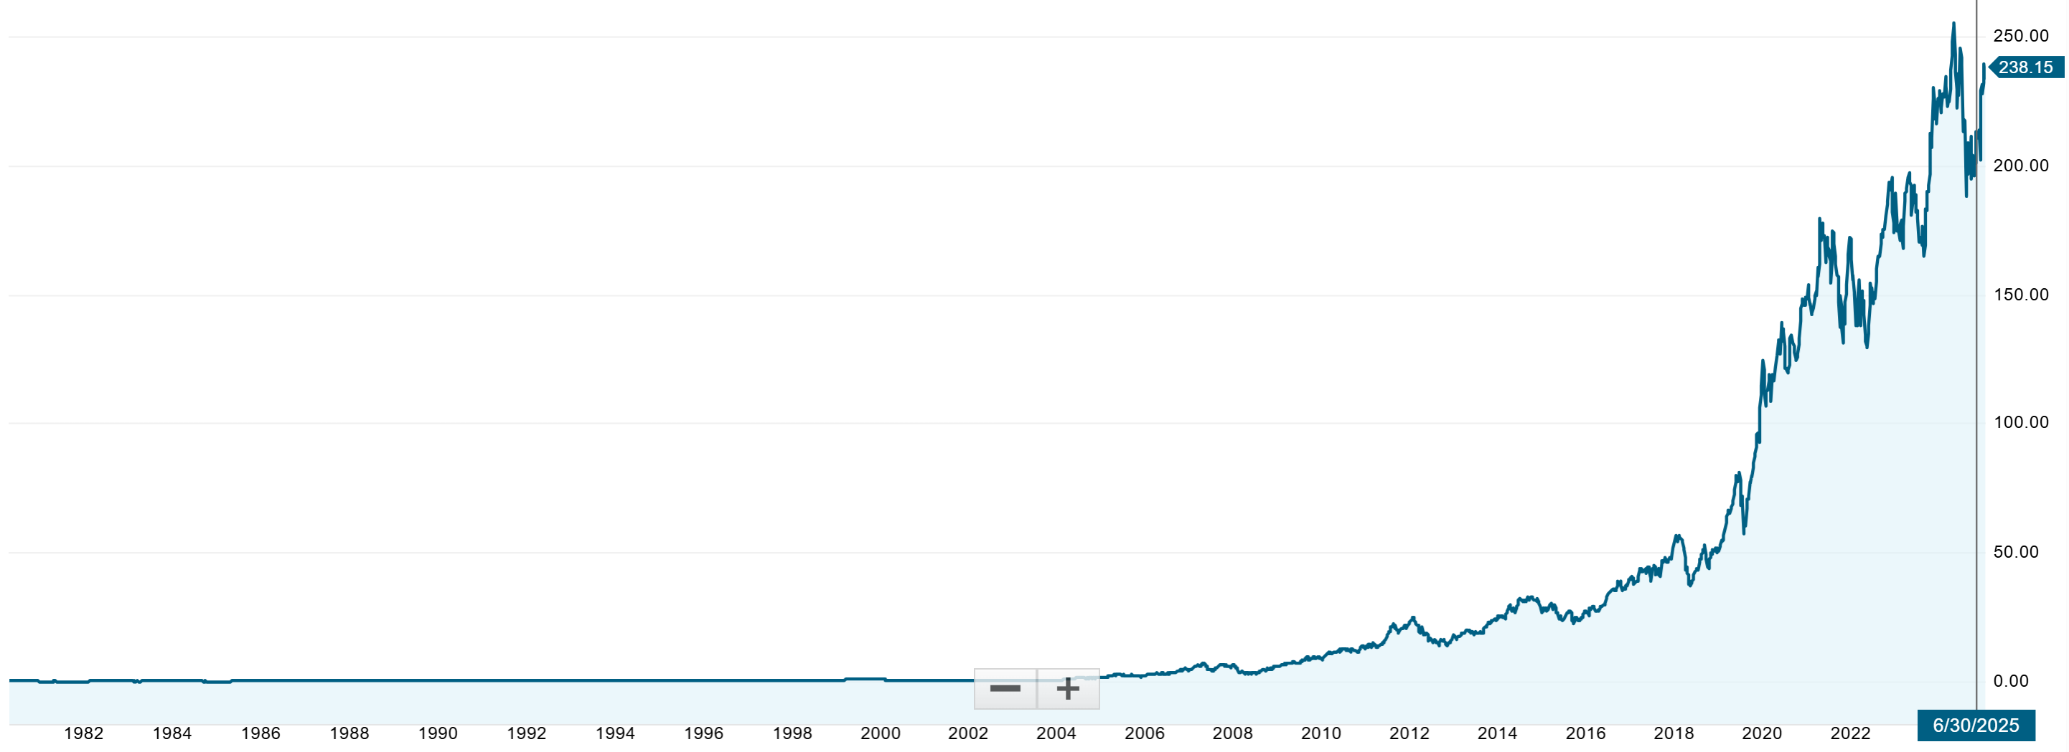
Example: Apple – Seven Trims + One Distribution vs Selling
Trim #7 – 6/23
$191.65 – $8.6k
+19% gain
Trim #6 - 8/22
$161.03 – $8.1k
+199% gain
Bought 2/08
$4.06/share
$11.5k cost
Club Distribution 70% of Stock
Trim #5 - 9/19
$53.69 – $9.6k
+73% gain
Total $ Trimmed
$39,9k
Distributed stock
$78.8k
Trim #3-3/12
$19.60 - $5.5k
+78% gain
Trim #4 - 3/15
$30.99 - $3k
+58% gain
As 9/6/25
Club’s Remaining Value
$97k
@$238/share
10.8% in portfolio
Trim #2-11/10
$11.02 – $3.1k
+54% gain
Trim #1-11/09
$7.14 - $2k
+70% gain
Source: harles Schwab pricing , 9/16/2025.
Securities are for educational purposes only

Slide 33
How Much Should You Trim?
It is your choice, but I recommend 10% and 20%.
Big enough to reduce the weight to be able to capture long term returns.
The long term debate is: Great long term potential vs taking some money off the table.
This is the discussion with our mechanical system.
Every trim done, runs the risk of missing out and just selling everything at the peak.
Easier to sell small amounts. Less stress.
As we saw earlier, it is tough to identify the peak.
Notes:
Don’t forget the charts of AMGN, NOK, etc.

Slide 34
I Think Trimming Works, But can I Own My Stocks Forever?
I would like to own my stocks forever.
We only own 10-25 great stocks – we have a big advantage to be selective.
However, forever isn’t realistic. At some point, some stocks will have to be sold. Most leaders don’t stay at the top forever.
Focus on the strength of the economic moat.
SSG Sections 1 & 2 are good at analyzing economic moats.

Slide 35
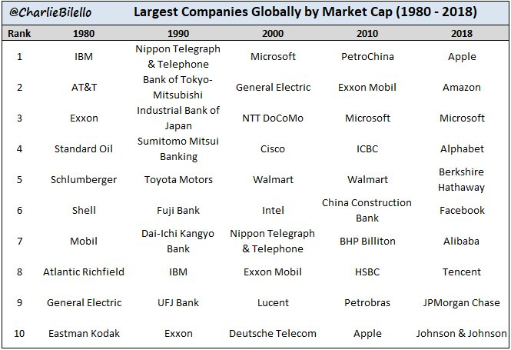
Top Market Cap Stocks per Decade
Securities are for educational purposes only
Notes:
Focusing on US companies.
The diamonds are for 4 decades – most people would not think of Exxon.
The circles are 3 decades. - MSFT
The squares are in only 2 decades. – AAPL, WMT, IBM
Purple is for technology sector.
Red is for telecom.
Orange is for Consumer Discretionary.

Slide 36

Leaders Do Not Stay on Top Forever
Valuation is not my primary reason to trim.
Managing risk is the goal.
Pulling some money out to diversify might allow you to find your next big winner.
“Remember to weed your garden” or “Letting my winners run!”
Is this stock a wide moat?
I’ve used this book as a framework for how I invest.
Securities are for educational purposes only
Notes:
Go into Moats and castles and that moats are competitive advantages that helps protect them from competition. and every company is a castle and how big is their moat? A company is like a castle with a moat.

Slide 37
Summary
Trimming should help let your winners run and control your position size. This has helped me hold on to great long-term winners. I call this process - Buy & Manage.
Sell when you think the future is poor. Remember, not all stocks will win over the long term. Selling is tough!
Of course, you can’t only buy winners. Get used to selling losers. It is a normal course of investing.
Trimming doesn’t identify when to sell.
Wide Economic Moats or “Quality from the SSG” stocks help identify good business models for the long term.
Notes:
By learning more I can understand the stock’s long term business model and if it has a sustainable competitive advantage. Buffett
Compounding money over time is easier with quality versus trading value stocks.
An economic moat (competitive advantage) allows a company to fend off competitors and earn sustainable excess economic profits.
Trimming might be easier to do.

Slide 38
Trim or Sell? Which Is Better for Your Portfolio?
Craigbraemer1@gmail.com

