Slide 1
The Case for Stocks with Growing Dividends
Craig Braemer CFP® CFA®
Director, San Francisco Chapter

Slide 3
Content
Why should I care about dividends?
Dividend basics
Dividends and your SSG
A growing income stream strategy
Looking for growing dividend stock ideas
Summary
Growing dividends are great!

Slide 4
Why Care About Growing Dividends?
Source: Ned Davis Research and Washington Crossing Advisors, 12/31/20.
Notes:
Dividend growers and initiators is a subcategory
drawn from the dividend payers group and include
only those companies that increased their dividend
during the preceding 12-month period.

Slide 5
Looking at the Annualized Return from the Chart
RETURNS BY DIVIDEND CATEGORY (1973-2020)
Source: Ned Davis Research and Washington Crossing Advisors.

Slide 6
Looking at Risk and Return from the Chart
Risk and Returns by Dividend Category (1973-2020)
Source: Ned Davis Research and Washington Crossing Advisors, 12/31/20.

Slide 7
Implication Summary
Dividend-paying companies win vs non-payers.
Dividend-paying stocks are usually less volatile than typical growth stocks.
Be careful of stocks that cut their dividend.
Dividend-growing companies seem to have strong shareholder focus and solid financial history.
Growth, profitability, and commitment to shareholders are good investor concepts.
Notes:
less risk with dividend payors

Slide 8
Example of a Dividend Cut – Core Labs
Core Lab Lowers Quarterly Dividend by 54.5% on 1/24/2020
As of 3/28/2022, the price is $31.32. No recovery!
10/1/2020 - $14.29 with an annual .04 Dividend. Another 96% decline!!!
Source: Price history from Charles Schwab.
Securities are for educational purposes only

Slide 9
Before We Talk on Dividend Growth….
Let’s cover some dividend concepts.

Slide 10
Dividend Concepts
What is a dividend? It is the portion of the company’s earnings paid to shareholders.
Higher dividend yielding stocks typically grow slower.
Growing dividend stocks can start with a low yield and grow each year for possibly a long time.
All sizes of stocks can pay dividends.
Predictable income source.
Dividends help buffer market volatility and inflation.
If you can get a growing dividend and appreciating stock price, you win two ways.

Slide 11
How is a Dividend Decided?
Dividends are declared at the discretion of its Board of Directors (BoD). Typically, quarterly.
They (BoD) take into account business activity, cash generation and the capital needs of the business to determine a dividend amount.
Historical payouts and dividend increases are big considerations by the BoD.
Cash flow statement is useful with dividends. Balance sheet would be next.

Slide 12
Why Doesn’t Everyone Pay a Dividend?
Many fast-growing companies invest in their internal growth opportunities.
Other reasons:
They don’t generate enough cash flow
Excess debt
Cyclical industry
Not as tax efficient
As already shown, there are large repercussions if a company stops or reduces the dividend.

Slide 13
Payout Ratio – The Key Dividend Ratio
Payout ratio = Dividend / EPS
Easily comparable
This metric is key to help determine future:
Sustainability
Growth
Having lower payout ratios help in the long run.
Be careful of high payout ratios. A range up to 50-60% payout ratio seems reasonable.
Notes:
This is the Key Dividend Ratio
High payout ratios might lead to dividend cuts.
Growing earnings can lead to growing dividends.
Portions of SSG focus on dividend analysis.

Slide 14
Payout Ratio Analysis
Kohl’s started a dividend in 2011
Apple started a dividend in 2012
Notes:
From Value Line

Slide 15
Financial Statement Analysis
Watch out for firms that add debt to pay for their dividends. Cash flow analysis helps.
If you want a growing dividend, keeping debt low is better.
BetterInvesting recommends % debt to capital of not more than 33%. This gives company flexibility over time.
Some industries – utilities, REITs and the defense industry - normally have more debt, higher payout ratio and a higher dividend yield.

Slide 16
Dividend Stocks and the SSG
Find growing companies with the SSG.
Growing earnings can lead to growing dividends.
Portions of SSG focuses on dividends.
Payout ratio is a key metric.
Use a low payout ratio with an attractive SSG to potentially find a winning stock.

Slide 17
SSGPlus - Section One
Notes:
Dividend chart only in SSG Plus

Slide 18
Dividends and SSG Section 3

Slide 19
Question Time
Before we get into dividends with the SSG and a dividend growth strategy, lets cover a few questions.

Slide 20
Dividends’ Contribution to Total Return Over the Decades
Source: ProShares, and Morningstar, 1/1/60-12/31/19. Past performance is no guarantee of future results. Chart is provided for illustrative purposes.

Slide 21
S&P 500 Annualized Dividend Growth Rate
Source: ProShares and S&P Dow Jones Indices
Notes:
Dividends tend to grow annually at the index level.

Slide 22
A Dividend Growth Strategy
This strategy is focused on investing in high quality dividend paying stocks that meaningfully grow their dividends over time.
The key to this strategy – screen for a minimum of 10 years of growing dividend.
Yield can be low, but the dividend is growing.
The payout ratio is very important. Keep it under 50%, slower growers maybe 60%.
If no growth in the dividend over a 12 month period – sell. 2020 was unique.
Notes:
Why? He wants growing dividend stocks.

Slide 23
Dividend Growth Strategy other Rules
Use the SSG to find solid growth companies:
Focus on quality, look for:
Something unique (Economic moats) about their company that gives them an advantage (ie: #1 market share, low cost, etc.). This is key and very important.
Look for positive and strong cash flow
Concern over cyclical nature
Strong financial strength helps pays dividends
Low debt to total capital - 33% or less
This is not the high-dividend yield strategy
Be careful of poor business models
SSG is a fine tool to analyze business models

Slide 24
Dividend Growth Strategy - Selling
Again, if a company doesn’t raise its dividend annually – normally I would just sell. In 2020, I suspended this rule due to Covid and did more research.
The rule was put back into place at the end of 2021.
Other reasons to sell:
A company’s share price is significantly overvalued.
Company’s payout ratio gets too high.
Position size becomes too large for portfolio.
Dividend growth rate drops to a very slow pace or flattens completely.
Notes:
Financial strength helps paying dividends. Debt to total capital – 33% or lower.

Slide 25
This Dividend Strategy has Certain Traits
My goal is to get a consistent stream of meaningfully increasing dividends over time.
Notes:
Why? He wants growing dividend stocks.
Now that I am older, I like the quarterly cash flow and the growth of that cash flow.
I liked this slide from a fund company.

Slide 26
Stock Ideas – NOBL and SMDV
NOBL (S&P 500 Dividend Aristocrats--an ETF)
This looks for companies with the longest dividend year-over-year growth track records.
25 consecutive years of dividend increases.
SMDV (ProShares Russell 2000 Div. Growers)
Must have 10 consecutive years of dividend increases to qualify for the Russell 2000 Dividend Growers Index.
Largest sectors-financials, industrials and utilities.
Securities are for educational purposes only

Slide 27
Dividend Stock Ideas
Large Dividend Stocks
Smaller Dividend Stocks
Source: Proshares.com. NOBL and SMDV. 12/31/21
Securities are for educational purposes only

Slide 28
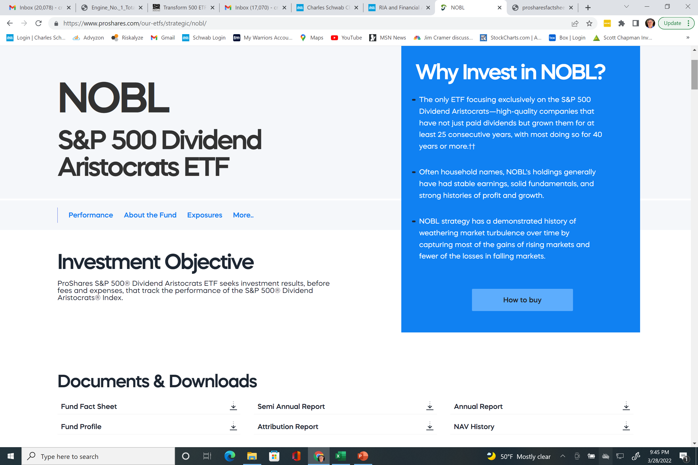
Where to Find These Dividend Ideas?
Go to www.proshares.com
Securities are for educational purposes only
Notes:
Might be other good things to read here. Good website for dividend work.

Slide 29
Well Known Stock Dividend Lists
Dividend Champions – may or may not be S&P stocks, covers companies that have increased dividends for at least 25 or more years, includes companies included in Dividend Aristocrats. www.dripinvesting.org
Dividend Contenders – stocks that have raised their dividends consecutively for 10 to 24 years.
Dividend Challengers – stocks that have raised their dividends consecutively for the last 5 to 9 yrs.
Do your homework with these lists!
Source: The Champions, Contenders and Challengers lists are free and maintained monthly by Justin Law and The DRiP Investing Resource Center.
Notes:
I would focus on Contenders and Challengers for new LT ideas that might have lots of growth opportunities.

Slide 30
Summary
Dividends are real and a fact.
If you focus on growing dividend stocks, you can have a future growing income stream.
Might be a good alternative to fixed income.
A company with a history of solid dividend growth is highly valuable. It also can mean that the company has excellent management and desirable long term growth prospects.
Companies that have paid dividends a long time will probably continue.

Slide 31
The Case for Stocks with Growing Dividends
Craigbraemer1@gmail.com

