Slide 1
Toughest Investment Decision-
When to Sell
Howard Johnson
Online Chapter
hlj83003@gmail.com
Thanks to Carol Theine of the Puget Sound Chapter!
Notes:
You can present this powerpoint using the sample portfolio. Or you might consider using it as an outline for doing a Club Portfolio Review.
Questions on this presentation can be sent to Carol Theine at ctheine@Puget.bettervesting.net

Slide 2
Disclaimer
The information in this presentation is for educational purposes only and is not intended to be a recommendation to purchase or sell any of the stocks, mutual funds, or other securities that may be referenced. The securities of companies referenced or featured in the seminar materials are for illustrative purposes only and are not to be considered endorsed or recommended for purchase or sale by BetterInvestingTM National Association of Investors Corporation (“BI”). The views expressed are those of the instructors, commentators, guests and participants, as the case may be, and do not necessarily represent those of BetterInvestingTM. Investors should conduct their own review and analysis of any company of interest before making an investment decision.
Securities discussed may be held by the instructors in their own personal portfolios or in those of their clients. BI presenters and volunteers are held to a strict code of conduct that precludes benefiting financially from educational presentations or public activities via any BetterInvesting programs, events and/or educational sessions in which they participate. Any violation is strictly prohibited and should be reported to the CEO of BetterInvesting or the Director of Chapter Relations.
This presentation may contain images of websites and products or services not endorsed by BetterInvesting. The presenter is not endorsing or promoting the use of these websites, products or services.

Slide 3
When to Sell
You need the money
Diversification/Rebalance
Stock has declining fundamentals; not meeting your expectations
Significant long-term bad news
Stock is overvalued
Improve portfolio future potential return

Slide 4
1. You need the money.
Personal: College, Home, Land, World Cruise, Boat, Computer, Living Expenses
Club: A Member Withdrawal
The tougher decision might be….
WHAT to sell

Slide 5
2. Diversification / Rebalance
Stock as % of Portfolio
Sector
Company Size
Growth Rate

Slide 6
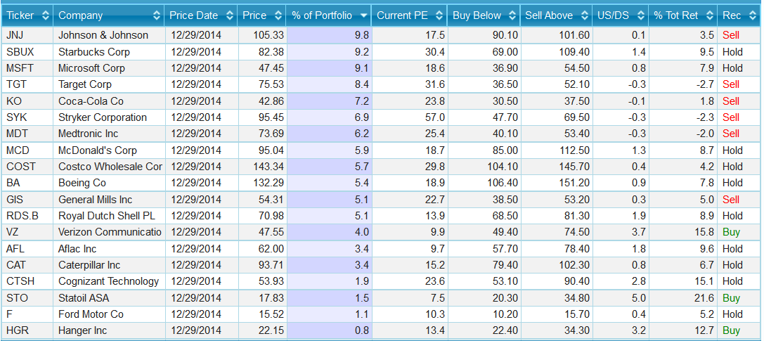
2. Diversification / Rebalance
Source: SSGPlus Portfolio Summary Report

Slide 7
2. Diversification & Rebalance
Stock as % of Portfolio
The ideal is equal weight. (100 divided by # of stocks)
    100 ÷ 19 = 5.3%
A Reasonable range is for each stock is .5 to 1.5 times equal weight
  Smallest Holding Threshold = .5 x 5.3% = 2.63%
  Largest Holding Threshold = 1.5 x 5.5% = 7.89%
12 members; Reasonable Range 2.5 – 8%
  Largest Holdings: JNJ (9.8%),
  SBUX (9.1%), TGT (8.4%)
  Smallest Holdings: HGR (.8%), F (1.1%),
  STO (1.5%), CTSH (1.9%)
Notes:
Most clubs try to keep it at 1 stock per member to follow. From that standpoint, 19 might be too many stocks for a club of 12.
Understand your small holdings. In this case, HGR & CTSH are recent positions the club has started to invest in. Club working to improve overall growth for portfolio. F & STO were “dart board” plays. (“gambling”). Okay to have a little bit (small %) of “fun” in a portfolio.

Slide 8
What to do about Imbalance
Large Holdings
  Sell ALL if significantly overvalued – PROFIT is not a dirty word.
  Sell a portion if not significantly overvalued.
  Don’t add to that position
Small Holdings
  Understand why a small holding – spinoff, building position, significant stock price decline (quality issues?)
  Sell ALL if not a quality stock.
  Add to the position if a quality stock.

Slide 9
2. Diversification & Rebalance
Source: Excel Spreadsheet

Slide 10
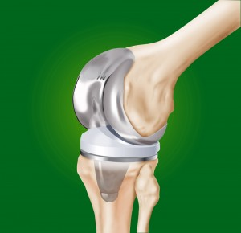

2. Diversification & Rebalance
Same Industry
SELL ONE? -- Keep the BEST!
Discount Stores
Medical Devices
Target – 8.4%
Costco – 5.7%
Medtronic – 6.2%
Stryker – 6.9%

Slide 11
2. Diversification & Rebalance
Size Diversification by Revenue
Sample Club:
99% in Large Companies
1% in Medium
Small (25%): <$1 billion in Sales
Medium (50%): $1 billion to $10 billion in Sales
Large (25%): > $10 billion in Sales

Slide 12
2. Diversification & Rebalance
Growth Diversification
Source: Excel Spreadsheet
Notes:
Large companies classified by revenues sometimes may change when classified by revenue growth. Nicholson talked by classification of companies by growth in his writings. Because earning follow sales this may also be an appropriate classification. Some larger companies may act like a smaller or mid-sized company when classified by sales growth.

Slide 13
3. Declining Fundamentals/
Not Meeting Your Expectations
Perhaps Most Important Reason to Sell
Remember generally EPS follows Sales, Price follows EPS
Tools
Stock Selection Guide – SSG
Quarterly Trend (aka PERT-A)
PERT Report

Slide 14
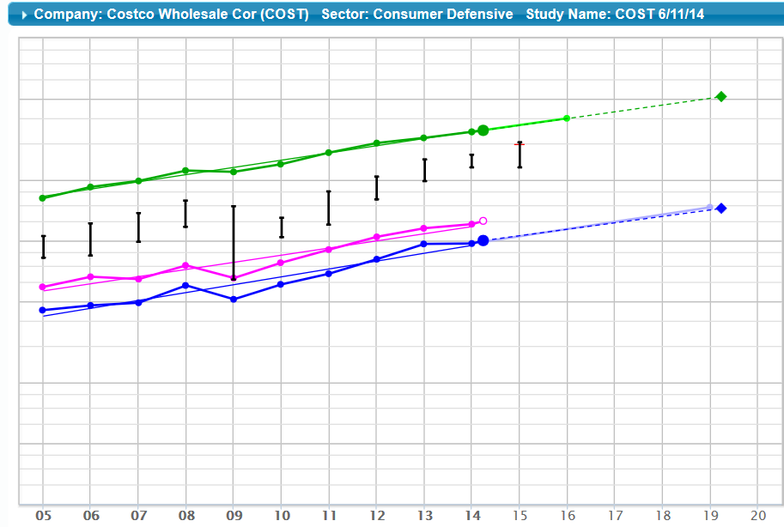
The Stock Selection Guide is a key tool to evaluate fundamentals and valuation
Notes:
COST

Slide 15
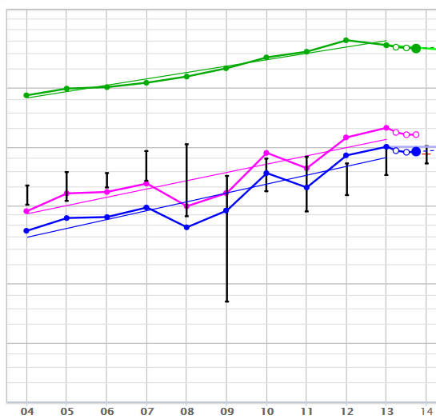
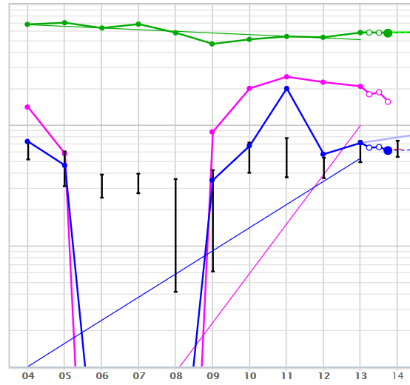
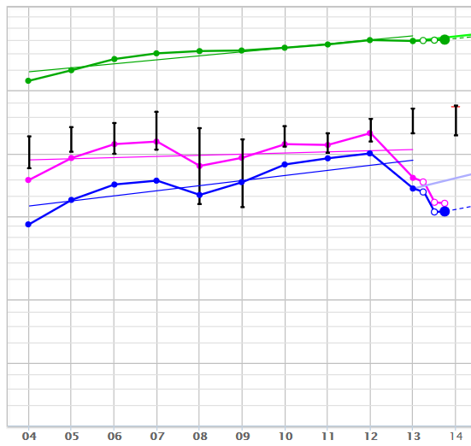
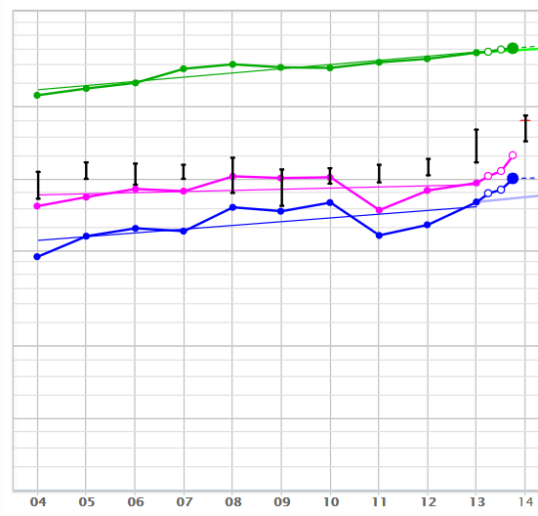
3. Declining Fundamentals on SSG
Notes:
Which of these graphs give you cause for concern?
Top Left =Aflac (AFL)
Top Right = Ford (F)
Bottom Left = Target (TGT)
Bottom Right = Johnson & Johnson (JNJ)

Slide 16
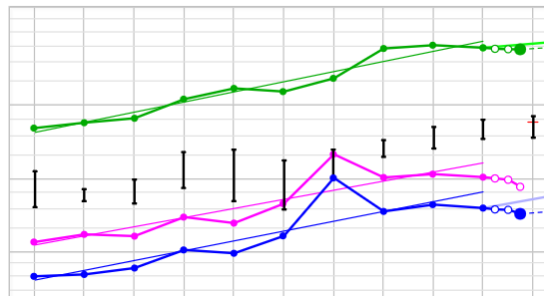
3. Declining Fundamentals Meeting Expectations?
Notes:
Coke (KO)

Slide 17
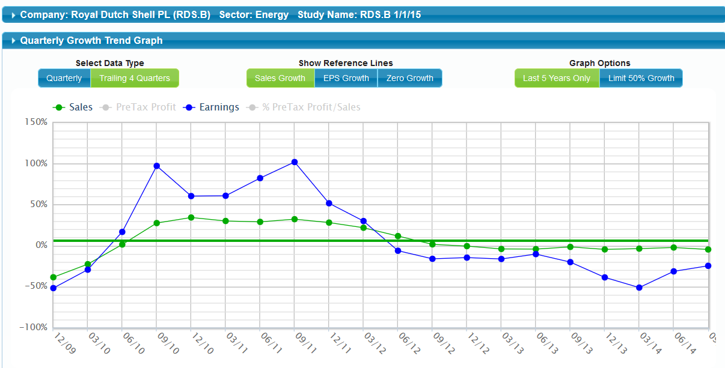
3. Declining Fundamentals
Quarterly Growth Trend
(aka PERT-A)

Slide 18
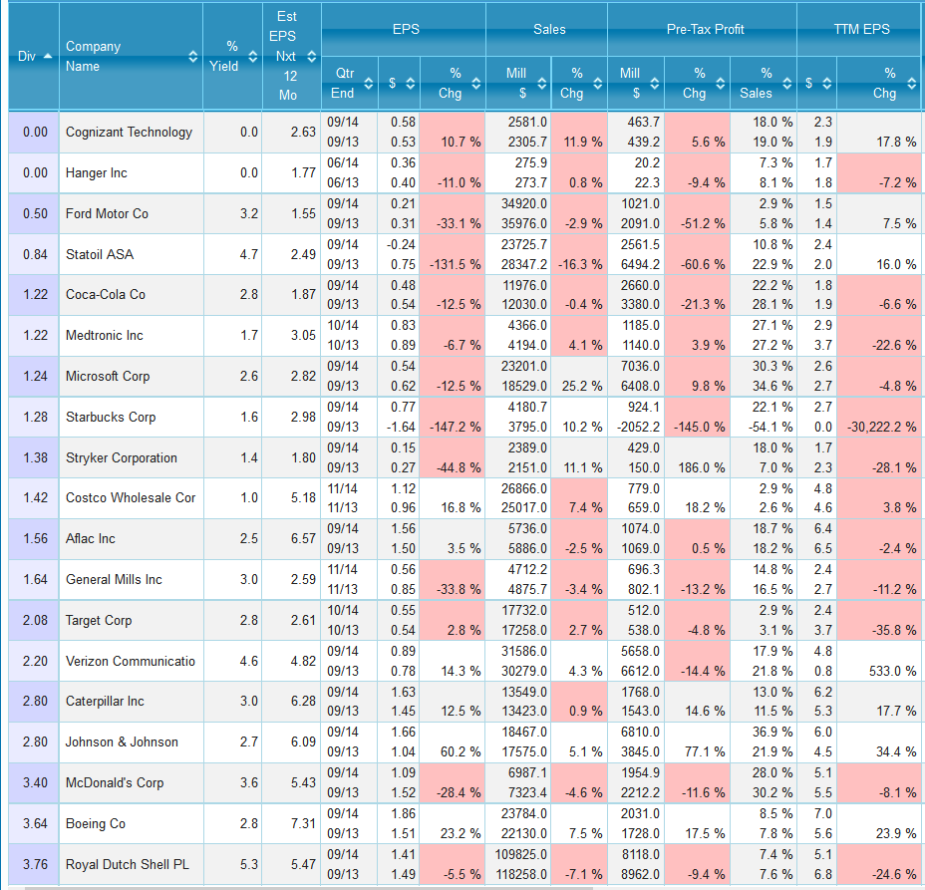
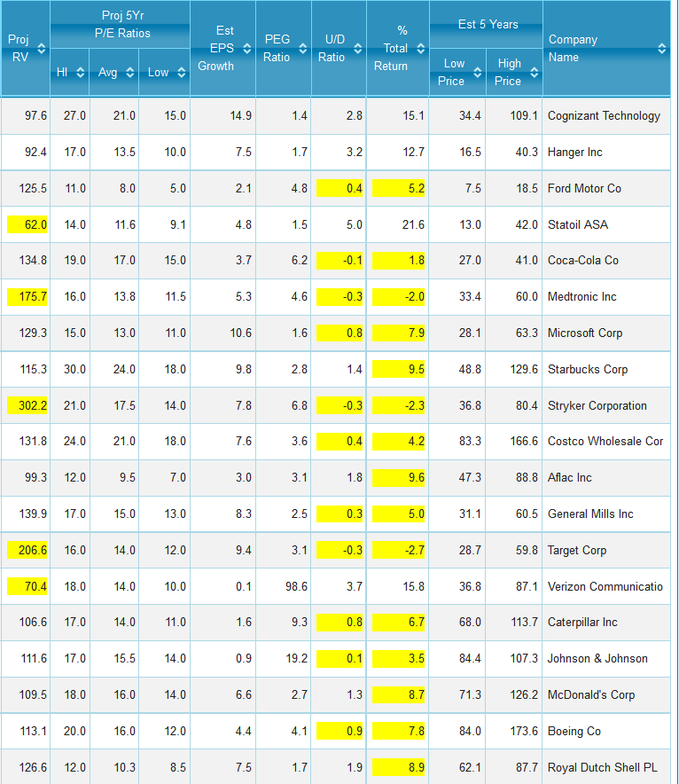
PERT Report
Quality
Valuation

Slide 19
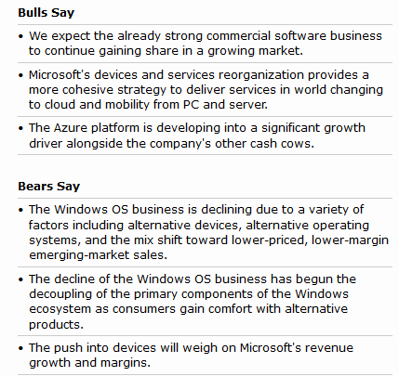
4. Significant Long-term
Bad News
Microsoft News –
Good or Bad?
Satya Nadella – New CEO – Enterprise Guy
Success at integrating Nokia handset purchase?
Decline of PC sales
Windows 8/Surface/Phone not successful
Source: Morningstar

Slide 20
5. Overpriced
Taking profits is a good thing
If you “love” the company, you can always buy it back again at a lower price. Consider selling at least a portion.
Tax consequences
Tools
SSG signals:
  High Current P/E (Toolkit: Relative Value: >150%)
  Upside/Downside Ratio < 1.0
  Low Potential Return (< 5%)
Value Line – The “Value Line” and Projected Total Return box

Slide 21
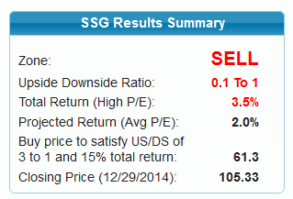
5. Overpriced
.1 U/D
Acceptable?
2.0 to 3.5% Return Acceptable?
JNJ

Slide 22
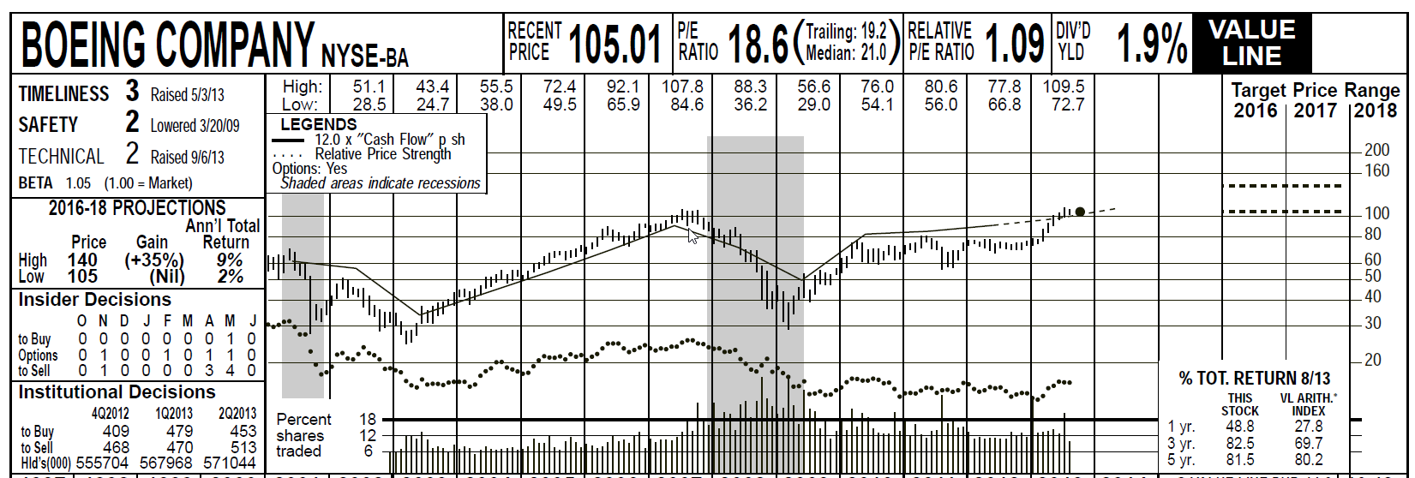
Overpriced?
The Recent Price and Projected Low Price are in the same price range. Does this leave room for acceptable future price appreciation potential?
Is the Low Projected Ann’l Total Return of 2% acceptable?
Historically, the Low Projection is the mostly likely outcome.

Slide 23
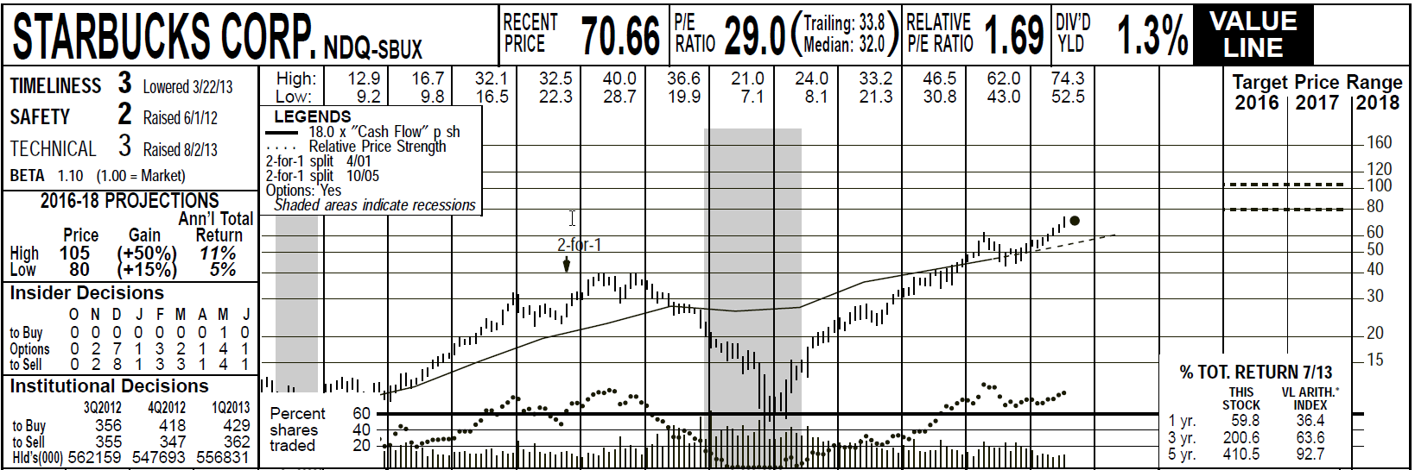
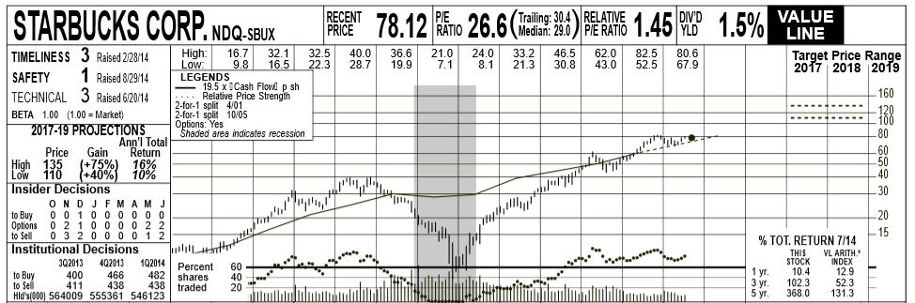
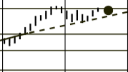
Overpriced?
The Value Line
8/30/2013
8/29/2014
When the black dot is floating above the Value Line it is an indicator of overvalue

Slide 24
6. Improve Portfolio Potential
Future Return
Look for the lowest potential returns and consider replacements.
Stock Comparison Guide can assist in decision making process

Slide 25
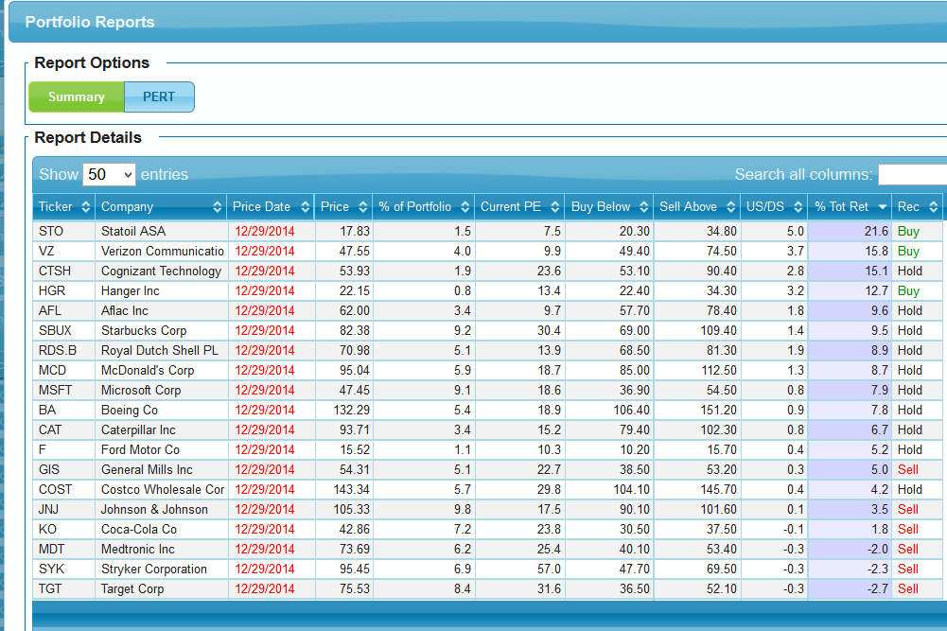
Notes:
You can also do this with the Portfolio Summary reports in Toolkit & Online SSG.

Slide 26
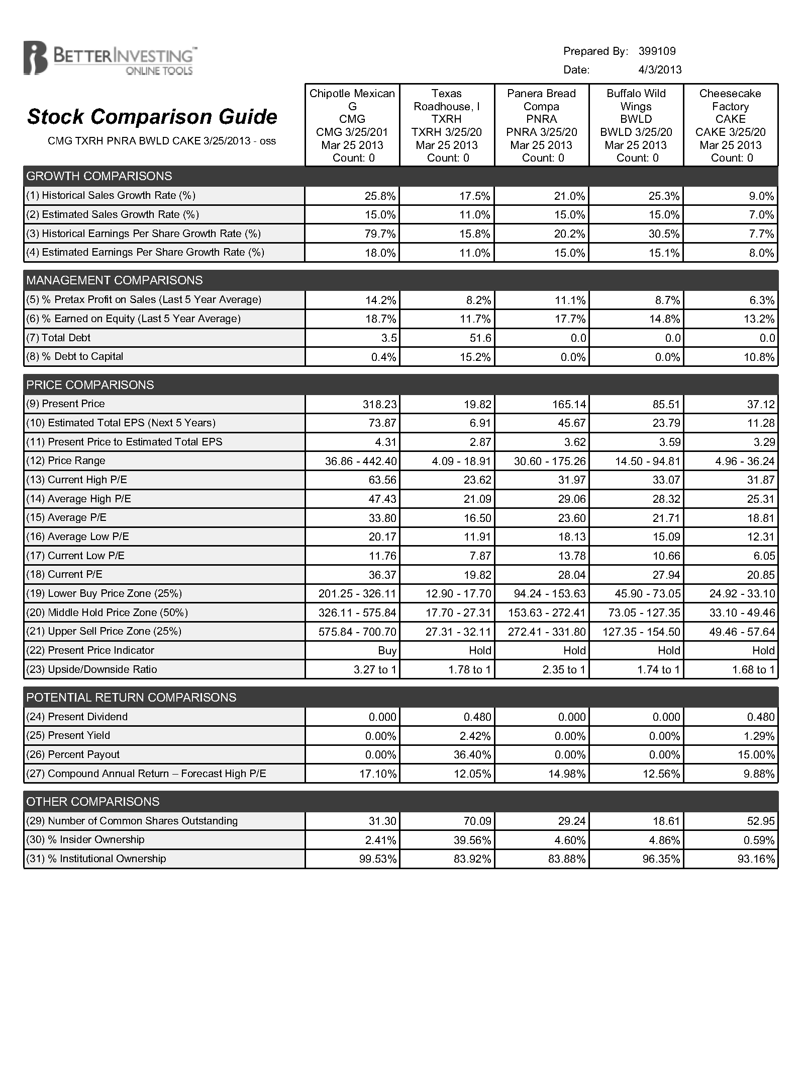

Slide 27
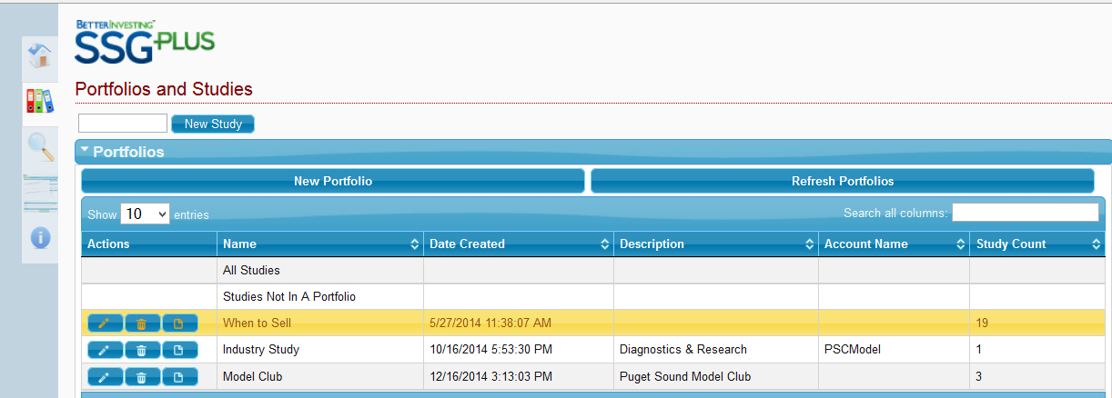
SSGPlus Portfolio Reports
Select Report Button

Slide 28
Bad Reasons for Not Selling
Emotional or psychological attachment.
You hate to take a loss.
You hate to admit to a mistake in the purchase.
Remember the “Rule of 5”…of 5 stocks you purchase, it’s likely that:
    1 will outperform
    3 do about as expected
    1 will underperform

Slide 29
When to Sell
You need the money
Diversification/Rebalance
Stock has declining fundamentals; not meeting your expectations
Significant long-term bad news
Stock is overvalued
Improve portfolio future potential return

Slide 30
Make A Difference
In Someone’s Life
If you have benefited from
BETTERINVESTING,
please pick up some
BETTERINVESTING
materials
and introduce others to this opportunity.
www.betterinvesting.org/investbetter

Slide 31

Questions?

