Slide 1

2024 Annual Meeting – 8/3/2024
Education Segment – Stock Splits and Finding Good Companies
Puget Sound Chapter
Carol Theine, President
Jim Willcox, President, Director
Craig Braemer, Vice-President, Director
craigbraemer1@gmail.com

Slide 2
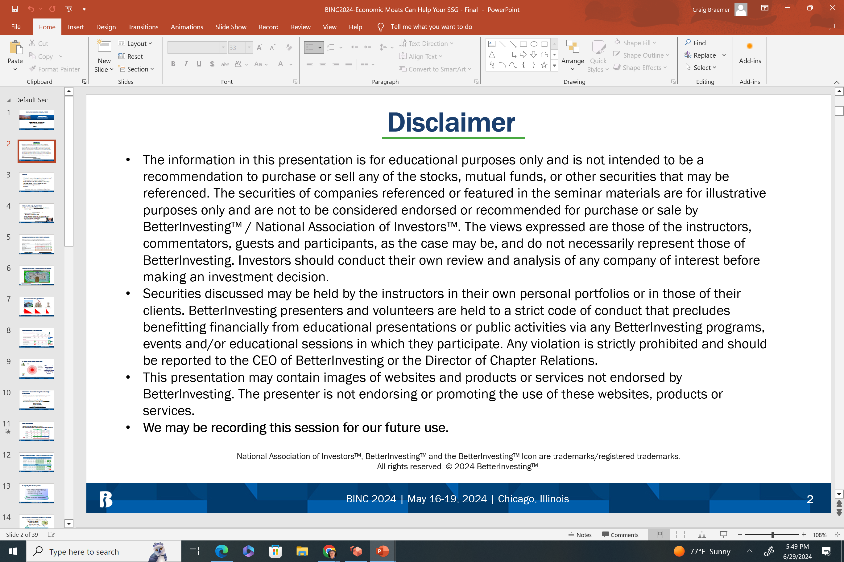
PRESENTATION DISCLAIMER
The information in this presentation is for educational purposes only and is not intended to be a recommendation to purchase or sell any of the stocks, mutual funds, or other securities that may be referenced. The securities of companies referenced or featured in the seminar materials are for illustrative purposes only and are not to be considered endorsed or recommended for purchase or sale by BetterInvesting™ / National Association of Investors™. The views expressed are those of the instructors, commentators, guests and participants, as the case may be, and do not necessarily represent those of BetterInvesting. Investors should conduct their own review and analysis of any company of interest before making an investment decision.
Securities discussed may be held by the instructors in their own personal portfolios or in those of their clients. BetterInvesting presenters and volunteers are held to a strict code of conduct that precludes benefitting financially from educational presentations or public activities via any BetterInvesting programs, events and/or educational sessions in which they participate. Any violation is strictly prohibited and should be reported to the CEO of BetterInvesting or the Director of Chapter Relations.
This presentation may contain images of websites and products or services not endorsed by BetterInvesting. The presenter is not endorsing or promoting the use of these websites, products or services.
We may be recording this session for our future use.

Slide 3
BetterInvesting Mission
The BetterInvesting mission is to provide a program of sound investment information, education and support that helps create successful lifetime investors.
BetterInvesting is a registered charitable non-profit educational organization founded in 1951.

Slide 4
Agenda
BetterInvesting background
Education – Stock Splits
Education – Identifying Good Companies
Annual meeting
Voting for directors
Summary
How do we help clubs and our individual investors better? This is our daily goal.

Slide 5
San Francisco Bay Area Chapter
The San Francisco Bay Area Chapter (SFBAC) serves clubs and individual members in the San Francisco, Oakland, Walnut Creek, San Mateo, San Rafael, Santa Rosa, Napa, Vallejo, Eureka, Menlo Park, Napa and Pleasanton.
SFBAC board members are unpaid volunteers with a passion for assisting and
educating local clubs and individual investors.

Slide 6
Upcoming Events
www.betterinvesting.org/chapters/san-francisco-bay-area/local-events
SF Model Club meetings – 2nd Thursday of the month at 6:45 pm. All meetings are virtual.
Upcoming event – October Education event. Look for emails or the above website for more details.
SF Board meetings – 2nd Tuesday of the month at 7:30. Help guide your local chapter of investors. All meetings are virtual.

Slide 7

Stock Splits
Identifying Good Companies
Education Segment
Sub-Title
Presented By:
Kweli Lewis and Craig Braemer CFP® CFA®
Directors, San Francisco Chapter
August 3, 2024
WWW.BETTERINVESTING.ORG
Notes:
Before the event, remember to preview the PowerPoint deck and read the narrative note provided under each slide.
Also, there are several slides which need your input. Complete this before the event. Just highlight and start typing:
Title Slide 1: Enter your name, position, and chapter affiliation
Slide 45: If you have a model investment club, enter the date and time of your meetings along with contact information
Finally, some notes mention “Key Takeaways” or other information. These bits of information can be used to enhance the program to start a discussion, or have interaction with the attendees. (For instance, Slide numbers 8, 9, 15 and 24 have examples of this in the notes.) These have not been included in the voice recording.
At the event, introduce yourself and other BI volunteers that may be attending. Share a personal investing story about how BI has helped you, and how you want to give back. Ask that they sign the Event Attendance sheet, which is usually a requirement for MSW programs.
Don’t forget to order BI marketing materials, magazines, and the 90-Day Digital SSG Offer for them to freely pick up from an information table.
“Make It Yours” – Have fun and best wishes for a good event.
NOTE - there will be a 5-second lag between these opening instructions and the beginning of Slide 1 narrative to allow you to set the PPT program to this opening slide.
The narrative starts here:
Welcome Everyone to this BetterInvesting PowerPoint presentation of “Why Invest in Stocks.” At the end of the program, please help yourself to materials that are on the Information Table.

Slide 8
PRESENTATION DISCLAIMER
The information in this presentation is for educational purposes only and is not intended to be a recommendation to purchase or sell any of the stocks, mutual funds, or other securities that may be referenced. The securities of companies referenced or featured in the seminar materials are for illustrative purposes only and are not to be considered endorsed or recommended for purchase or sale by BetterInvesting™ / National Association of Investors™. The views expressed are those of the instructors, commentators, guests and participants, as the case may be, and do not necessarily represent those of BetterInvesting. Investors should conduct their own review and analysis of any company of interest before making an investment decision.
Securities discussed may be held by the instructors in their own personal portfolios or in those of their clients. BetterInvesting presenters and volunteers are held to a strict code of conduct that precludes benefitting financially from educational presentations or public activities via any BetterInvesting programs, events and/or educational sessions in which they participate. Any violation is strictly prohibited and should be reported to the CEO of BetterInvesting or the Director of Chapter Relations.
This presentation may contain images of websites and products or services not endorsed by BetterInvesting. The presenter is not endorsing or promoting the use of these websites, products or services.
We may be recording this session for our future use.

Slide 9
Content
Stock splits
  Recent large split - CMG
  What are they and why do they happen?
  Should you care?
Identifying good companies
  What to look for and why?
  Review several companies Section 1 + 2
Summary
Questions, reach me at Craigbraemer1@gmail.com

Slide 10
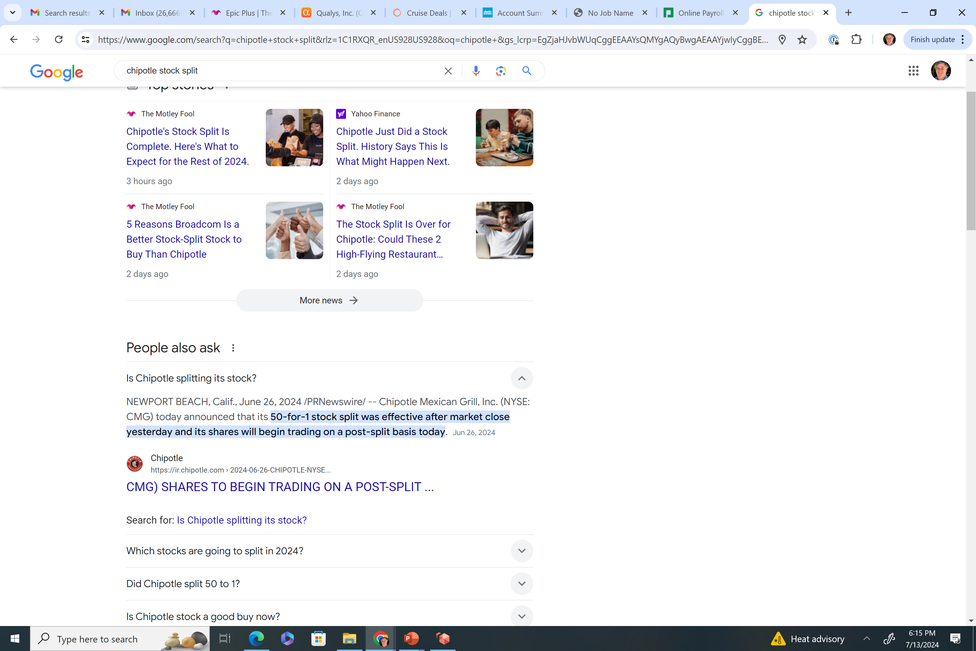
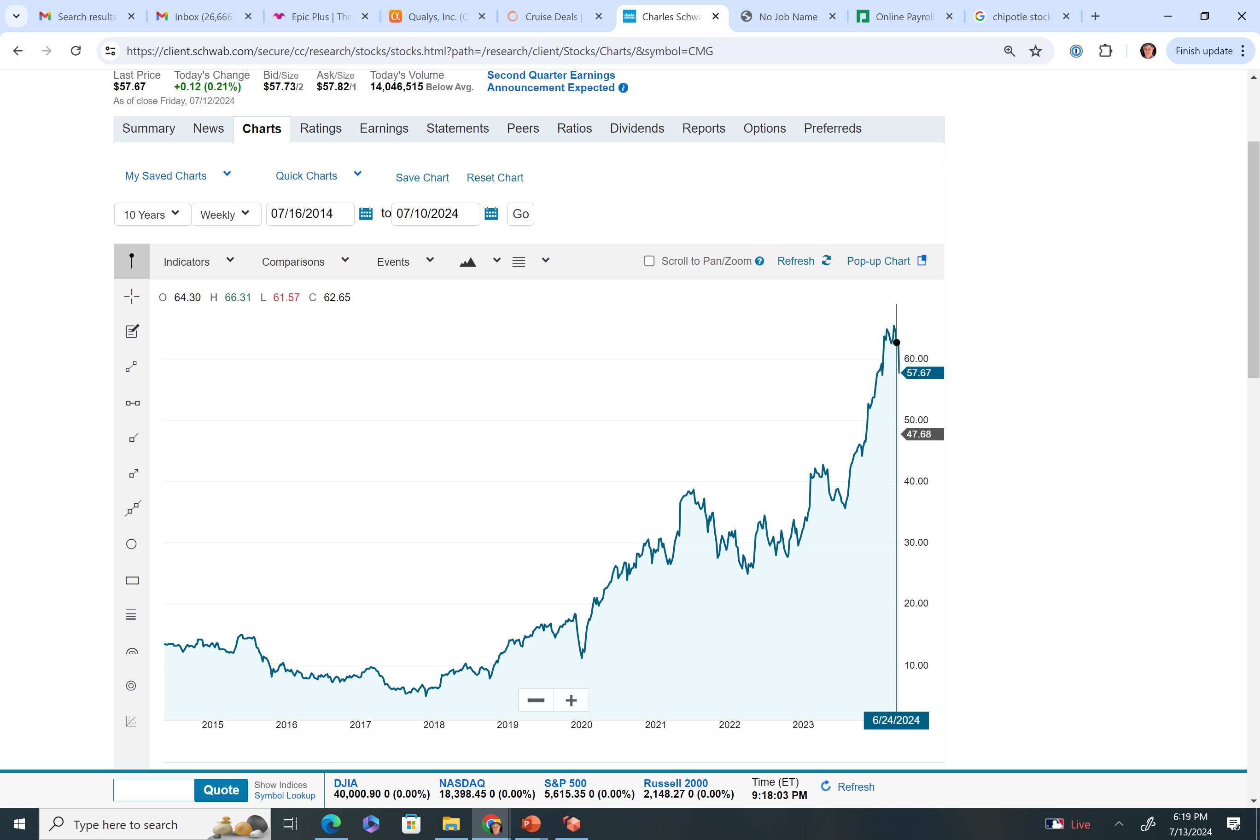
Chipotle Splits it Stock
CMG has been a good stock for the past 10 years.
Source: June 26, 2024 /PRNewswire/ -- Chipotle Mexican Grill, Inc..
Securities are for educational purposes only

Slide 11
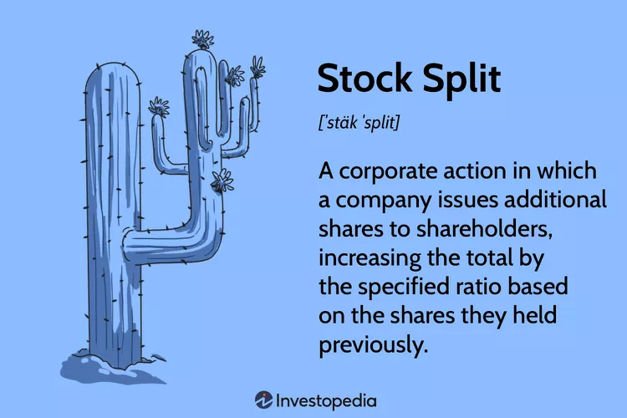
What Is A Stock Split?
The most common split ratios are 2-for-1 or 3-for-1 (sometimes denoted as 2:1 or 3:1). This means for every share held before the split, each stockholder will have two or three shares, respectively, after the split.
Source: Investopedia / Lara Antal. May 30, 2024..
Securities are for educational purposes only
Notes:
Go into Moats and castles and that moats are competitive advantages that helps protect them from competition. and every company is a castle and how big is their moat? A company is like a castle with a moat.

Slide 12
Stock Split Mechanics or The Math
The process of a stock split is expensive and requires legal oversight. It is approved by the Board.
Securities are for educational purposes only
Notes:
Go into Moats and castles and that moats are competitive advantages that helps protect them from competition. and every company is a castle and how big is their moat? A company is like a castle with a moat.

Slide 13
Thoughts About A Stock Split?
A stock split doesn't fundamentally change anything about a business.
Its financials remain the same.
The stock's earnings multiples are the same.
A company elects to perform a stock split to intentionally lower the price of a single share, making the company's stock more affordable.
More shares outstanding can result in greater liquidity, which facilitates trading.
There are also reverse stock splits.
Securities are for educational purposes only

Slide 14
Investing before or after the split?
Some investors will buy/invest in the company before the stock actually splits, which bids the price up.
However, after the split, some stocks tend to sell off (some not all).
You should not simply buy the stock because of the split.
Still do your research (First cut, SSG, Valueline etc.) before investing in the stock regardless of the split. Does the growth rate remain the same?

Slide 15
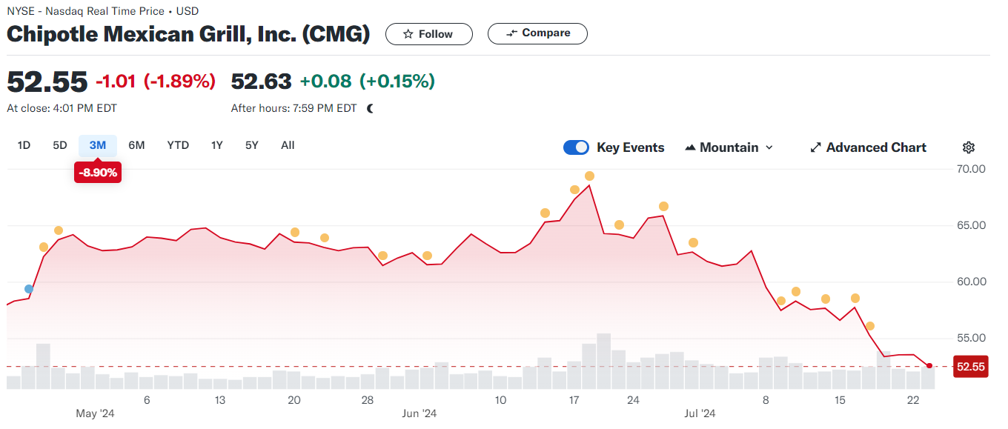
CMG- Post Stock Split 6-26-24

Slide 16
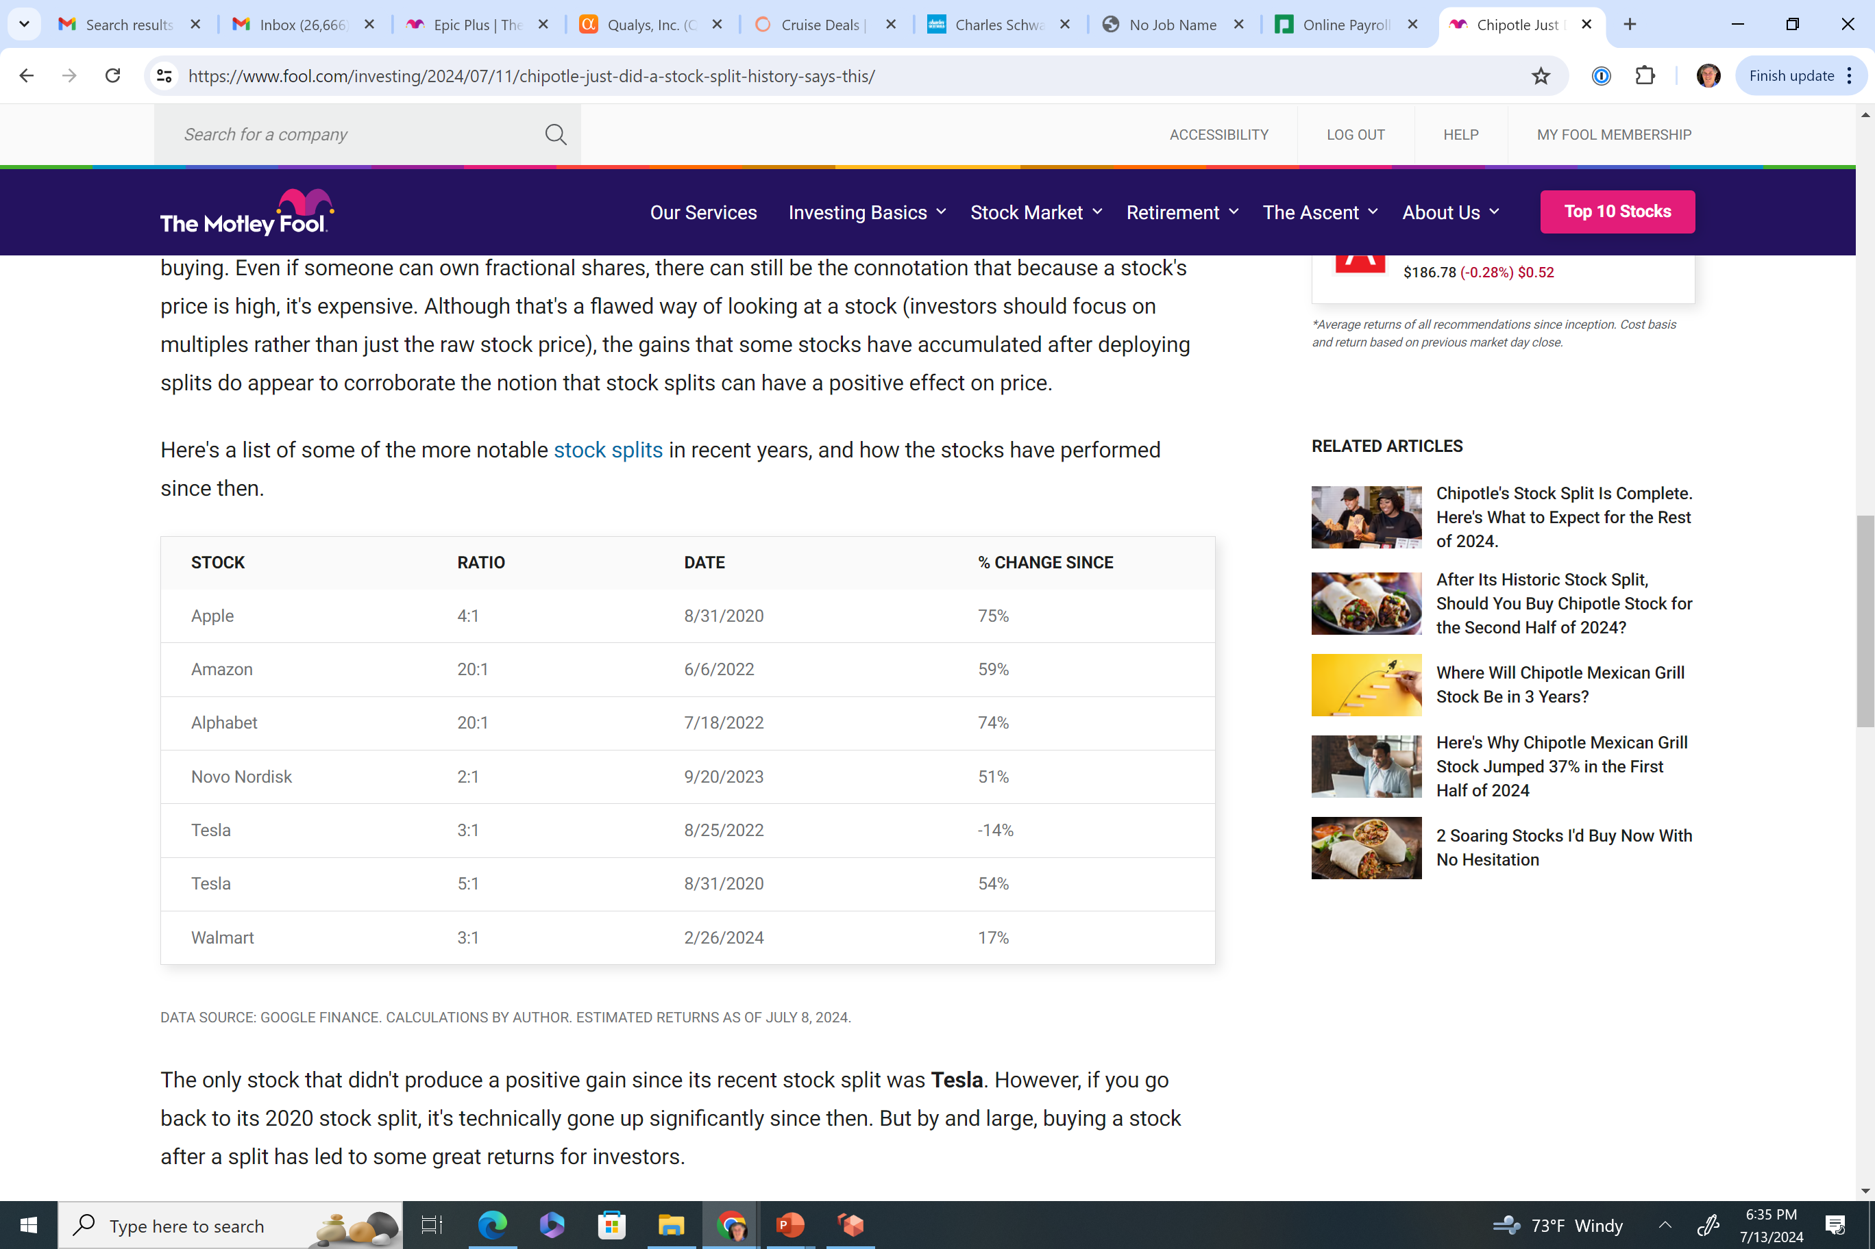
Recent Market Studies Show a Stock Market Benefit
Selective notable splits in recent years.
Source: ATA SOURCE: GOOGLE FINANCE. CALCULATIONS BY AUTHOR. ESTIMATED RETURNS AS OF JULY 8, 2024.
Securities are for educational purposes only
Notes:
But by and large, buying a stock after a split has led to some great returns for investors.

Slide 17
Positives Of A Stock Split
A stock split might be seen by some as a company with a big growth future.
A split could indicate executive-level confidence in the prospect of a company.
It could be a positive sign that a business is doing well as the Board of Directors approves the split.
The gains that some stocks have shown recently after a split show the potentially positive effect for investors.
Securities are for educational purposes only
Notes:
Let’s see that data

Slide 18
Summary
A stock split doesn't fundamentally change a business. Its financials remain the same.
A split could indicate executive-level confidence in the prospect of a company and is approved by the Board of Directors.
Recent data has show positive stock market reaction to a stock split.
Notes:
Go into Moats and castles and that moats are competitive advantages that helps protect them from competition. and every company is a castle and how big is their moat? A company is like a castle with a moat.

Slide 19

Question Time

Slide 20
Identifying Good Companies
Our hope is to find these kinds of stock.
Source: June 26, 2024 /PRNewswire/ -- Chipotle Mexican Grill, Inc..
Securities are for educational purposes only

Slide 21
Focus On High Quality Stocks
SSG Sections 1 & 2 are good at analyzing and finding high quality growth stocks
Section 1 – looks for growth companies.
Section 2 – looks for companies with strong financials and low debt loads.
Let’s run through some stocks!
Securities are for educational purposes only

Slide 22
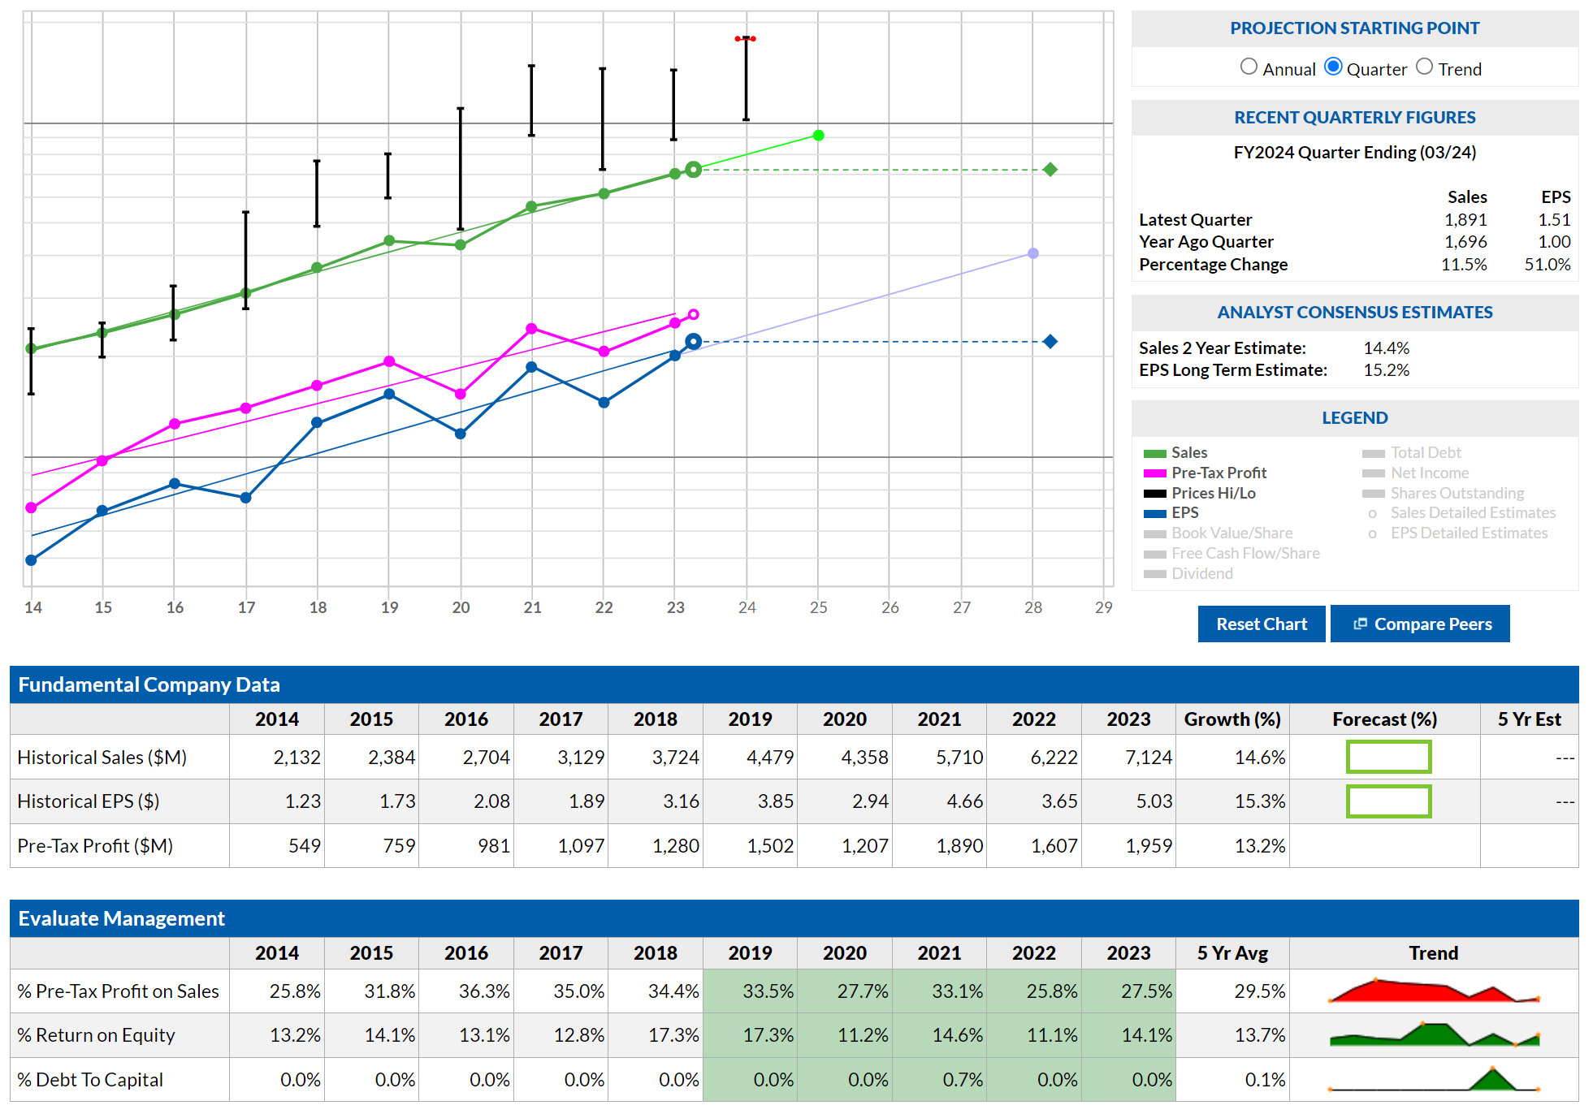
Stock #1 – ISRG – Intuitive Surgical

Slide 23
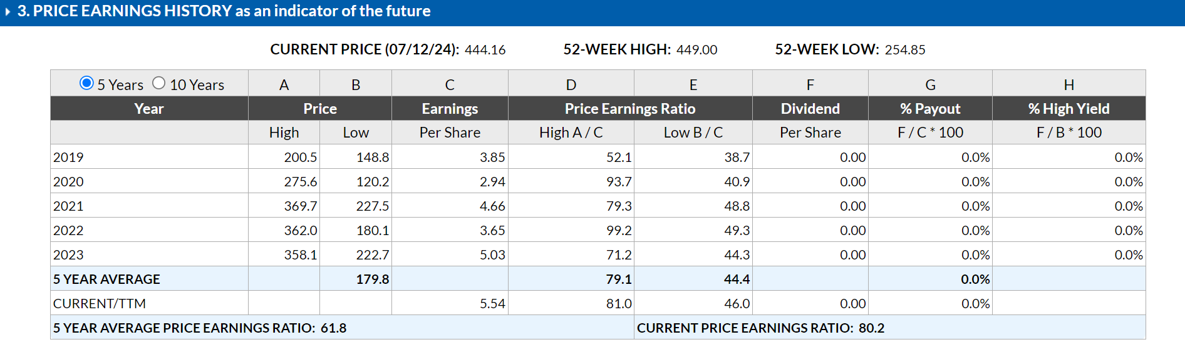
Stock #1 – Intuitive Surgical - ISRG
A Problem?
In the short term, valuation could be a problem, thus you will have to pick your spots to buy a high quality company like ISRG.
Securities are for educational purposes only

Slide 24
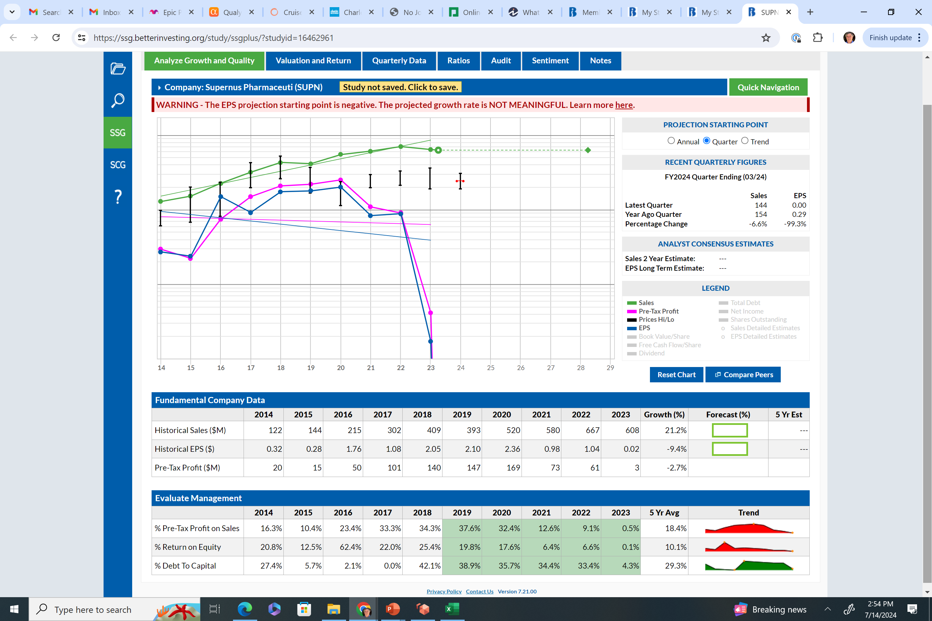
Stock #2 –Supernus - SUPN
Securities are for educational purposes only

Slide 25
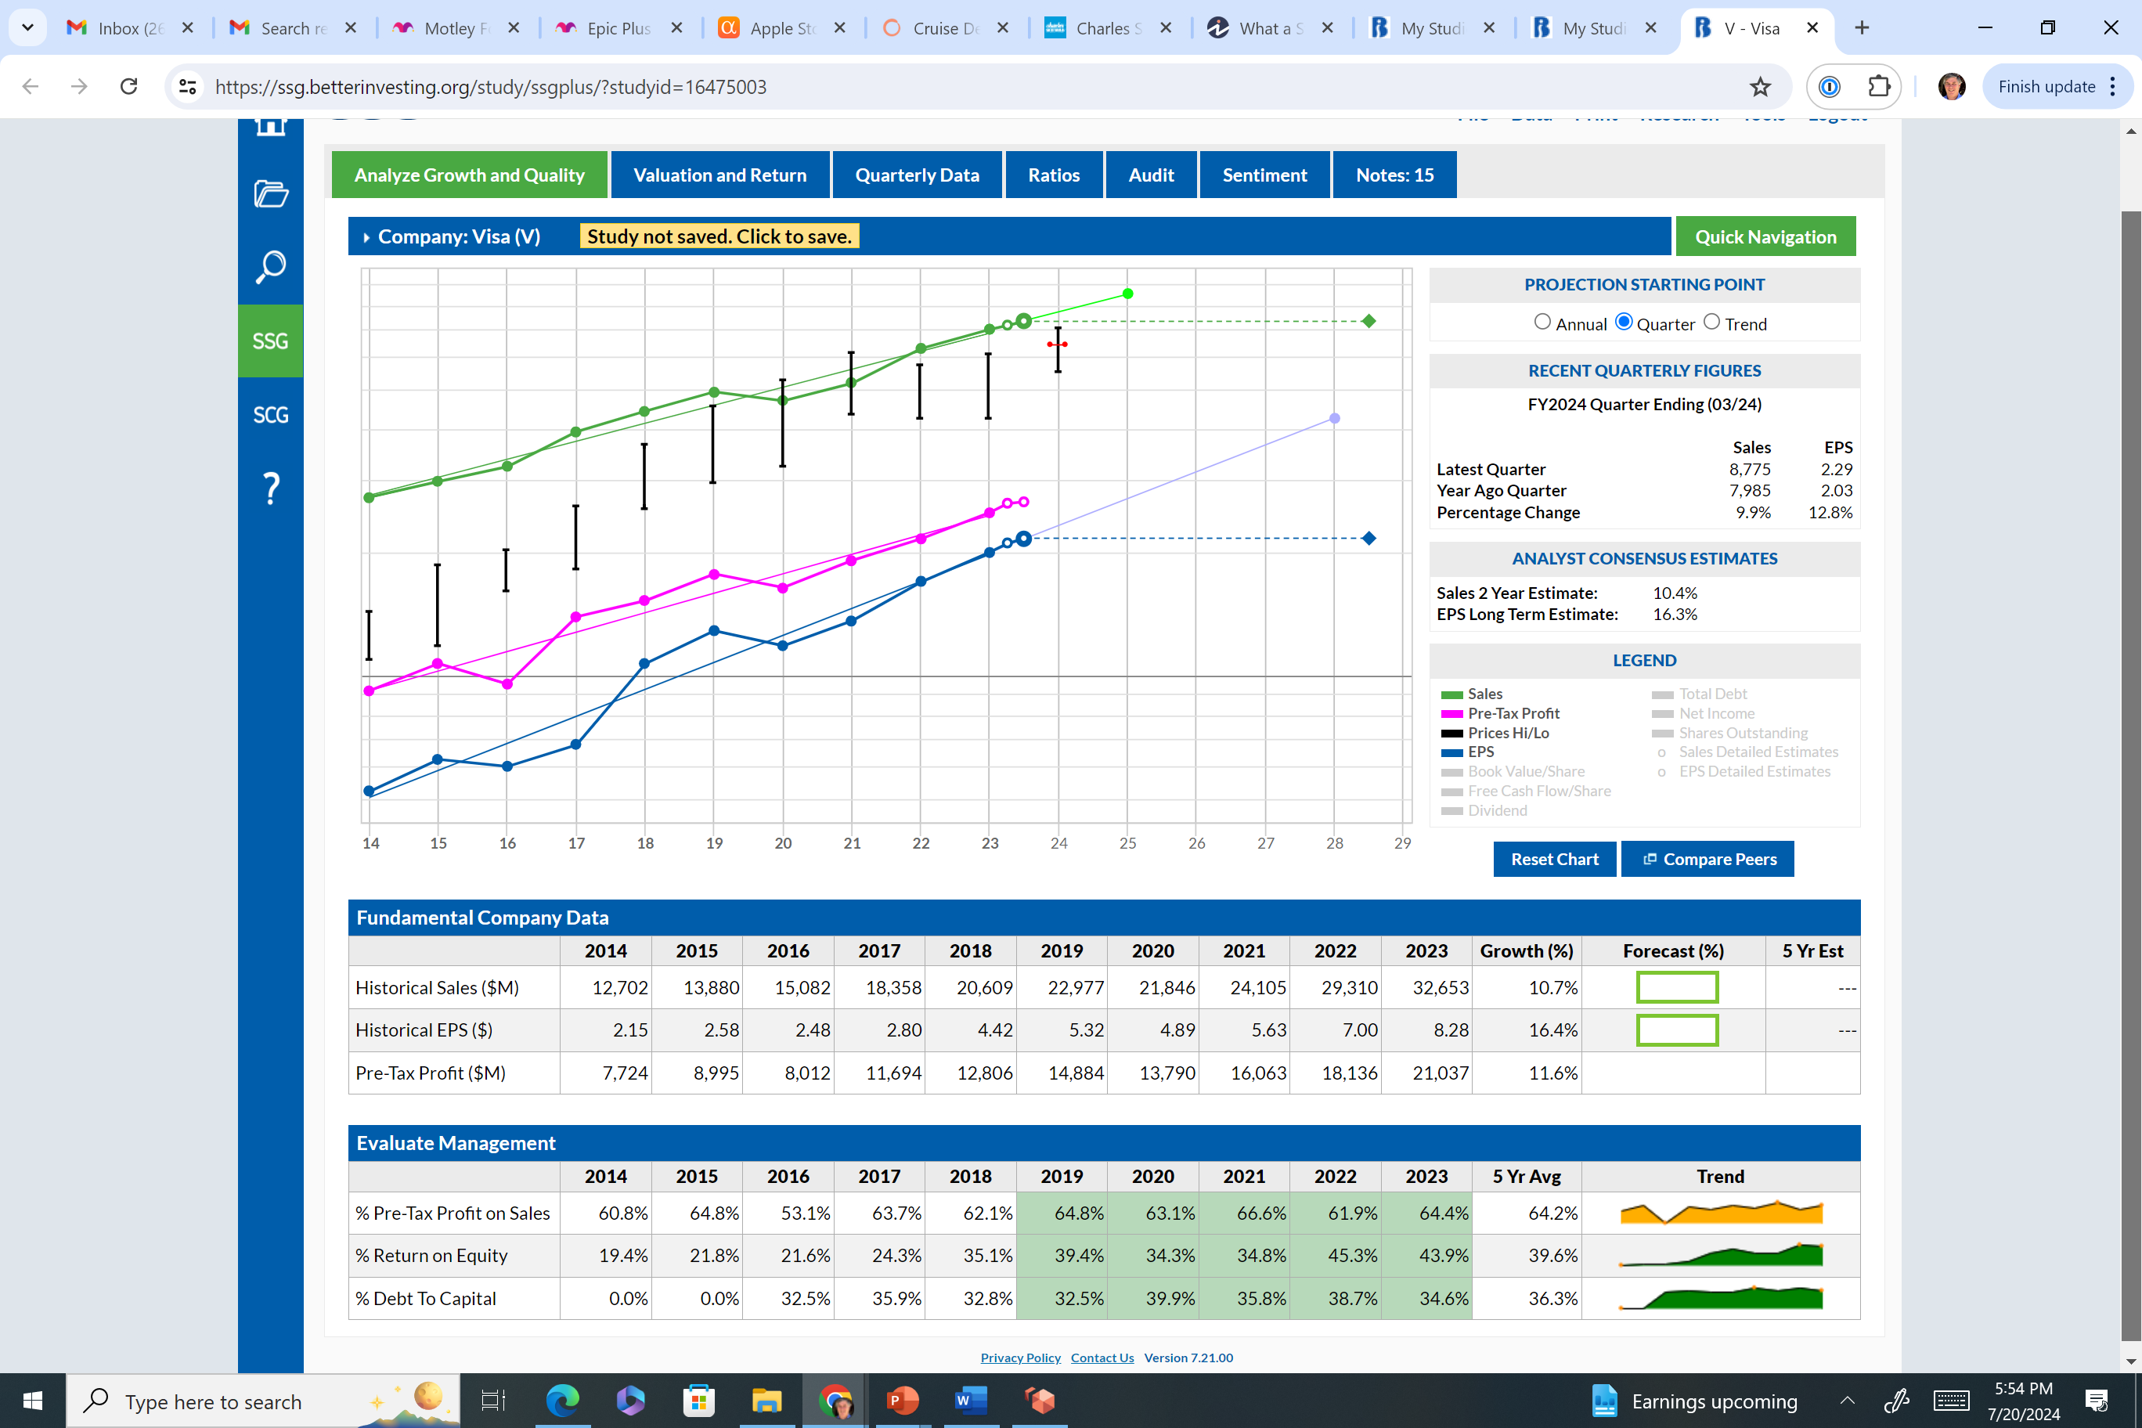
Stock #3 – Visa - V
Securities are for educational purposes only

Slide 26
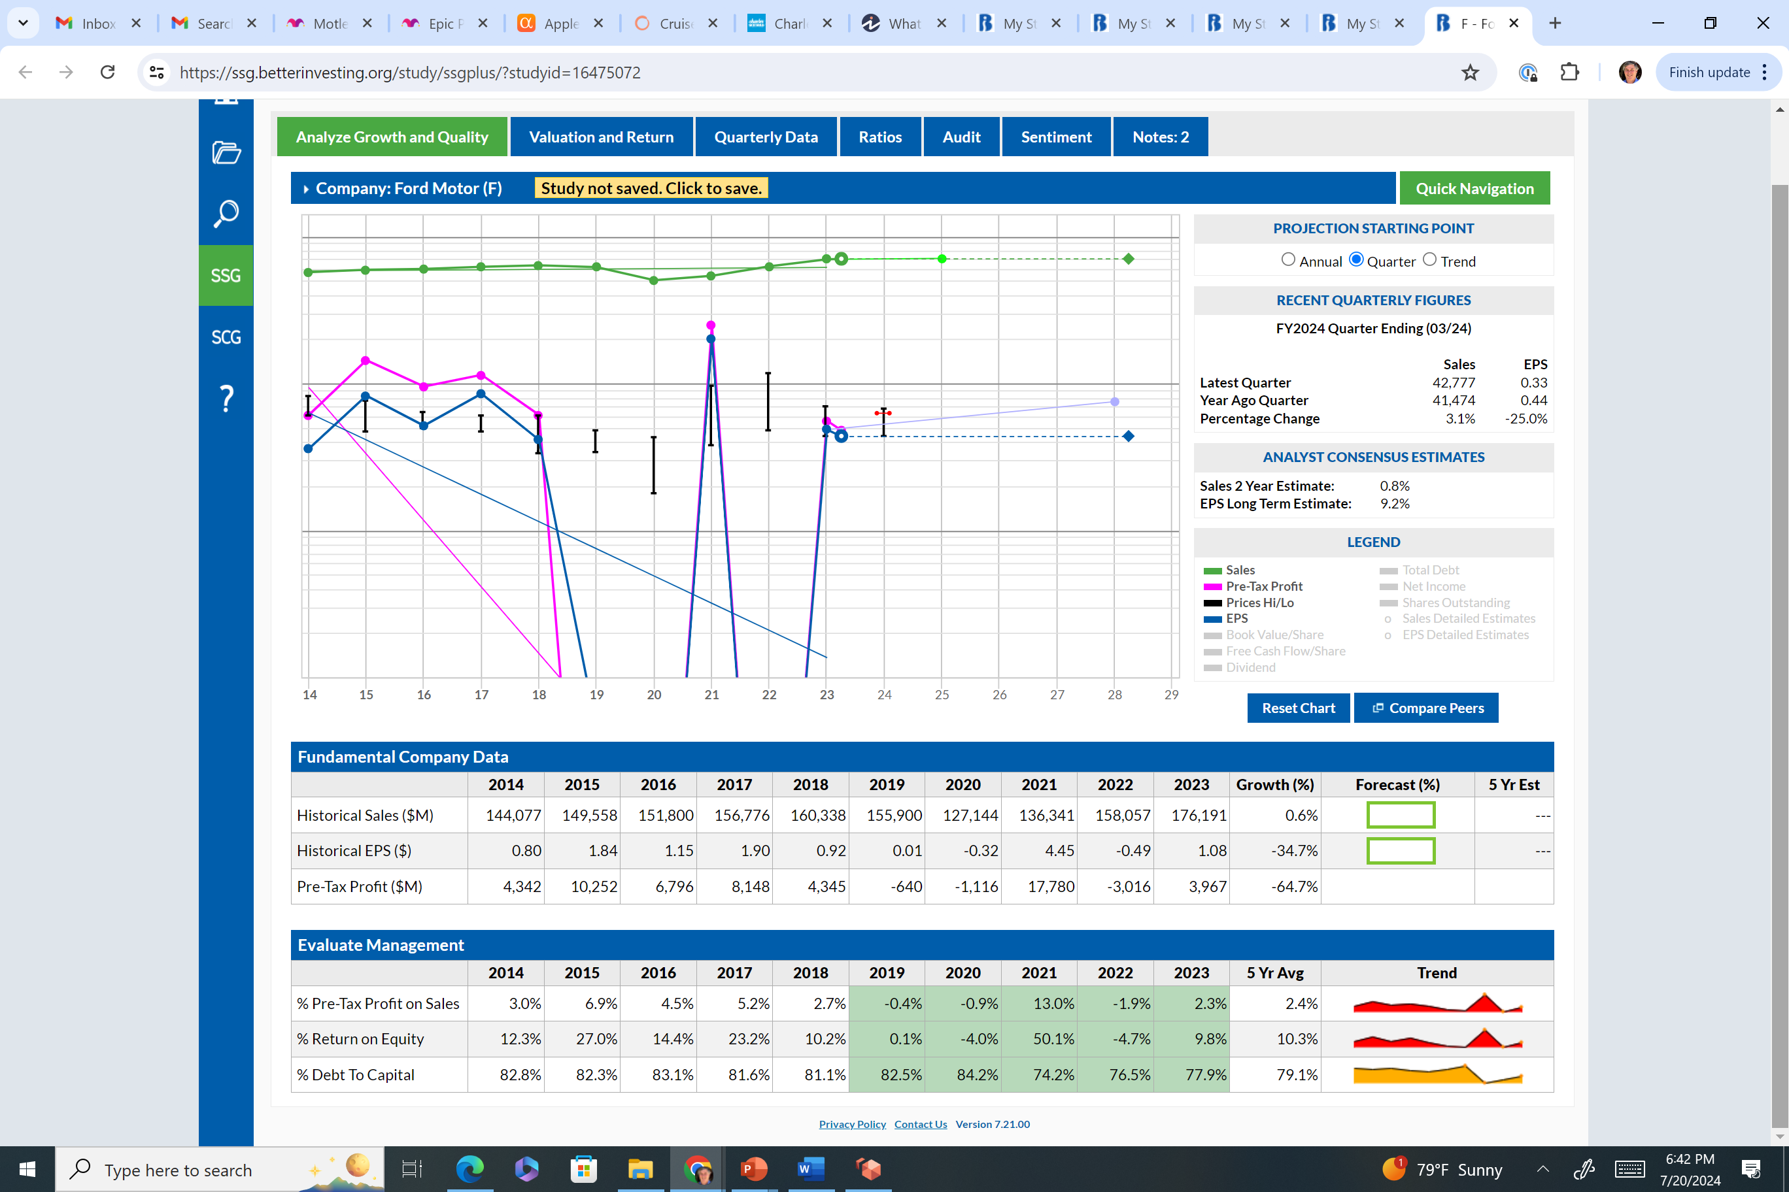
Stock #4 – Ford Motor - F
Securities are for educational purposes only

Slide 27
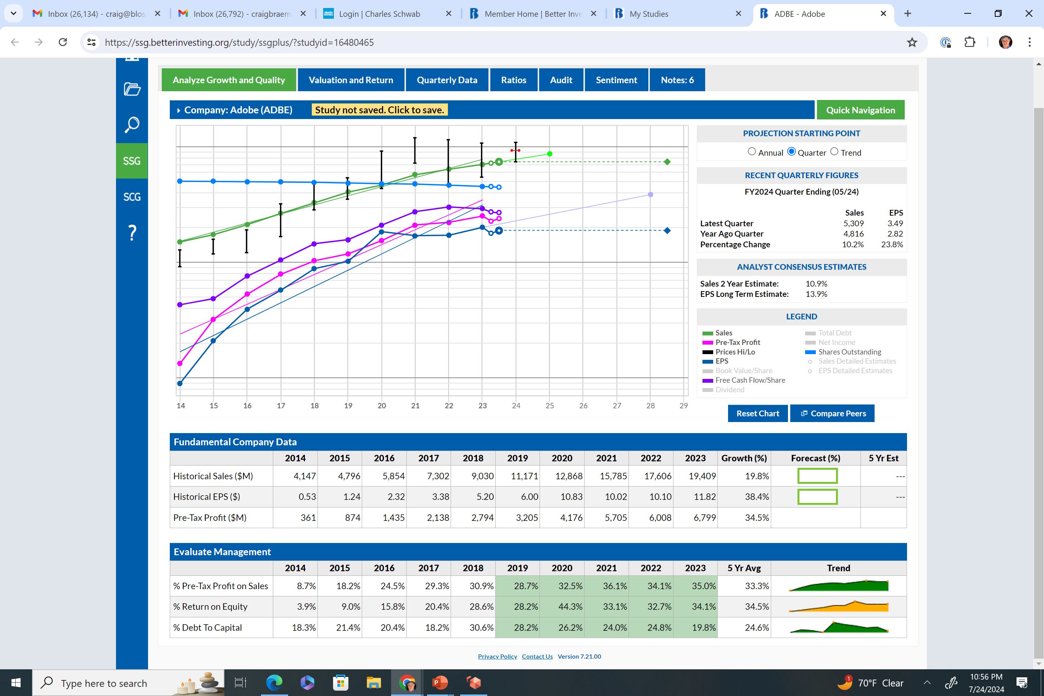
Stock #5 Advanced – Adobe - ADBE
Securities are for educational purposes only

Slide 28
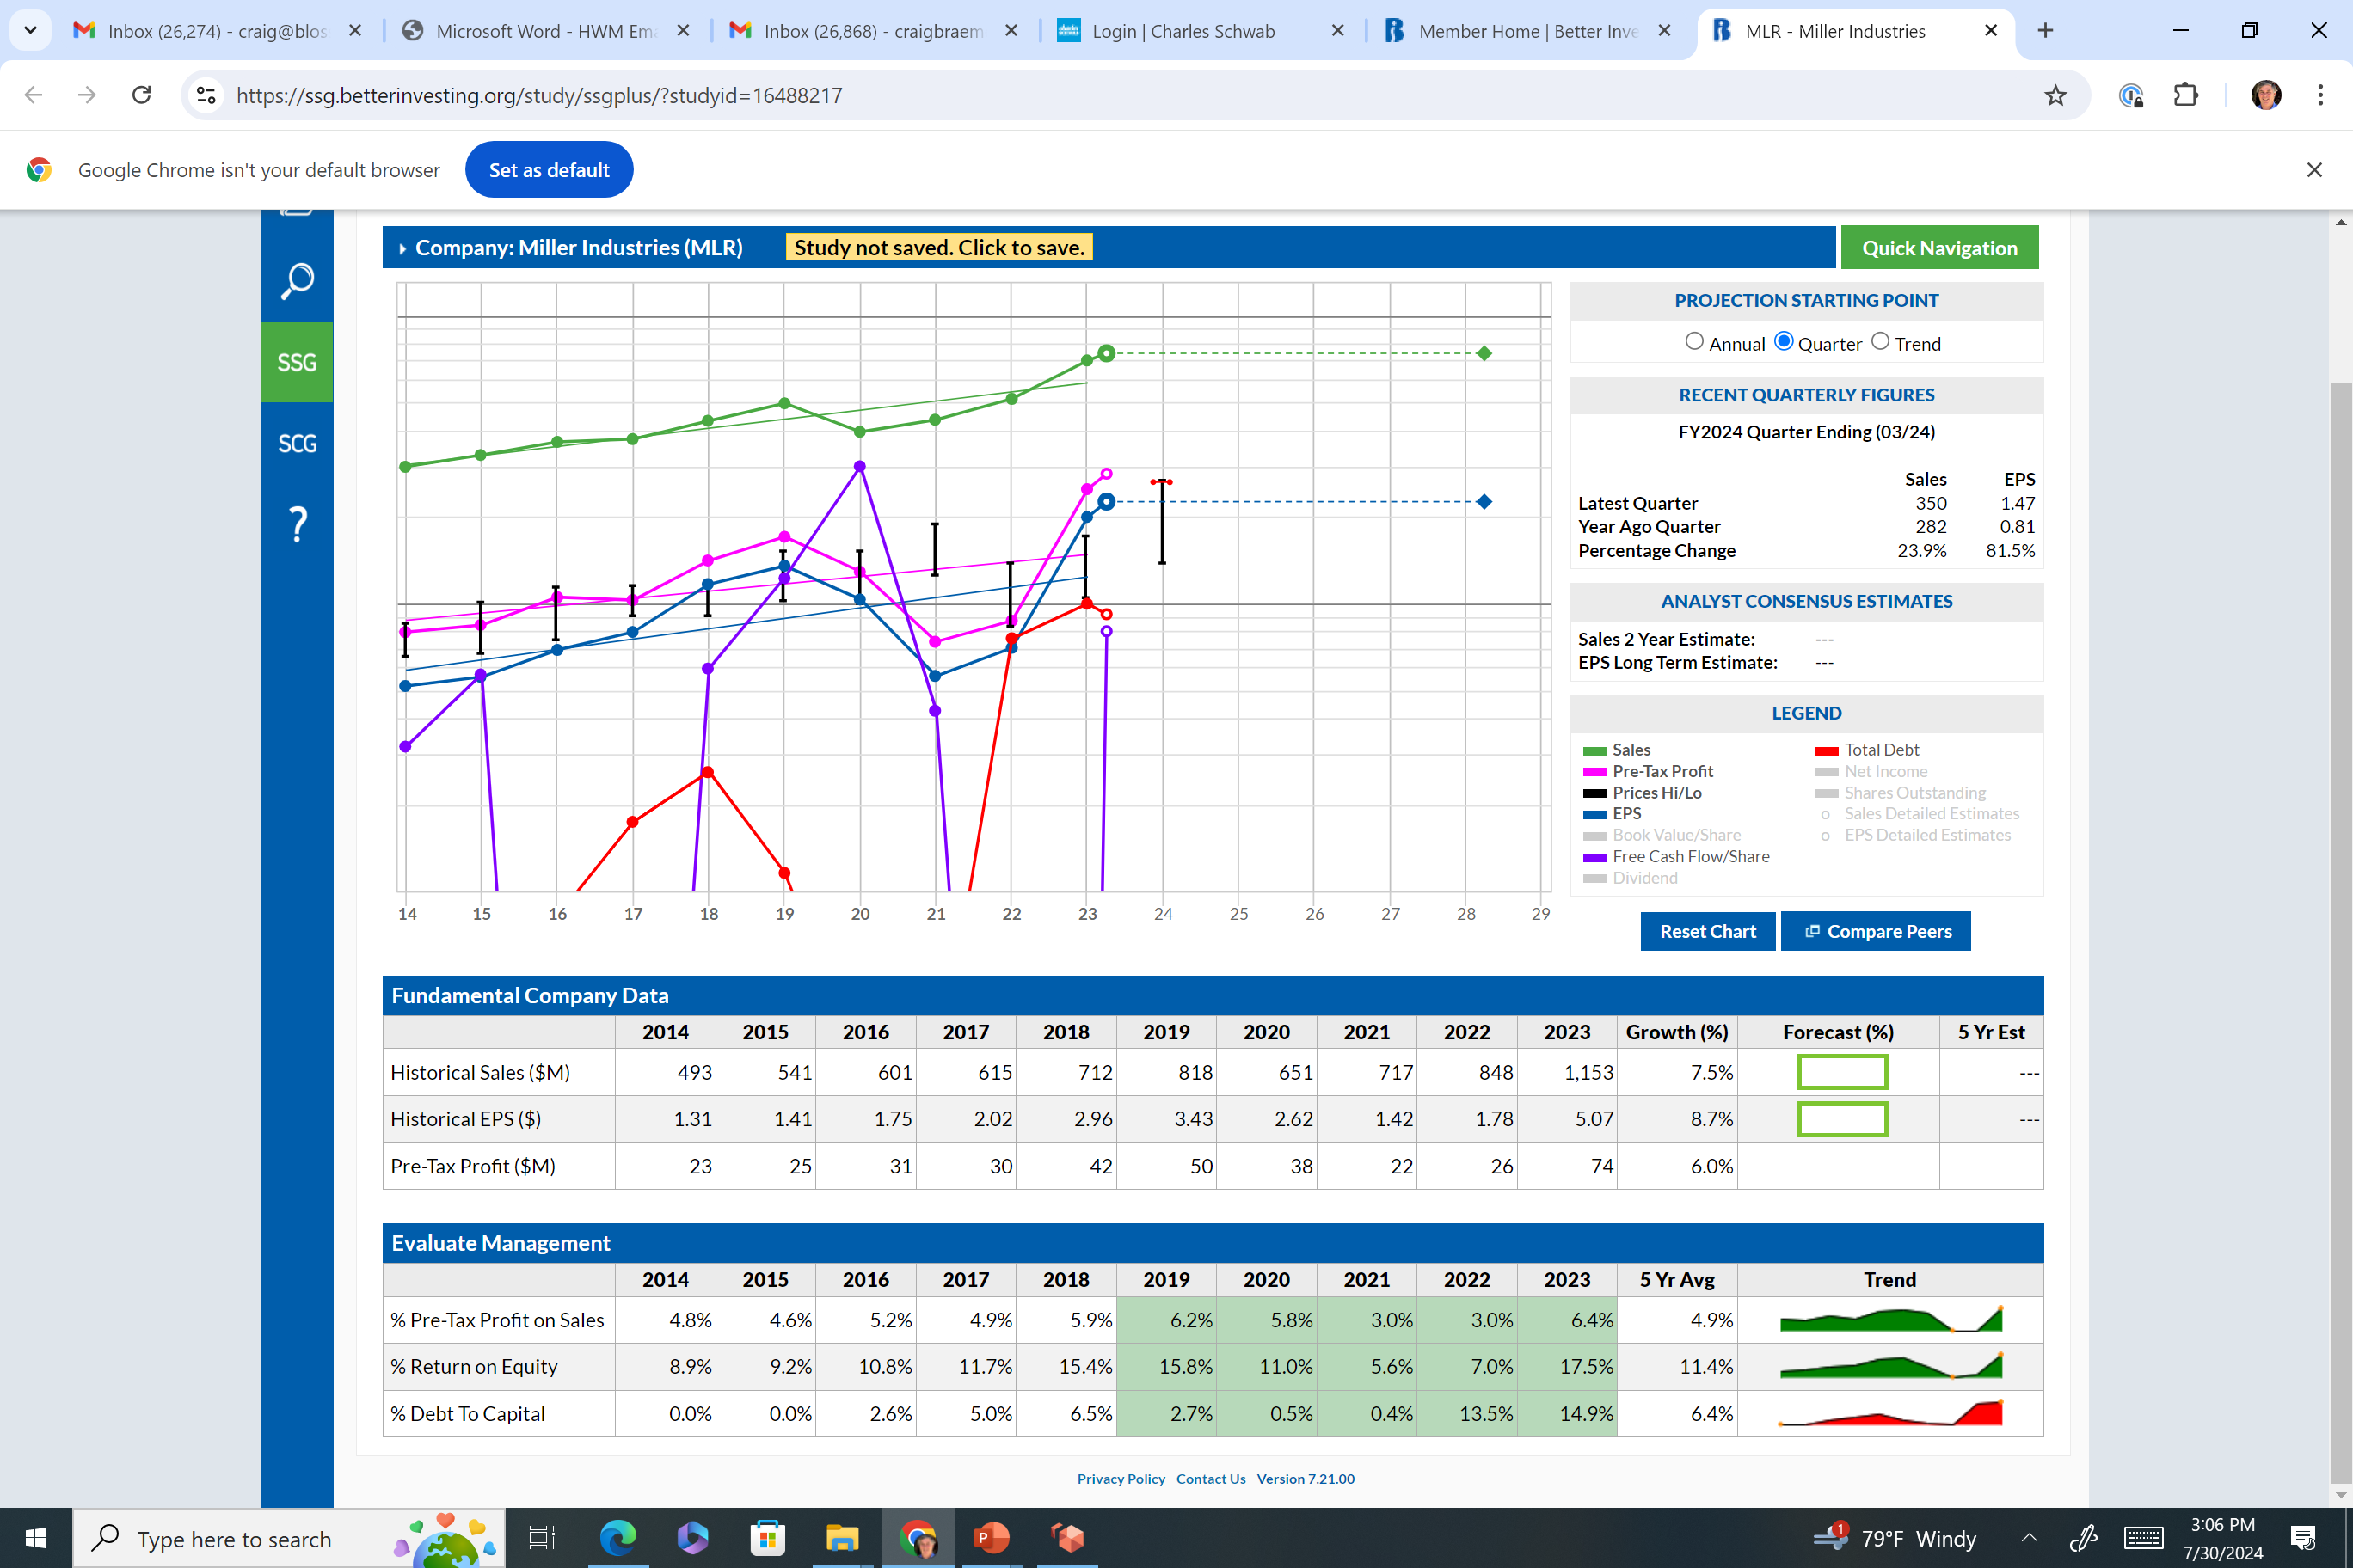
Stock #6 Advanced – Miller Ind. - MLR
Securities are for educational purposes only

Slide 29

Stock #7 – Vertex Pharma. - VRTX
Securities are for educational purposes only

Slide 30
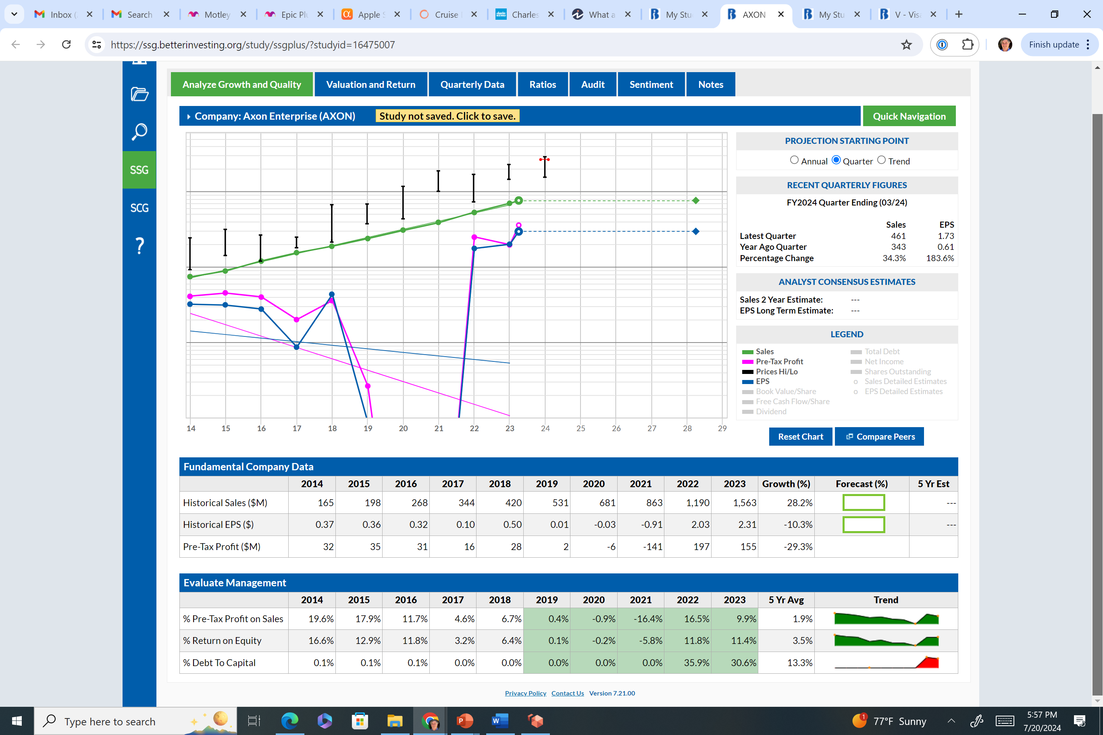
Stock #8 – Axon Enterprise - AXON
Securities are for educational purposes only

Slide 31
Non-Core Stocks
BI separates the world into two categories.
  Core vs Non-Core.
We typically teach about Core stocks.
If we always just owned Core Stocks, how did Amazon become a widely held stock in Clubs?
You must do a different type of analysis with non-core stocks.
Many cases, like AXON – it has good growth and requires more analytical work.
Notes:
Many years ago, AMZN was not the predictable or profitable. However, if you thought they were going the right direction and wanted to own them for the growth. It made sense.

Slide 32
Core Stocks
Under Core –think of the typical growing company that has:
  Relatively straight lines, parallel lines and up to the right.
  Allows for the ability to predict the future based upon the past.
Strong section 2.
We spend most of our time on Core because it is easier to see and predict.
Notes:
We showed you 3 stocks – V, ISRG, VRTX that fit the Core category in my mind.

Slide 33
Summary – Identifying companies
We reviewed 8 charts. 3 Core stocks and one Non-Core stock – AXON. 2 stocks were?? 2 Advanced.
Core is the typical stock for most BI clubs.
Expanding your horizon into non-core stocks can be fruitful, but it requires more work.
Non-core stocks typically have a story of what makes this investment unique.
  Think AMZN taking over the world 10-20 years ago.
  AXON’s story – the demand for accountability with police cameras.

Slide 34

Questions or Comments?
.
Craigbraemer1@gmail.com
www.betterinvesting.org
Back to the Chapter’s Annual Meeting
Notes:
Thank you for your attention. Are there any questions or comments?

Slide 35
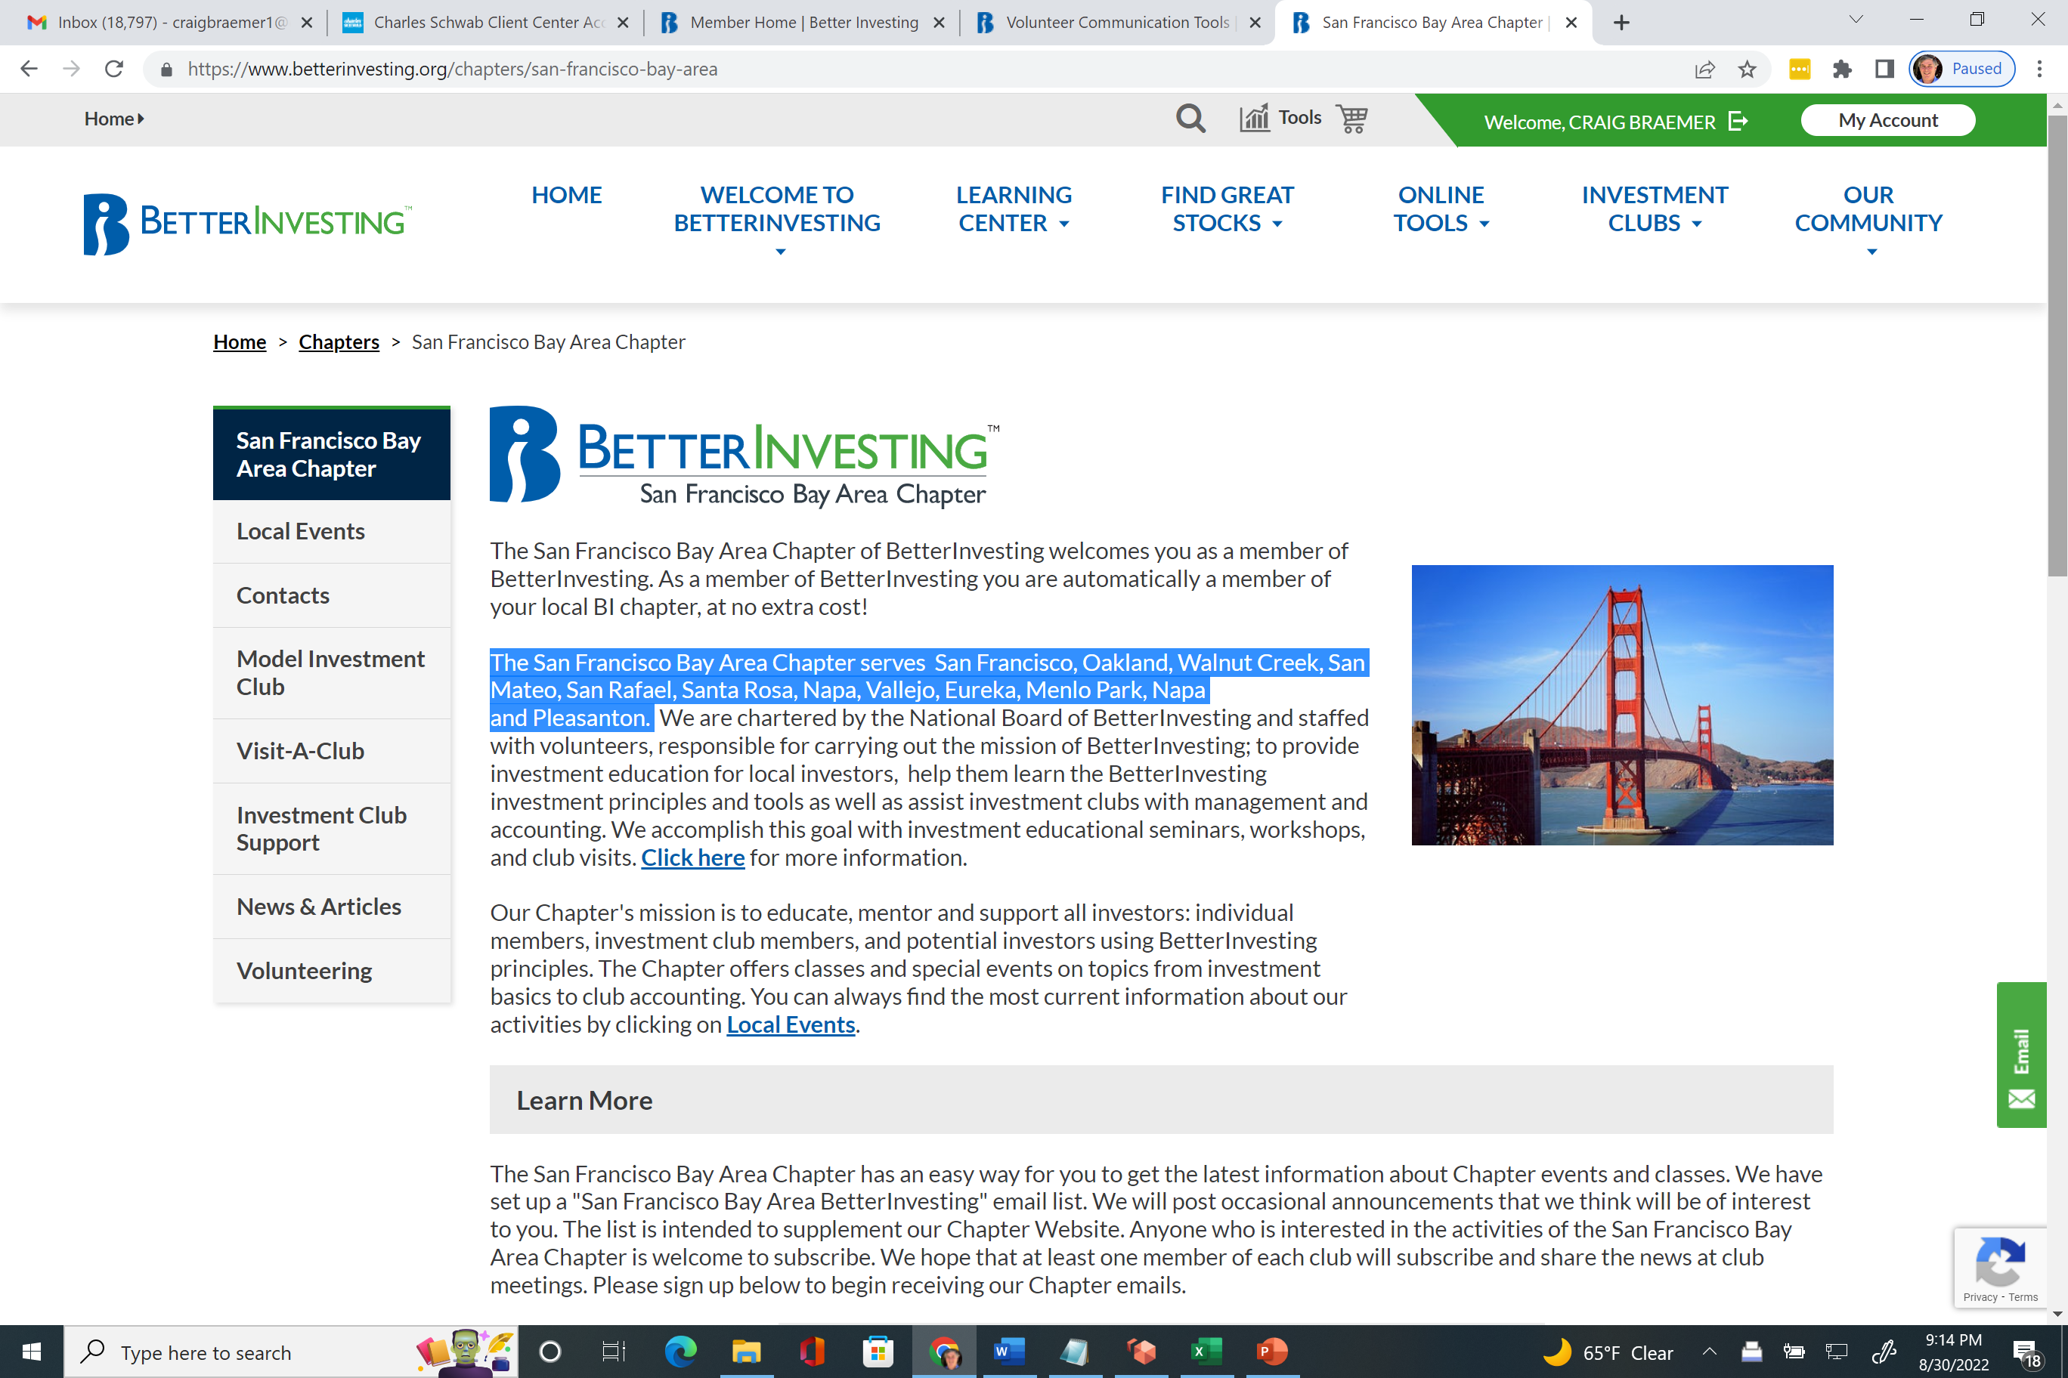
Annual Meeting - Chapter Information www.betterinvesting.org/chapters/san-francisco-bay-area
Local Events for dates, times, places, registration link
Visit the club meeting. 2nd Thursday of the month at 5:45 pm. Virtual.
If you would like a club visit, let us know. We have been told Clubs find it valuable.
Consider joining us.

Slide 36
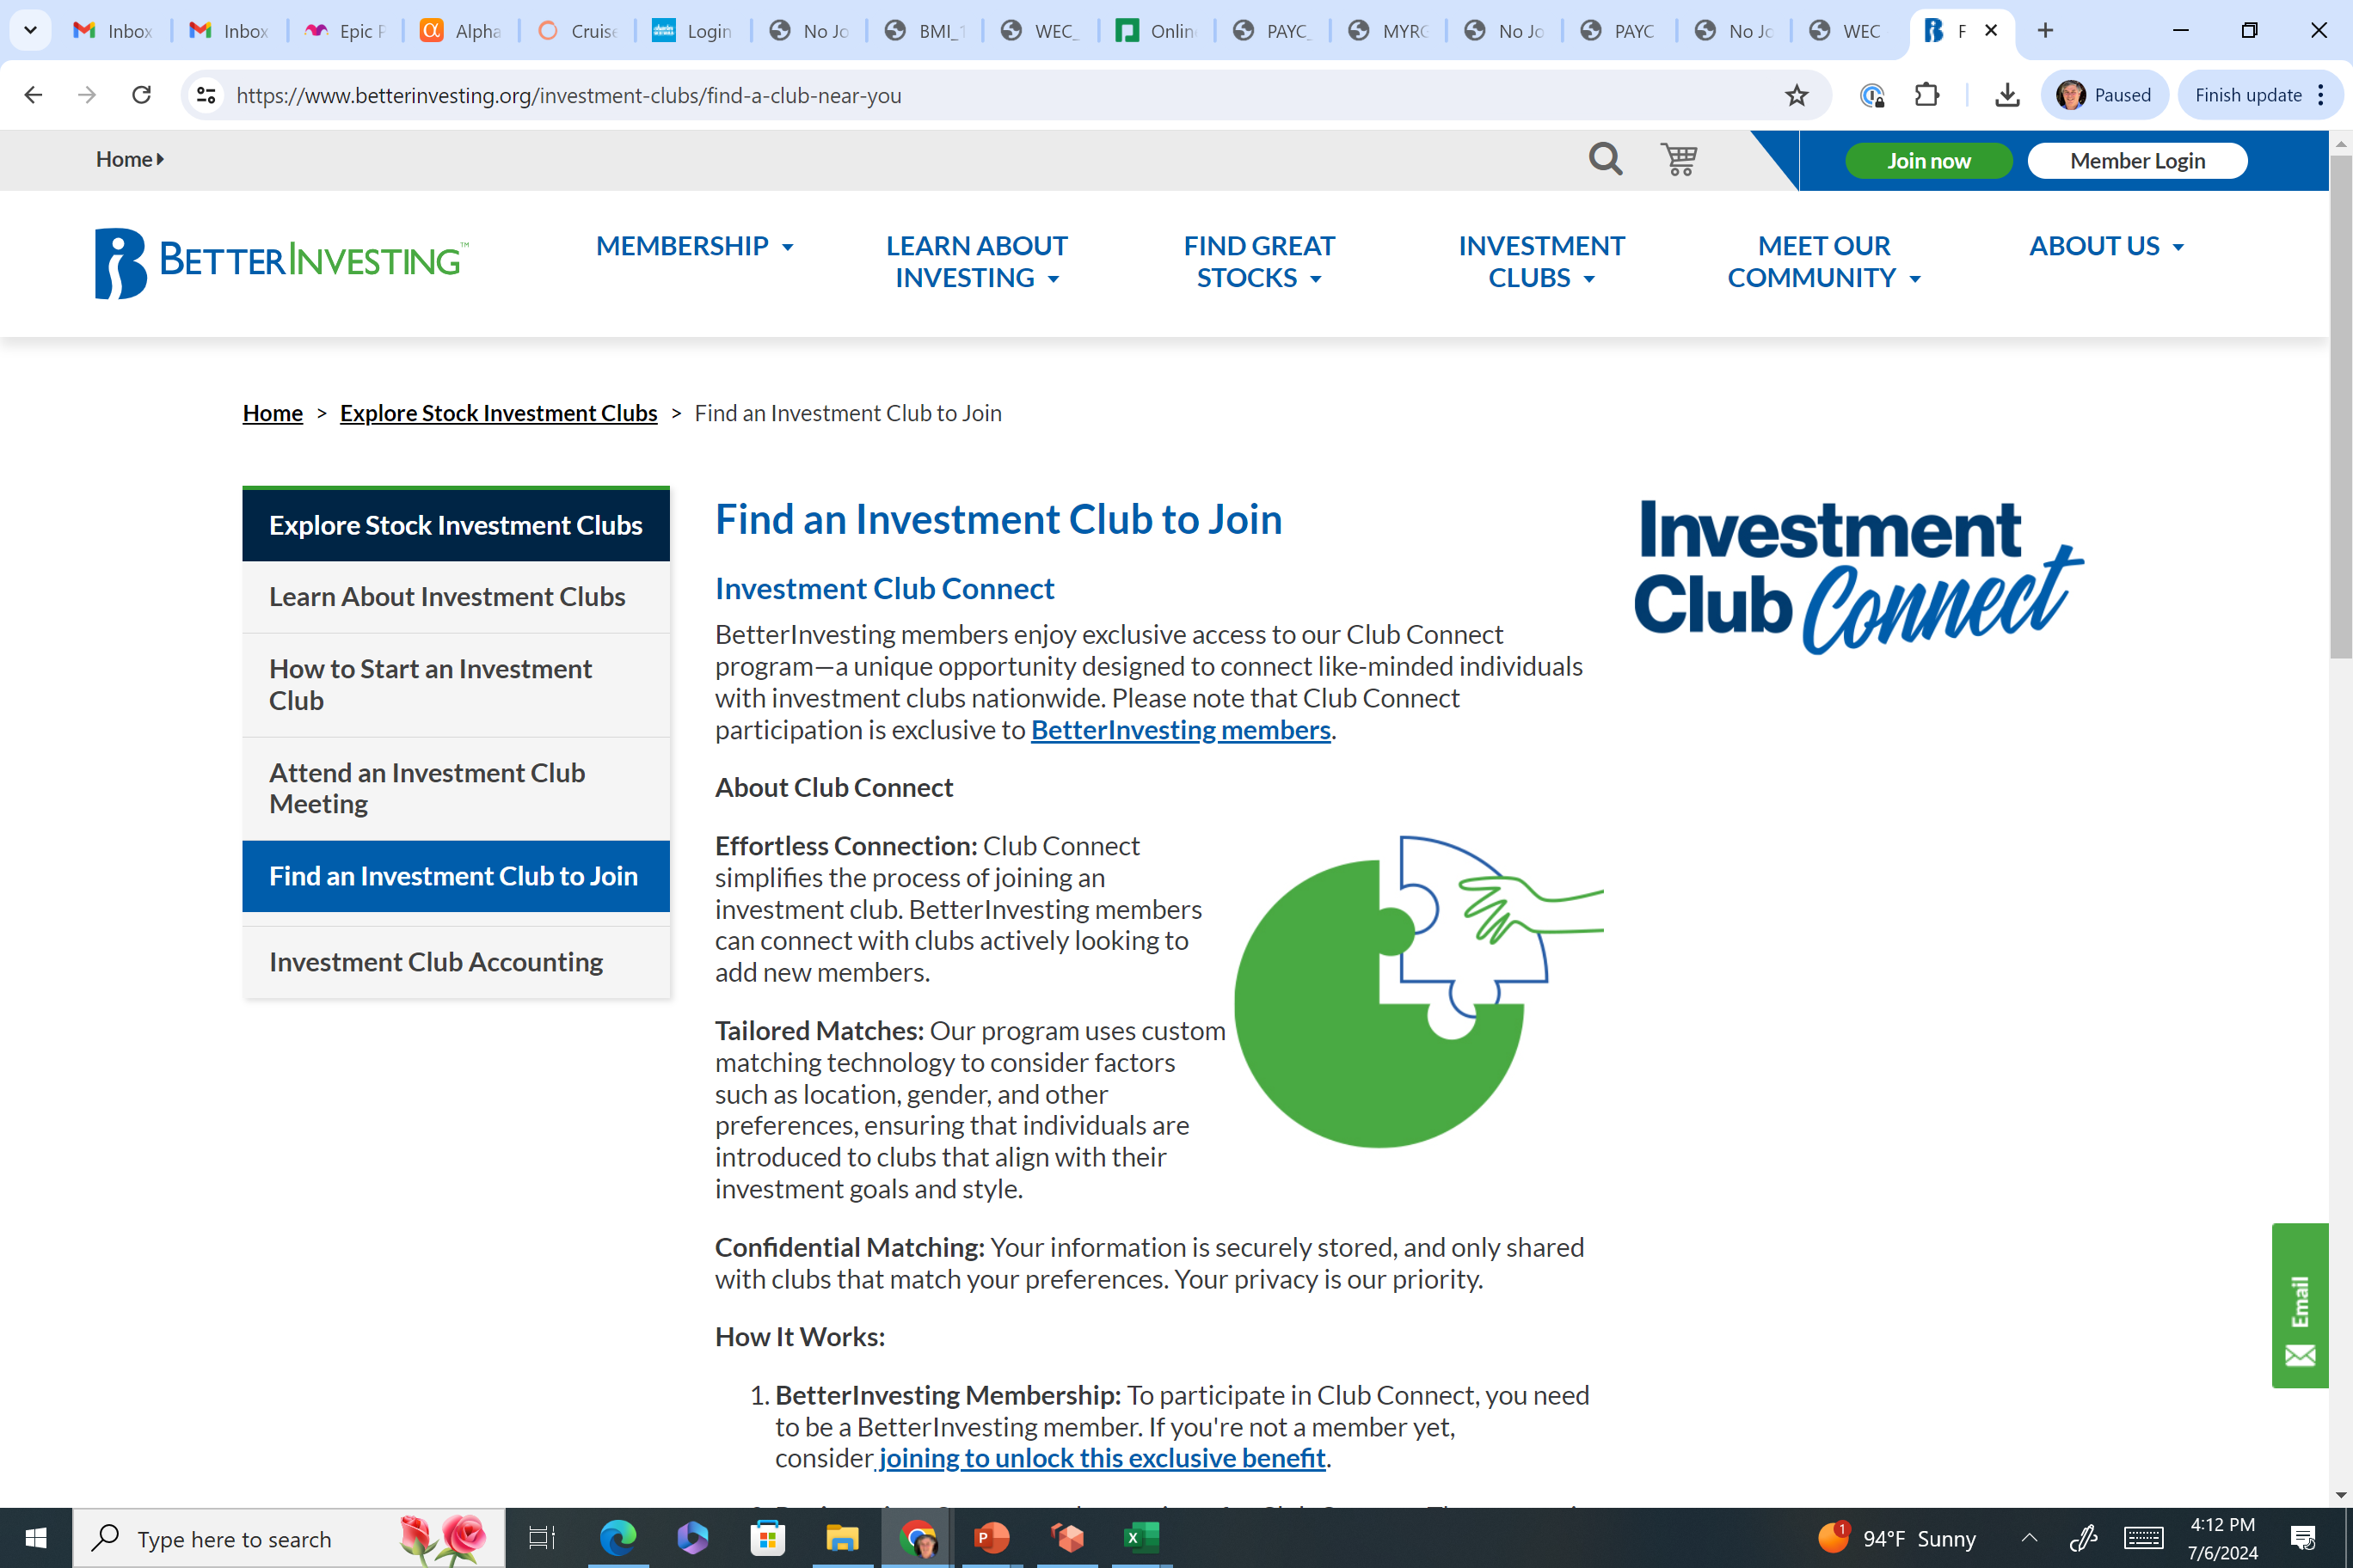
Annual Meeting – Club Connect
This is new. If you are looking for a Club or if you are a Club looking for members.
Please check it out.

Slide 37

Your Volunteer Directors
Director | Term | Term Ends
Braemer, Craig | End of Term | 9/30/2024
Dexheimer, Ann | End of Term | 9/30/2024
Gold, Henry | 3 year | 9/30/2026
Harbert, Jacquelyn | 3 Year | 9/30/2025
Lewis, Kweli | 3 year | 9/30/2026
Louie, Carolyn | 3 year | 9/30/2026
Thomas, Vivian | 3 Year | 9/30/2025
Willcox, James | 3 Year | 9/30/2025
Willcox, Joanne | 3 Year | 9/30/2025

Slide 38
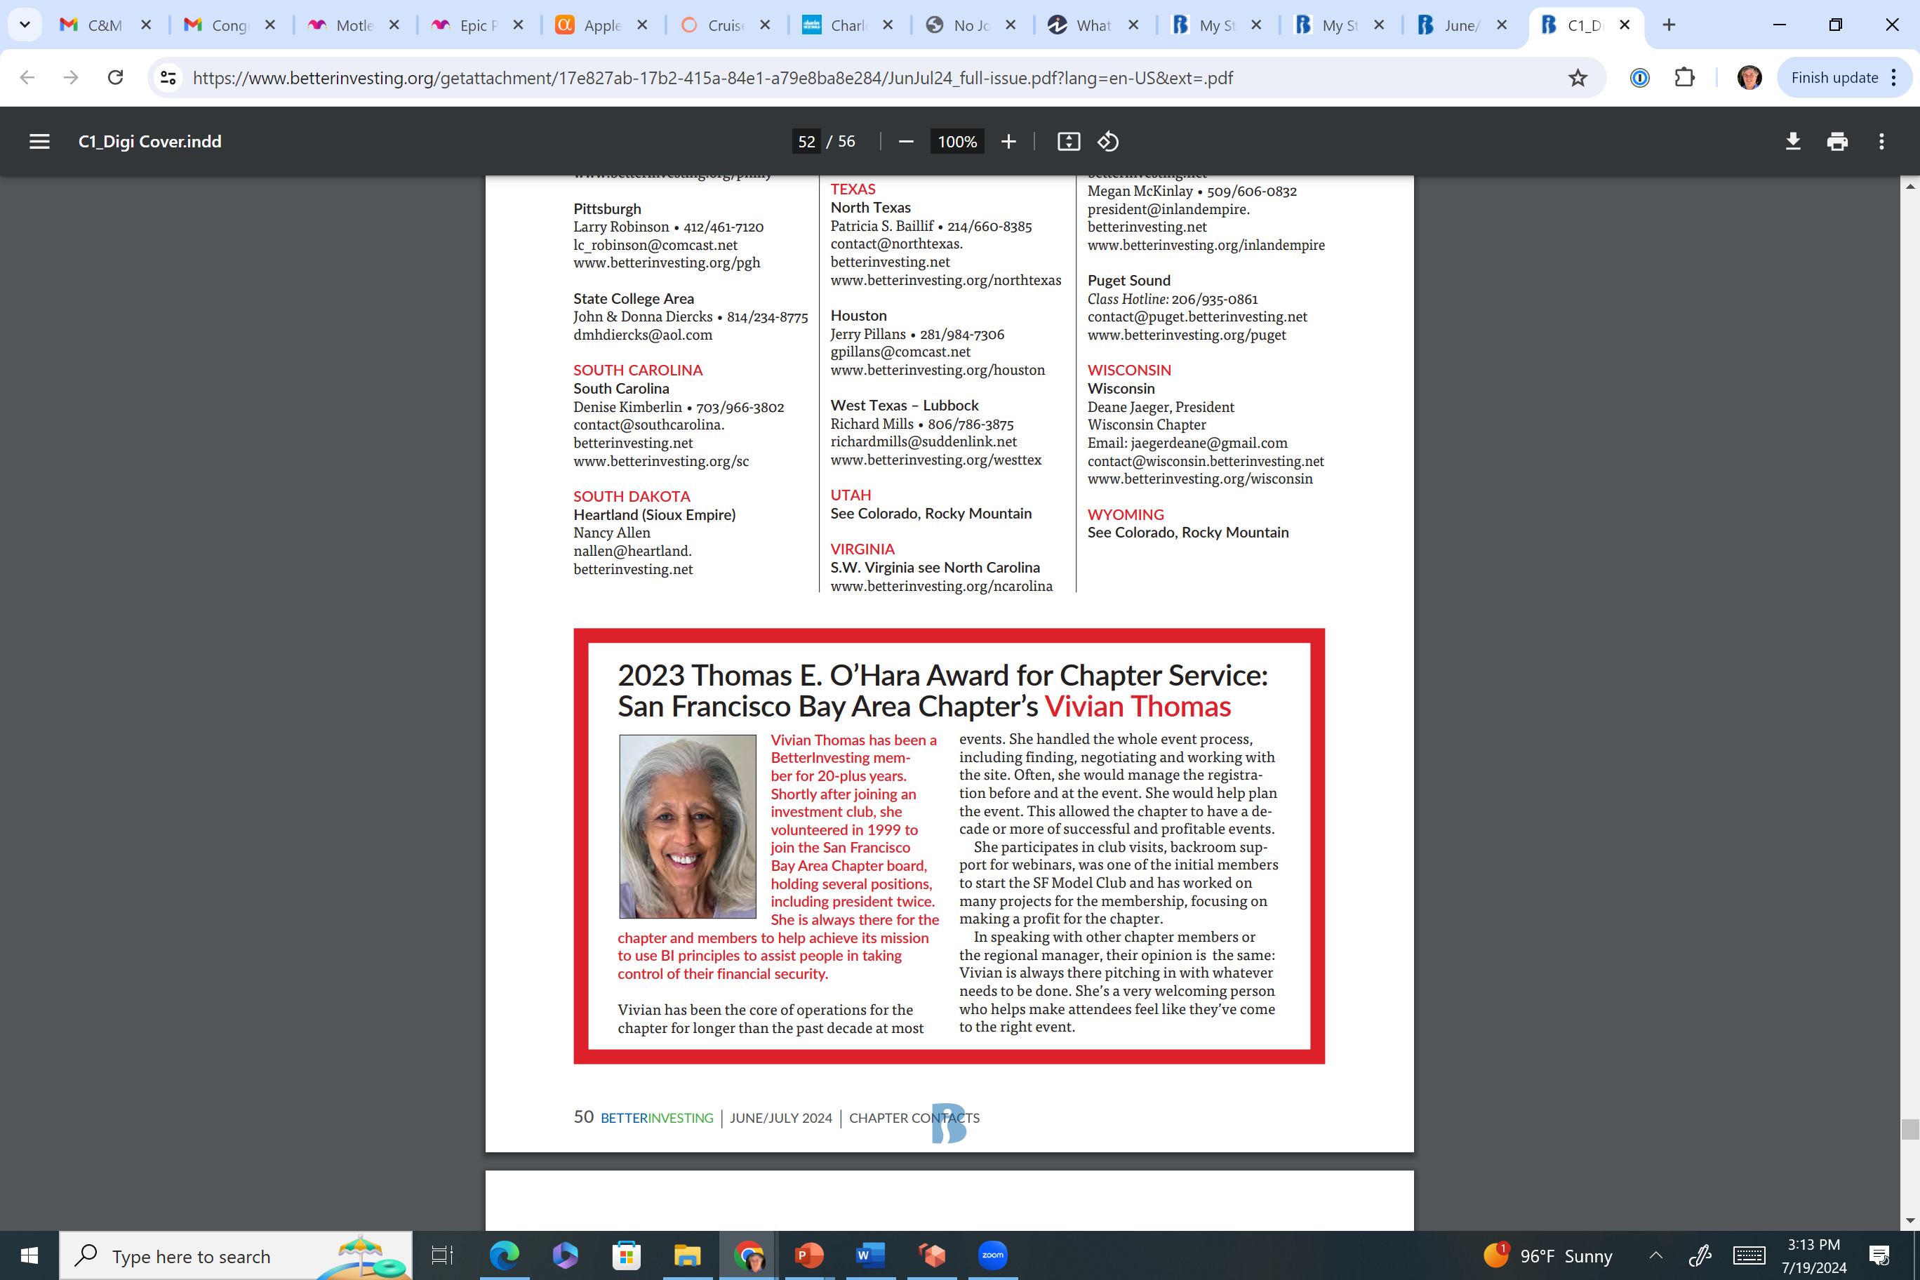
Congratulations - National Award
Thank You For Your Service

Slide 39
2023-2024 Chapter Activities
Participated in the California Chapters 3-part Series - Basic Stock Analysis and Stock Study and guest speaker. This was a virtual event.
Taught 9 other classes throughout the year. Including some through the San Francisco Library during April’s Financial Literacy Month.
Some of the classes taught included basic SSG investment education to outreach to advanced classes.
5 club visits – most visits were in-person.
San Francisco Bay Area Model Investment Club met 12 times online, some meeting were also in-person.
Club Connect has started! Check it out.

Slide 40
SF Model Club Holdings – 2024 – 7 - 7

Slide 41
How Can We Help You?
What can we do to better serve you as individual investors?
How can we help your club?
Your Chapter is Here to Serve You

Slide 42
Elections Slate - Please vote
Directors (3 Year term until 2027)
Braemer, Craig
Dexheimer, Ann

Slide 43
Become a Volunteer
Meets monthly online on 2nd Tuesday evening – 7:30 pm
Chapter Needs Volunteers:
  Future leaders
  Class and event planning
  Teachers
  Club visits
  Web author & social media
  Benefits – You will boost your investment education, you will be helping others, and you will get free access to BI online software tools.
Email: craigbraemer1@gmail.com or contact@sanfran.betterinvesting.net

Slide 44

For Your Participation
Q / A

