Slide 1
Discounted cash Flow (DCF)
A Vital concept in
Investment Analysis
Presented by Mel Crotzer, President, South Towns investment Club, melcrtzj@gmail.com

Slide 2
Background
The South Towns Investment Club (STIC) uses Morningstar, Value Line, and CFRA reports for information on companies of interest.
Morningstar and CFRA provide “fair value” estimates of a company’s stock price based on their proprietary Discounted Cash Flow (DCF) analysis.
STIC uses these fair values, in part, to find under or over-valued companies.
STIC members became quite interested in “What is a DCF?”. What’s under the hood?
To begin, certain questions need to be answered: What is a discount? What is cash? (You mean earnings, right?).
So the journey to understand a bit about DCF analysis starts with some basic financial math.

Slide 3
A Gentle Dive into DCF Analysis: Agenda
Future Value and Compounding
Present Value and Discounting
Applications to Annuities (briefly)
Application to Bonds (briefly)
Application to Stocks

Slide 4
Future Value and Compounding
Scenario: Invest $1000 at an interest rate of 7% (=0.07)
Future Value (FV) after first year:
> FV₁ = 1000 + 1000 x 0.07 = 1000 x (1.07)= $1070.
After the second year: FV₂ =1000 x 1.07 x 1.07 = 1000(1.07)² = $1144.90
After 10 years: FV₁₀ = 1000(1.07)¹⁰ = $1967.15
Generalize, with P = initial investment; r = interest rate (decimal);
n = number of years.
FV_{n} = P(1 + r)^{n}

Slide 5
Present Value and Discounting
Think of discounting as the reverse of compounding. E.g., Assume $1000 is needed one year from today, and r = 0.07. What amount invested TODAY, PV, give $1000 one year from now?
1000 = PV(1 + .07);
PV = Present Value = 1000/1.07 = $934.58
What if $1000 is needed 2 years from now?
PV = 1000/(1.07) x (1.07) = 1000/(1.07)² = $873.44
What if $2000 is needed 2 years from now and $3000 is needed 3 years from now?
PV = 2000/(1.07)² + 3000/(1.07)³ = 1746.88 + 2448.89 = $4195.77
Year 2: 1746.88(1.07)² = 2000; Year 3: 2448.89(1.07)³ = 3000.

Slide 6
Present Value of Periodic Payments
In general, with FV = Amount needed n years from now and r = interest rate (decimal):
PV = FV/(1 + r)^{n}
When discounting, r is usually referred to as the “Discount Rate”.
Consider a string of yearly payments, C_{i}, over some time interval n. C_{i} can vary over the n years. What is the present value of this stream of payments?
PV = C₁/(1 + r)¹ + C₂/(1 + r)² + C₃/(1 + r)³ ------ + C_{n}/(1 + r)^{n}
This is the Discounted Cash Flow(DCF) evaluation model. It has many applications.

Slide 7
Ordinary Annuity Valuation
Consider an ordinary annuity. Suppose you want an investment that will pay you $1000 at the end of each year for 15 years.
If the interest rate is 0.09, guaranteed over the 15 year time interval, what is the present value of the investment.
PV= 1000/(1.09)¹ + 1000/(1.09)² + ------ + 1000/(1.09)¹⁵ = $8060.69
This is the current value of the annuity.

Slide 8
Bonds: Definitions
A bond is a security issued by a corporation or government that wants to borrow money from the public or institutions. Some definitions:
Par (Face) Value – The amount of the loan that the borrower must pay the lender at maturity.
Maturity – The date on which the par value is paid to the lender.
Coupon – The interest that the borrower pays the lender each period up to and including the maturity date.
Coupon Rate = Coupon/Par Value.
So, how is a bond value calculated?

Slide 9
Bond Valuation
Not surprisingly, a bond’s value is calculated using Discounted Cash Flow to find its present value.
Consider a $1000 par value bond with a 10 year maturity and a coupon of $50. Assume the coupon is paid at the end of a year and the interest rate is 5% (0.05)
The present value will be the sum of the discounted coupons plus the discounted par value at year 10.
Bond Value = 50/(1.05)¹ + 50/(1.05)² + --- + 50/(1.05)¹⁰ + 1000/(1.05)¹⁰ = $1000!
The price of the bond (present value) is $1000 because the interest rate = coupon rate = $50/$1000 = 0.05.
However, interest rates don’t stay constant and neither does the price of a bond.

Slide 10
Bond Price Sensitivity: Duration
As interest rates increase the bond price will decrease. This happens because the denominator in the bond price formula increases while the coupon, maturity and face value remain fixed.
For example, if the interest rate in the preceding example increases to 6% (a 100 basis point increase in bond jargon), the price of the bond decreases to $926.40
Bond Value = 50/(1.06)¹ + 50/(1.06)² + --- + 50/(1.06)¹⁰ + 1000/(1.06)¹⁰ = $926.40
If interest rates fall to 4%, the price of the bond would be
Bond Value = 50/(1.04)¹ + 50/(1.04)² + --- + 50/(1.04)¹⁰ + 1000/(1.04)¹⁰ = $1081.11
The percentage change in bond price when the interest rate changes by 100 basis points (1%) is called the duration of the bond – a measure of bond price sensitivity to changes in interest rates.
For this example, the duration is (Price(4%) – Price(6%))/(2*Price(5%)) * 100 = 7.7%

Slide 11
Stock Valuation
The equation for pricing a bond can be used as a template for evaluating the price of a company’s stock. Make the following substitutions in the bond equation. Each substitution will then be explained.
--In place of coupons, substitute free cash flow, C_{i} , over time. These will vary. (Note – Free cash flow is cash flow from operations minus capital expenditures)
--In place of the interest rate, substitute the Weighted Average Cost of Capital, or WACC, which will be designated as R.
--In place of the discounted bond par value, substitute a terminal value (TV).
--In place of Bond Value, substitute Enterprise Value (EV).
EV = C₁/(1 + R)¹ + C₂/(1 + R)² + C₃/(1 + R)³ ---- + C_{n}/(1 + R)^{n} + TV/(1 + R)^{n}
--Note, EV is the total value of the company. Some adjustments are needed before converting EV to a stock price.

Slide 12
Stock Valuation: Cash Flows
Why free cash flow and not earnings?
Earnings, which are based on sales income, are subject to adjustments.
Under Generally Accepted Accounting Principles (GAAP), companies can deduct non-cash items for tax purposes, such as depreciation, amortization, and goodwill impairment.
Sales include goods or services sold on credit. A company needs enough cash on hand until accounts receivable are paid.
Lenders to an expanding company want to know the company’s current and future free cash flows before providing a loan.
Bottom Line: Cash is a better indicator of a company’s financial health than earnings. Cash is king!

Slide 13
Stock Valuation: Weighted Cost of Capital (WACC)
A company’s capitalization consists of debt and shareholder equity. Each company will have different percentages of each part of capitalization.
Lenders require a certain return on loans and shareholders expect a return on their investment beyond what could be earned on a bond.
The WAAC is the required rate of return needed to satisfy both bondholders and stockholders and is used as the discount rate in the DCF stock analysis.
WACC = (% Debt) * (Return on bonds) + (% Equity) * (Return on equity)

Slide 14
Stock Valuation: WACC Components
The return on bonds is basically the company’s interest expense as a percentage of their debt, adjusted for taxes. Interest expense is tax deductible.
Return on Bonds = (interest expense)/(Debt)*(1-tax rate)
The expected return to stockholders is based on the Capital Asset Pricing Model (CAPM). Specifically, the stockholder expects a return on their investment greater than a 10-year treasury bond which is considered a safe investment.
This excess return is calculated as a stock market premium multiplied by the riskiness of the stock.
Return of Equity = Return on 10-year bond + market premium*stock beta
The stock beta is calculated as that stock’s price volatility compared to the total stock market volatility. Beta is a proxy for a stock’s risk.
NOTE – Both stock and bond returns are greatly influenced by the prevailing interest rate environment! Yes, the Fed influences the stock market.

Slide 15
Stock Valuation: Terminal Value
Analysts typically project a company’s cash flows from 5 to 10 years out. How to address the years beyond that? Two methods are commonly used:
Perpetuity Method – Assume some small growth rate beyond n years = g. Multiply the final cash flow, C_{n} by a perpetuity factor as follows (Gordon Growth model):
TV = C_{n} * (1+g)/(WACC-g)
A second method, the Exit multiple Method, multiplies the final cash flow (actually EBITDA) by a factor typical of the Company’s industry or sector. The assumption is that after n years, the company is sold.
TV = EBITDA_{n} * industry factor
Investment professionals (e.g. Investment Banks) prefer the Exit Multiple method for terminal values. Academics prefer perpetual growth.
In both methods, TV is discounted to the present, dividing by (1+WACC)^{n} . The discounted TV is then added to the other discounted cash flows to give the enterprise value of the company.

Slide 16
Calculating the “Fair Value”
The final step: Add to the enterprise value, EV, any cash the company has, subtract the debt, and divide by the number of shares to give the fair value, dollars per share.
EV = C₁/(1 + R)¹ + C₂/(1 + R)² + C₃/(1 + R)³ ---- + C_{n}/(1 + R)^{n} + TV/(1 + R)^{n}
Fair Value = (EV + cash – debt)/(number of shares)
The Fair Value is then compared to the market price. If the market price is below the fair value, there may be a buying opportunity. If the market price exceeds the fair value, it may be prudent to wait before purchasing, or it may be a signal to sell if the stock is owned.

Slide 17
The DCF Method and an SSG Analysis
The WACC represents the required rate of return for the enterprise. Compare the WACC to the Compound Annual Returns in the SSG. If the SSG rate of return is greater than the WACC, then the company is doing well. If not, perhaps choose another company.
--Whether to buy or sell is another matter. Is the return >15% per year? Is the price in the “Buy” zone.
The SSG Preferred Method simulates a simple DCF calculation.

Slide 18
Comparison of Fair Values Calculated by Various Analysts
Compare FV’s among the following analysts:
Morningstar (Mstar)
CFRA
Simply wall Street (SimpWS)
Guru Focus (Gufo)
FVs for the Magnificent 7 are compared
The FVs are compared to market prices on 3/18/2024

Slide 19
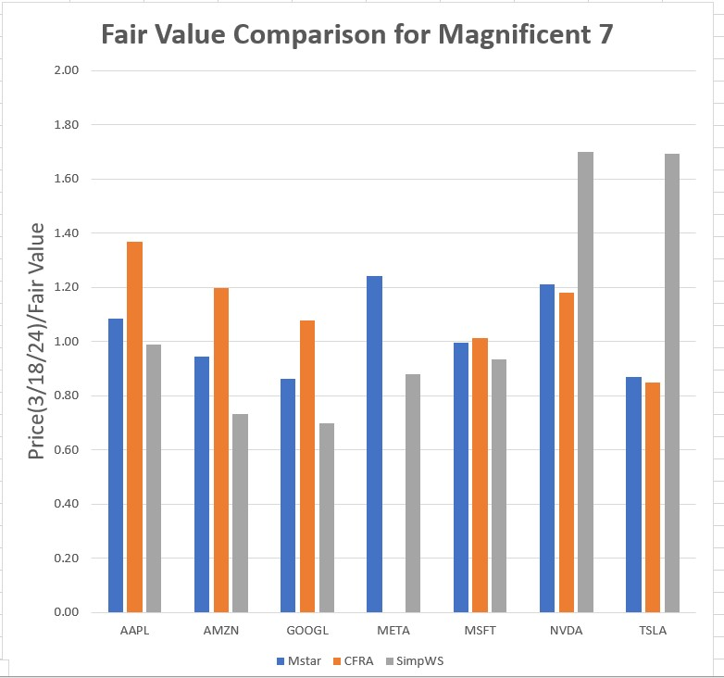

Slide 20
Fair Value Comparison for Magnificent 7
Compare Methods
Generally wide variation among methods
CFRA’s FV’s are generally higher than Mstar’s, but not excessively
SimpWS’s FV’s show considerable variation compared to CFRA and MStar
Compare Stocks
GOOGL and perhaps AMZN appear undervalued
NVDA and perhaps META and AAPL appear overvalued
Ignoring the SimpWS FV, MSFT and TSLA appear to be fairly valued

Slide 21
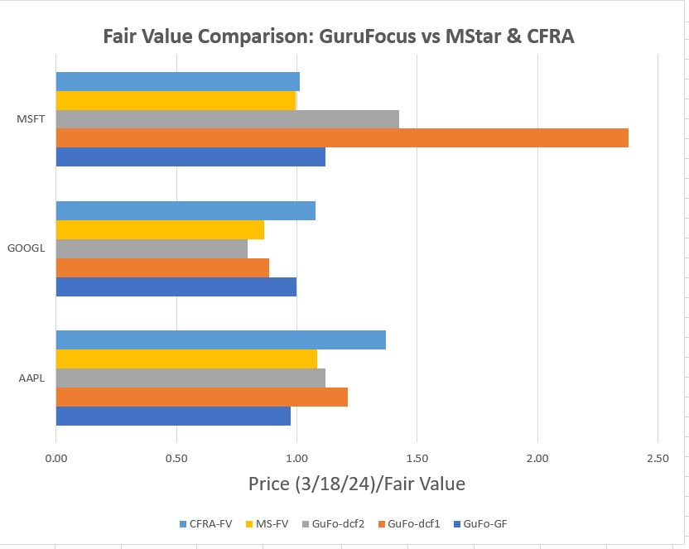

Slide 22
GuruFocus FV comparison to Mstar and CFRA
The 2 GuFo DCF methods predict very low FV’s for MSFT
For GOOGL and AAPL, the 2 GuFo DCF methods seem consistent with Mstar and CFRA
GuruFocus promotes its GF method, which accounts for the other measures

Slide 23
The DCF Method: Summary
DCF analysis has many applications in finance: evaluating a project, pricing a bond or annuity, or estimating a fair value of a security.
The DCF analysis is widely used for estimating a fair value for a company.
Calculated FV’s can vary widely depending on the assumptions made on future cash flows and the WACC.
Hence, it is important to look at other RELATIVE measures of value, such as P/E’s, P/Revenue, etc. and to compare results to other companies and sectors.

Slide 24
MSFT FV Calculation Using Yahoo and Value Line Data Growth rate Assumptions
Free Cash Flow (FCF) calculated as Cash Flow (CF) minus Capital Expenditures
FCF CAGR = 11%/ Year for 2024 through 2028
FCF CAGR = 7%/ Year for 2029 through 2033
Terminal growth rate= 3%/yr (Perpetuity Method)
EBITDA multiplier = 24 (Exit Multiple method)

Slide 25
MSFT FV Calculation Using Yahoo and Value Line Data WACC Assumptions
Debt/Capital = 15% (VL 2026-2028)
Ave. Interest /Total debt = 3.48%
Tax Rate = 17%
Risk free rate = 4.2% (Current 10 yr. bond rate)
MSFT beta = 0.9
Historical market Ave. rate of return = 10%/yr
Market risk premium for MSFT = 0.9*(10 – 4.2) = 5.2%/yr.
WACC = 0.15*3.48*(1-0.17) + 0.85*(4.2+0.9*(10.-4.2)) = 8.44%/yr.

Slide 26
MSFT FV Calculation Using Yahoo and Value Line Data Results
Net Debt = 12.5B (2023)
Number of shares = 7300 (VL 2026-2028 estimate)
Perpetuity method:
Fair Value = (Enterprise value – Net Debt)/Shares =
Fair value = (1855.3 – 12.5)/7300 = 252.4 $/Share
Exit multiple method:
Fair value = (3069.8 – 12.5)/7300 = 418.8 $/share
Market Price on 3/1/2024 = 415.56 $/share

Slide 27
References
“Fundamentals of Corporate Finance”; Ross, Westerfield, & Jordan; McGraw-Hill.
2. “Equity Asset Valuation”; Stowe, Robinson, Pinto, McLeavey; Wiley
3. “A Deep Dive into Discounted Cash Flow”; presented by Sofia Bitela; Better Investing Special Programs.
4. Terminal Values – www.Investopedia.com/terms/t/terminalvalue.asp
Questions: Contact Mel Crotzer, melcrtzj@gmail.com

