Slide 1
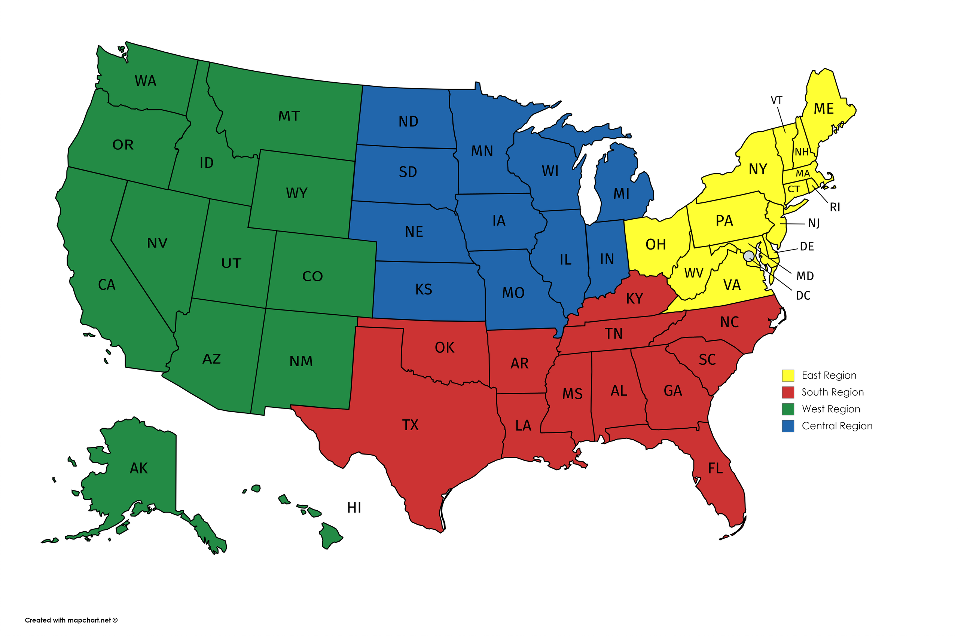

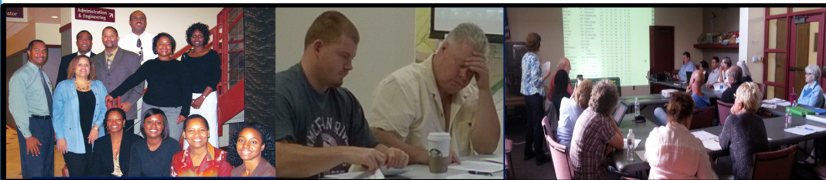
OLC Education Committee Presents
BI Mentoring Workshop
Brought to you by the
Jane Chatterjee & Bob Houle
Sriram Madabhushi, Chris McCarron, Dan Perlman, Phil Sudore
September 21, 2022 8:30 PM ET
Notes:
<CLICK>

Slide 2
DISCLAIMER
The information in this presentation is for educational purposes only and is not intended to be a recommendation to purchase or sell any of the stocks, mutual funds, or other securities that may be referenced. Investors should conduct their own review and analysis of any company of interest before making an investment decision.
Securities discussed may be held by the instructors in their own personal portfolios or in those of their clients. BI presenters and volunteers are held to a strict code of conduct that precludes benefitting from educational presentations or public activities via any BetterInvesting programs, events and/or educational sessions in which they participate. Any violation is strictly prohibited and should be reported to the CEO or Volunteer Relations.

Slide 3
Agenda
Introduction – About the OLC
Importance of Quarterly Data
Open discussion and Q&As
What are some of the Other resources?
Closing

Slide 4
Welcome From The Online Chapter (OLC)
To OLC and Non-OLC Members
Serves those not in a geographically defined chapter
BetterInvesting’s largest chapter
Approximately 3,000 members
Has BI programs and many functions like a regular chapter
But, has unique features
    Operates online
    Has worldwide members
    Has satellites
Has Educational Workshops every other month

Slide 5
Webinar Practices
During the presentation:
    Turn off your mic
    Put questions and comments in the chat
Closed captioning is available. Steps to activate CC
    Click More (lower right on screen)
    Accept default (English)
    Click Show Captions
The slides and recording of this webinar will be archived on the OLC Website in approximately two days

Slide 6
Based on an Impressive Presentation made by: Kathleen Richards from the NE Ohio Chapter at the 2022 BINC
Discipline. Discipline is more important than convictions. - Doug Gerlach
Fail to prepare. By failing to prepare, you are preparing to fail. - Ben Franklin.
Emotions. Fear, Greed, Arrogance, Attachment, Care-free, etc. can all be detrimental to investing.
Impulse actions: Sometimes we react ignoring logic.
Let the Data Speak. Trend is our friend.

Slide 7
When is this information important?
Looking for a new stock?
Watching a stock, you may consider buying?
Managing a portfolio to make hold or sell or buy more decision?
Post-mortem – after you gain or lose from a trade

Slide 8
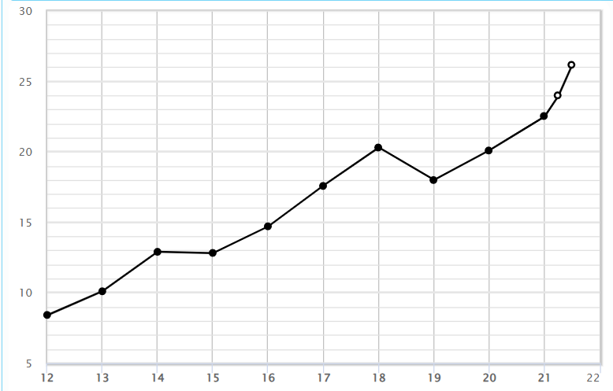
Quarterly Data to Focus On:
Pre-tax Profit
Profit Margin
  How it is moving
  How fast it is moving
  Sales drive profits
  Profits drive EPS
  EPS drives price

Slide 9
Pre-Tax Profit Data
Is the direction up or down?
How fast is it changing?
Are there torpedoes in sight?

Slide 10
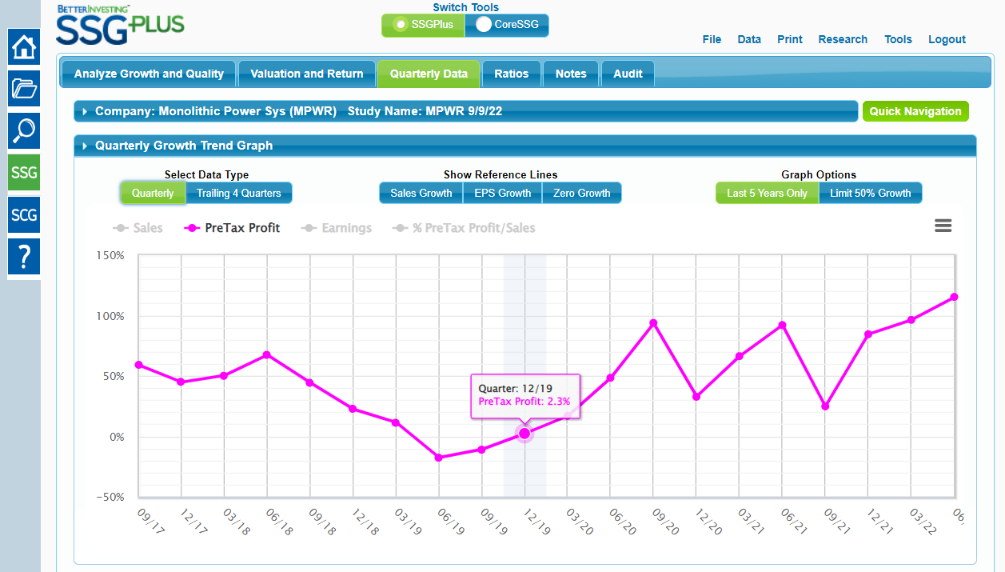
Quarterly Data from SSG Plus

Slide 11
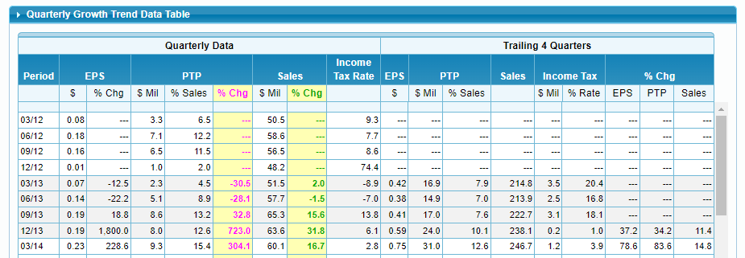
Quarterly Data from SSG Plus

Slide 12
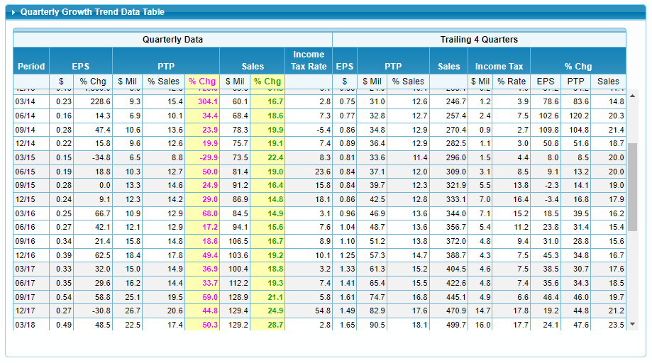
Quarterly Data from SSG Plus

Slide 13
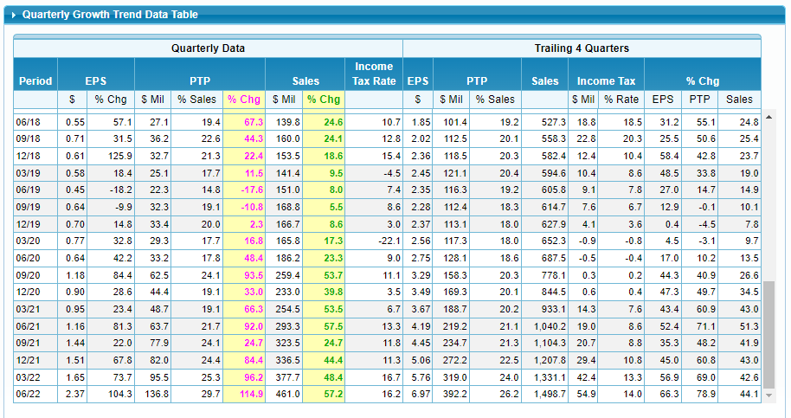
Quarterly Data from SSG Plus

Slide 14
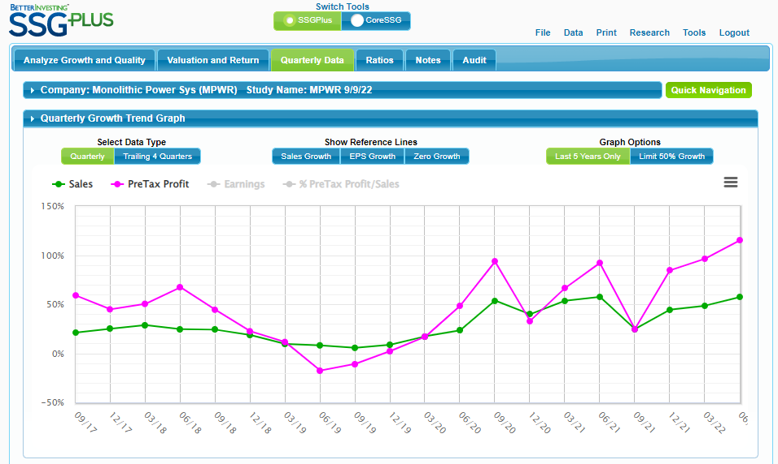
Quarterly Data from SSG Plus

Slide 15
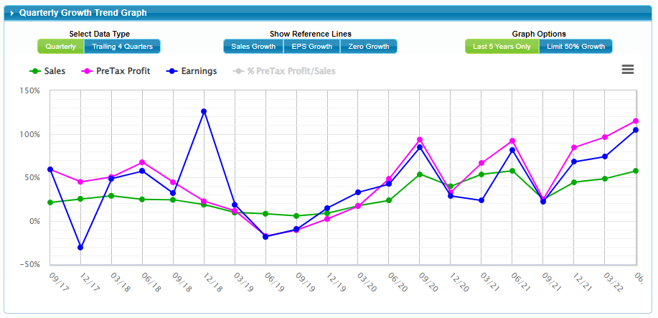
Quarterly Data from SSG Plus

Slide 16
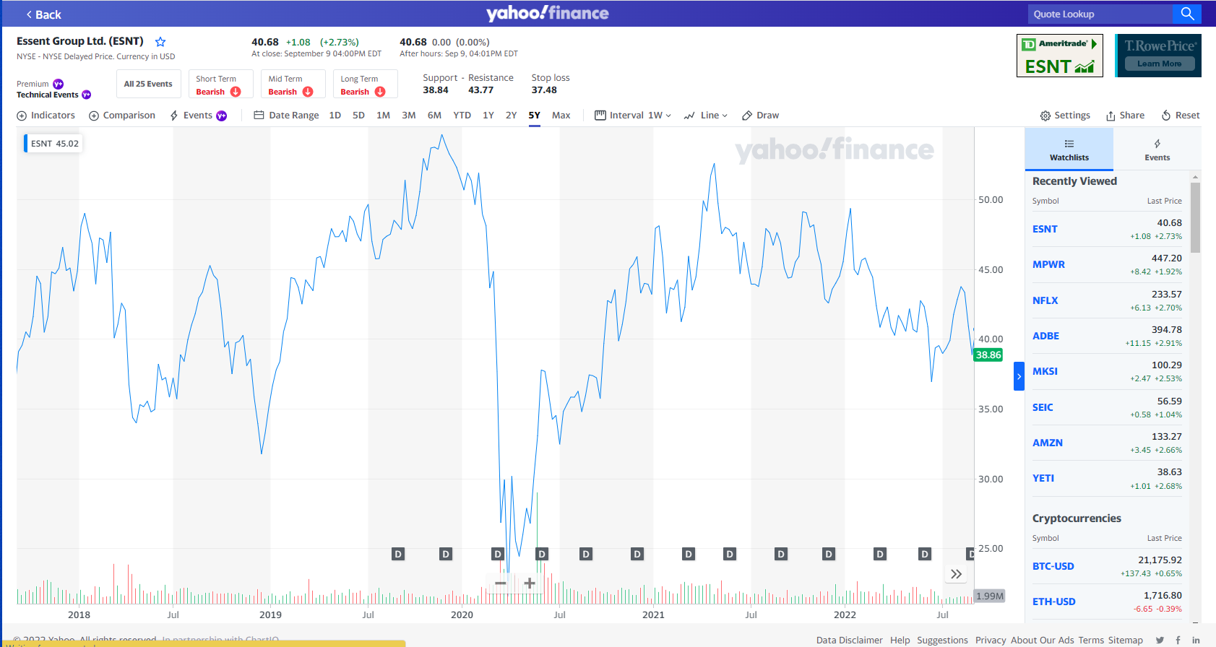

Slide 17
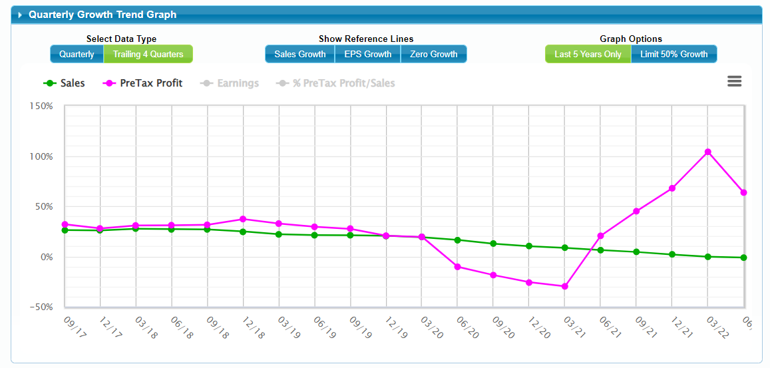
Example Data – ESNT Group Example

Slide 18
Quarterly Data and Price

Slide 19
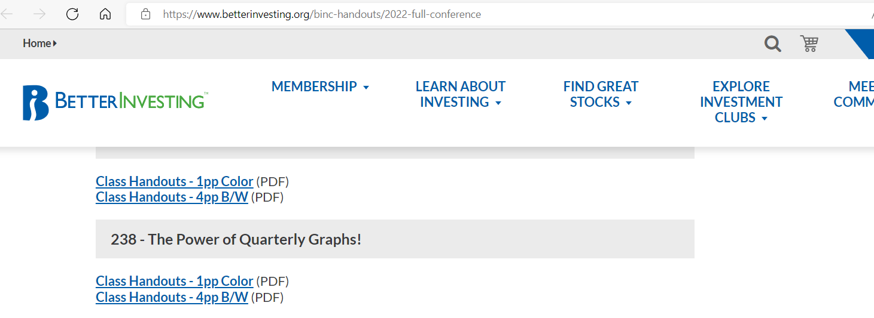
https://www.betterinvesting.org/binc-handouts/2022-full-conference

Slide 20
Quarterly Data and Conclusions
When we bought a stock, we did our research and expect it to be a long-term investment
    We need to look from short-term and long-term perspective
    Develop a process to see how the data are predicting potential trouble
  Do not buy when we are 2-3 quarters of decline for pre-tax profit
  Consider selling when we hit 2-3 quarters of decline for pre-tax profit – 4th may be too late

Slide 21
Questions?
contact@online.betterinvesting.net
?

