Slide 1

The Psychology of Investing:
Keeping Score
9/18/2024
Presented By Matt Spielman
Director, Houston Chapter, BetterInvesting
reeshau@yahoo.com
Notes:
Main Presentation Title Slide
Showcasing a logo/art

Slide 2
Disclaimer
Notes:
General Disclaimer Slide.
Note: Please ensure to check the copyright and usage of any image that is used for your slides.

Slide 3
Performance

Slide 4
Investment Performance Is Important
BetterInvesting’s goal is to outperform the market by 5 percent
What do you need to outperform the market?
You need to:
  Enjoy the endeavor
  Devote enough time to be successful
  Get through the tough times
    Combination of discipline and optimism
If you can’t outperform the market, save yourself some time and do the easy thing: buy an index

Slide 5
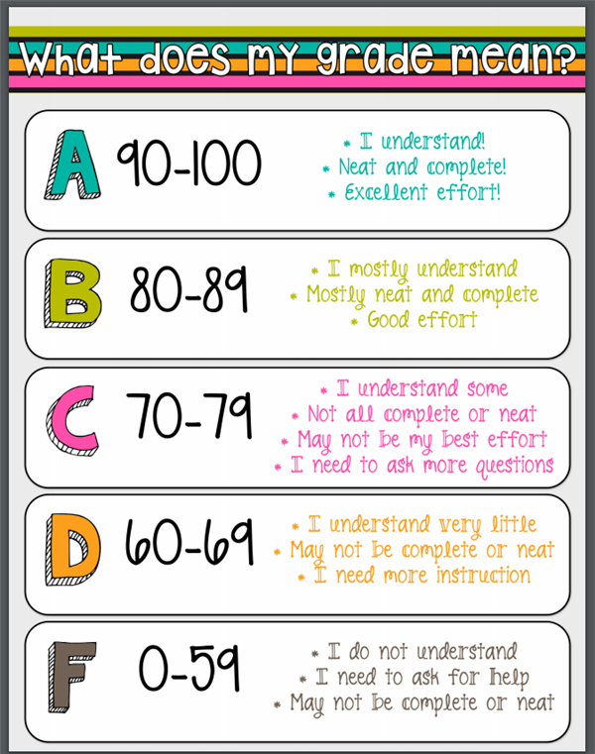
How Do You Keep Score?
How do we know we are meeting our goal?
Like so many things in life, we default to what we learned in school
This type of scale does not reflect real life
  competitive achievement
  Under uncertain conditions
  over a long period of time

Slide 6

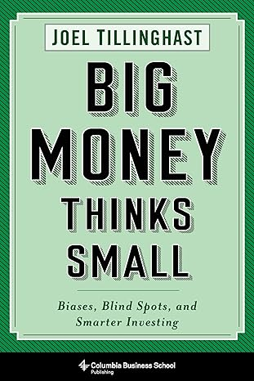
What does success look like?
Joel Tillinghast
Fund Manager, Fidelity Low-Cost Stock Fund, 34 years
Fund performance during his tenure: +3% over market
“Even with grade inflation, 55 percent wouldn’t be a passing grade, but in the stock market, being right 55 percent of the time is as good as it gets.”

Slide 7

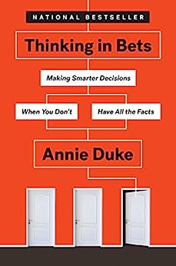
It’s Not Just Investing!
Annie Duke
WSOP Champion, lifetime winnings $5M
PhD Psychologist, focusing on decision making
“A great poker player who has a good-size advantage over the other players at the table, making significantly better strategic decisions, will still be losing over 40% of the time at the end of eight hours of play.”
If you lose 40% of the time, you win 60% of the time

Slide 8
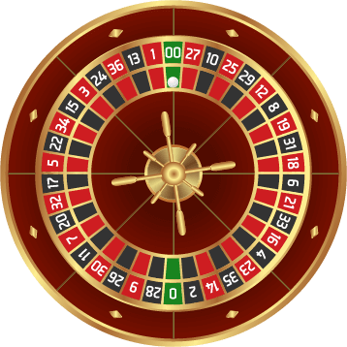
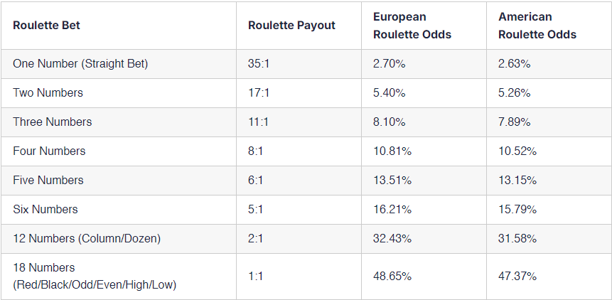
The House Always Wins
Roulette payout = 36 / Bet – 1
Green pockets are the house edge
House’s odds:
51.35%
52.63%

Slide 9
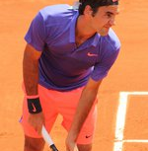
It’s Not Just Money!
Roger Federer
20 Time Grand Slam Champion
103 Tournament Titles
Matches Won: 81.9% (1265-280)
Sets Won: 75.8% (3,072-979)
Games Won: 58.2% (23,154-16,650)

Slide 10
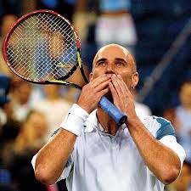
It’s Not Just Money!
Andre Agassi
8 Time Grand Slam Champion
60 Tournament Titles
Matches Won: 76% (872-275)
Sets Won: 71.5% (2,111-841)
Games Won: 57.9% (15,976-11,612)

Slide 11
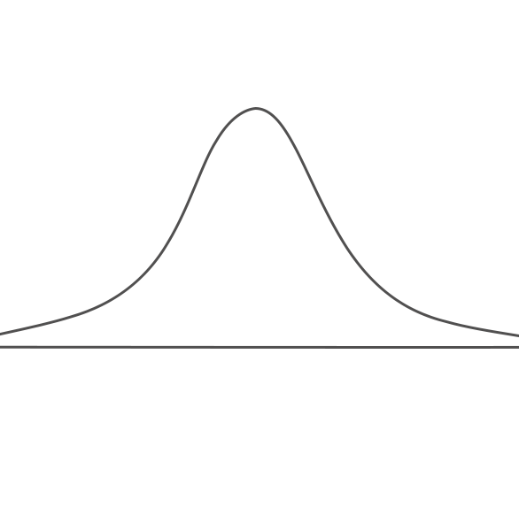
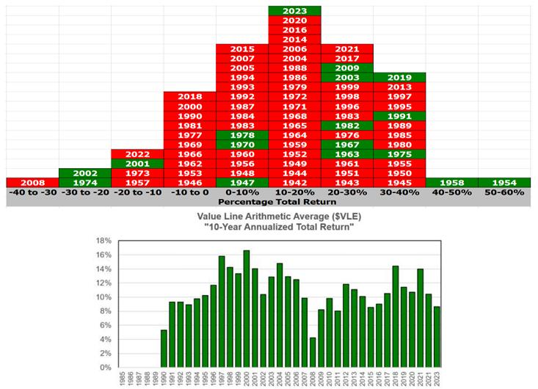
What’s With 55%?!?
Market performance, like many large datasets, generally follows a bell curve
Small advantages, compounded over time, create large results
  Every Casino Knows This

Slide 12
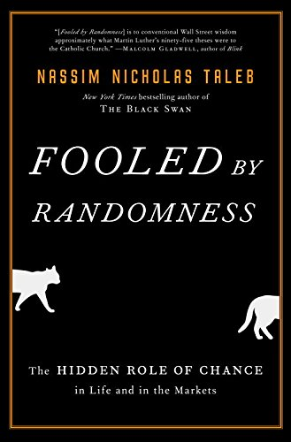
55%, Explained Statistically
In Fooled By Randomness, Nassim Nicholas Taleb describes the following situation:
  Suppose a retired dentist invests his portfolio
  He earns 15%, so he is an excellent investor
    He has a 10% error rate per year
      Out of 100 sample paths, 68 of them will fall between 5% and 25%
      95 of them will fall between -5% and 35%
What does the potential return of this investor look like?

Slide 13
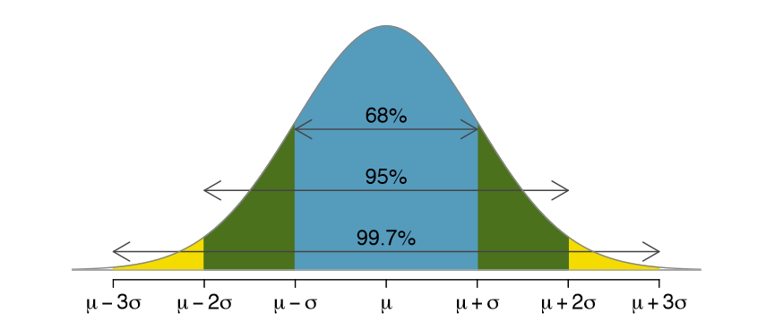
Investing Scenario: A Picture
Annual Investment Performance
-5%
0%
5%
15%
25%
35%

Slide 14
Investing Scenario: Monte Carlo Results
Probability of Success (Return > 0%) At Different Time Scales
Scale | Probability
1 Year
1 Quarter
1 Month
1 Day
1 Hour
1 Minute
1 Second
Noise to Performance
93%
0.7:1
77%
67%
2.32:1
54%
51.3%
30:1
50.17%
50.02%
1,796:1

Slide 15
Skewness: A Factor In Our Favor
These statistical results reflect a symmetric bet
  Equal bounds are placed on how much we can gain or lose
How much can we really lose on a stock?
How much can we really gain on a stock?
This difference is an example of Skewness. The payoffs are slanted in our favor.

Slide 16
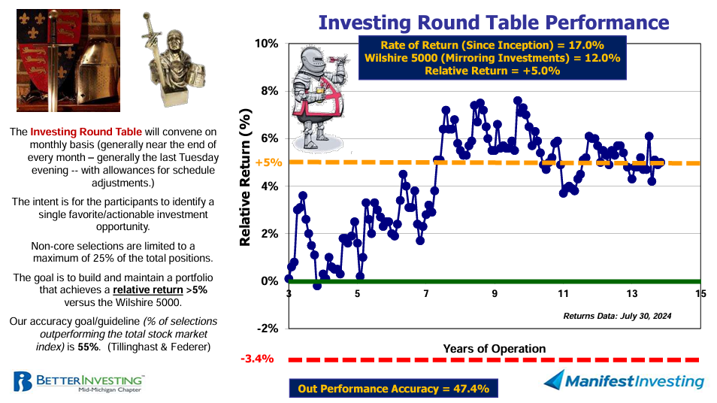
Example: Mid-Michigan Roundtable

Slide 17
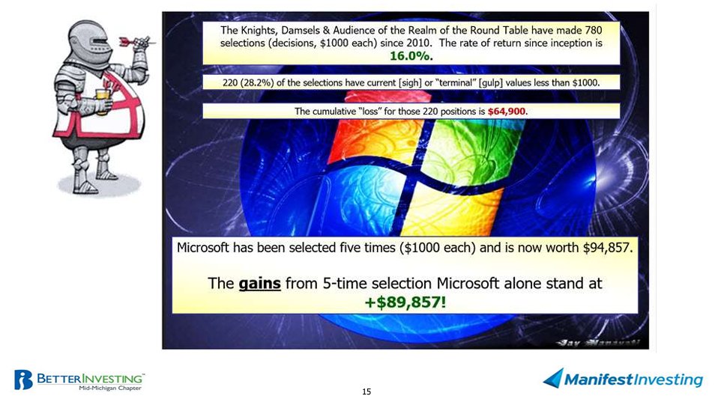
Example: Mid-Michigan Roundtable
Notes:
As of December 2023

Slide 18
Psychology

Slide 19
Come On Get Happy
What makes you happy?
    Objective circumstances
    Demographic variables
    Life events
A century of research says all these variables put together account for no more than 8-15% of the variance in happiness.
What accounts for most of the variance in happiness is how we are doing comparatively.
    “Comparison is the thief of joy”
Successful investors can teach us a lot. But be careful not to hold yourself to their example

Slide 20
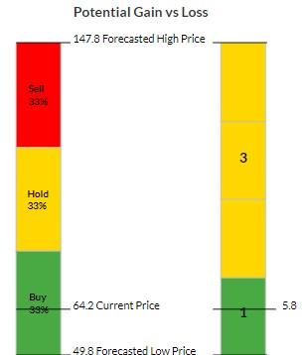
Come On Get Happy
1979
1952
Experiments in Prospect Theory tell us that humans feel pain twice as much as pleasure
  Your human may vary: experimental results range from 1.5 – 2.5 times
This leads us to be risk averse by nature
Checking frequently puts our emotions to the test more often
  It also pits our emotions against market “noise”
2
Emotional Breakeven
1

Slide 21
Self-Serving Bias
There is a predictable pattern to the way we field outcomes
  We take credit for the good stuff and blame the bad stuff on luck, so it won’t be our fault
  We are “predictably irrational”
  We seek out a plausible reason for an outcome, but also one which fits our wishes
  This behavior prevents us from learning from our experience
“This predictable fielding error is probably the most significant problem for poker players” (investors, too)

Slide 22

Self-Serving Bias
Self-serving bias comes from our drive to create a positive self-narrative
All-or-nothing thinking makes us put our self-image at stake when fielding outcomes
When we observe others, we tend to do the opposite
  we blame them for bad outcomes, and fail to give them credit for good outcomes
  This prevents us from learning by observing others
  This also costs our compassion for others

Slide 23
Fielding Outcomes
Outcome Quality
Good
Bad
EARNED REWARD
BAD LUCK
Good
Decision Quality
DUMB LUCK
JUST DESERTS
Bad

Slide 24
Fielding Outcomes – With Hindsight
Outcome Quality
Good
Bad
EARNED REWARD
BAD LUCK
Good
Decision Quality
DUMB LUCK
JUST DESERTS
Bad

Slide 25
Fielding Outcomes – Self-Serving Bias
Outcome Quality
Good
Bad
EARNED REWARD
BAD LUCK
Good
Decision Quality
DUMB LUCK
JUST DESERTS
Bad

Slide 26
Fielding Outcomes – Self-Serving Bias (Others)
Outcome Quality
Good
Bad
EARNED REWARD
BAD LUCK
Good
Decision Quality
DUMB LUCK
JUST DESERTS
Bad

Slide 27
Come On Get Happy
Change your self-serving habit from “being right” to “learning and improving”
  Leverage our tendency to derive some of our self-esteem by how we compare to our peers
  Enjoy the fact that these things are hard
    By doing something difficult and unusual, that most people don’t do, you are exceptional.
  “People with the most legitimate claim to a bulletproof self-narrative have developed habits around accurate self-critique”
  Take the perspective of someone else
“Many people say I’m the best women’s soccer player in the world. I don’t think so. And because of that, someday I might just be.” – Mia Hamm
Notes:
Taking the perspective of someone else gets us closer to the truth because that truth generally lies in the middle of the way we field outcomes for ourselves and the way we field them for others

Slide 28
Framing the problem
Narrow framing: making a judgment on a small element, without the proper context
  A single stock, without its portfolio
  Portfolio performance over a short period of time
  The outcome of a decision, without understanding the decision process
Narrow framing leads to many biases
  Disposition effect: “cutting the flowers, and watering the weeds”
  Sunk cost fallacy
  Possibility effect and certainty effect
  Regret

Slide 29
Use the proper frame
Use a broad frame when you reflect on your performance
Narrow Frame | Broad Frame
Single Stock | Portfolio
Checking prices daily | Checking prices infrequently / as needed
Selling your winners (Disposition Effect) | Selling to make your portfolio stronger
Possibility effect / certainty effect | Follow a consistent risk policy

Slide 30
Thinking Slow
System Interrupt – Engage System 2
  Thinking in Bets is hard, especially at first
    It will seem clunky, weird, and slow
    There will be times it doesn’t make sense
Discipline and tools can help you
  When I am researching a stock, I always:
    Use my investing checklist
    Complete an SSG
    Research Value Line and Morningstar
    Write down my investment thesis
    Use other processes and sources
Get an outside opinion

Slide 31
Keeping Score - Summary
Small advantages compound to long-term performance
Measuring performance objectively gives us a clear view
  Against the right benchmark
  Use a broad frame to avoid loss aversion
Comparing ourselves to the best may lead to discouragement
Learning from the best may lead to our improvement
Focus on our process gives us our small advantage

Slide 32
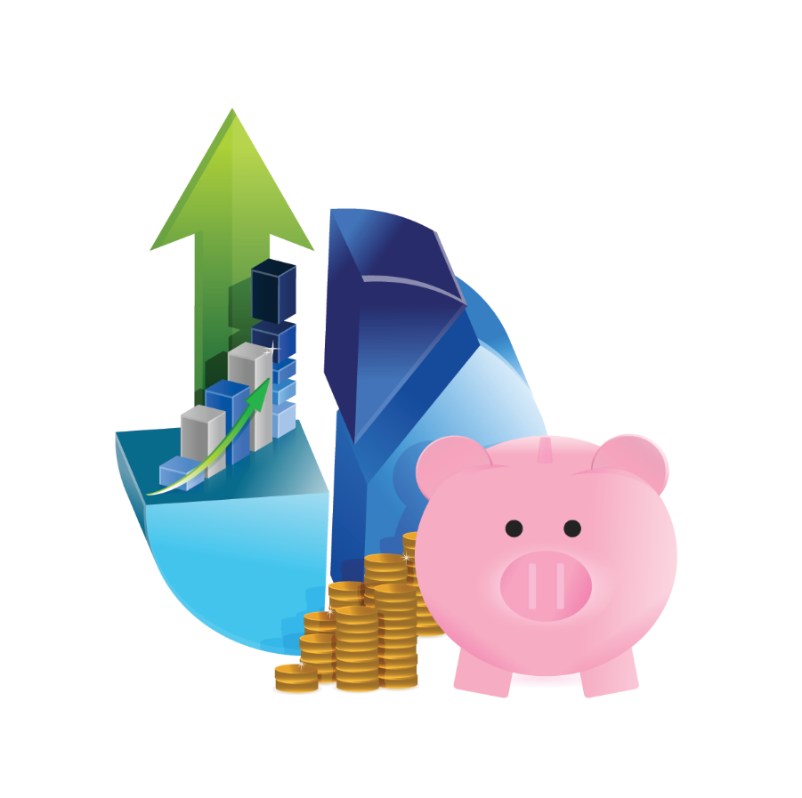
Question and Comments
The Psychology of Investing: Keeping Score
Matt Spielman
Director, Houston Chapter, BetterInvesting
reeshau@yahoo.com
Notes:
End Slide
Question and Comments

Slide 33
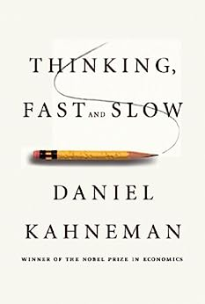
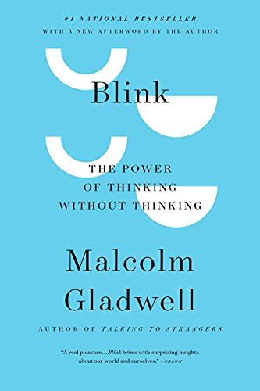
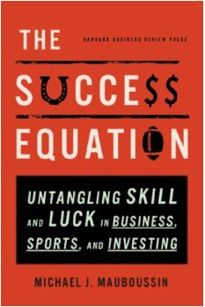
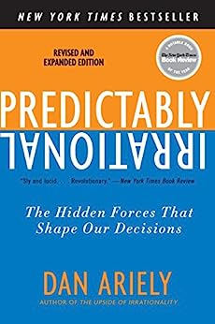
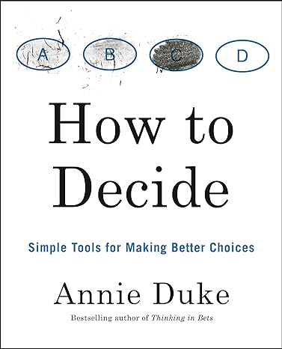
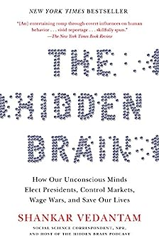
Bibliography

Slide 34
Graphics Sources
Bell Curve with standard deviations:
  LibreTexts.org Introductory Statistics, figure 3.9
  https://stats.libretexts.org/Bookshelves/Introductory_Statistics/OpenIntro_Statistics_%28Diez_et_al%29./03%3A_Distributions_of_Random_Variables/3.01%3A_Normal_Distribution
Bell Curve overlay with transparent background:
  https://www.hiclipart.com/free-transparent-background-png-clipart-ijvtp#google_vignette
Agassi Stats
  https://www.tennisabstract.com/cgi-bin/player.cgi?p=AndreAgassi
Grading Scale
  https://www.of90.net/Page/3283
Roulette wheel
  https://www.casino.com/blog/2021/09/15/roulette-wheel-layout-variations/
Roulette Payout table
  https://www.techopedia.com/gambling-guides/roulette-odds-probability

Slide 35
Course Description
It’s important to understand the performance of your portfolio. After all, you are putting a lot of effort into it. And your future depends on it. How do you know if you are doing well? What does “good” look like? We will discuss this, as well as how to measure your performance without getting discouraged when things are (temporarily) not going your way.

